Slide 1

Dog Body Language
How to speak dog!
Notes:
Image slide 1: https://www.flickr.com/photos/lilita/5652847156/sizes/z/ (https://www.doggiedrawings.net/freeposters)
Dogs have feelings just like us and they can be happy, sad, worried, wanting to play or wanting to be left alone, just like you do.
Dogs actually give us lots of clues about how they are feeling if we know what to look for.
You can tell how the dog is feeling by his body language.

Slide 2
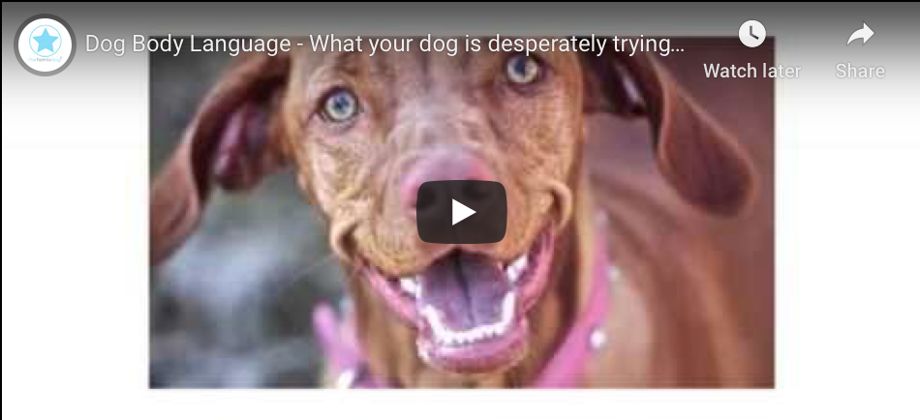
Video: Happy vs Scared dogs
Notes:
Here is a short video showing what happy dogs look like versus stressed/nervous dogs
https://youtu.be/bstvG_SUzMo

Slide 3
Body language that shows a dog is stressed, worried, or afraid
Flattened Ears
Notes:
https://www.wholedoguniversity.com/dog-behavior/dog-language-kids/
Lets review some of the body language from the video that shows a dog is stressed, worried or afraid:
In this picture the dogs ears are pulled back and flatted. Normal dogs ears are upright so that they can hear different sounds around them.

Slide 4
Body language that shows a dog is stressed, worried, or afraid
Lip licking
Notes:
Image slide 4: https://www.petcoach.co/question/?id=212323
In this picture the dog is licking his lips, mouth or nose because he is nervous

Slide 5
Body language that shows a dog is stressed, worried, or afraid
Hard stare
Notes:
https://www.wholedoguniversity.com/dog-behavior/dog-language-kids/
In this picture the puppy has hard eyes and is starring because he is worried.

Slide 6
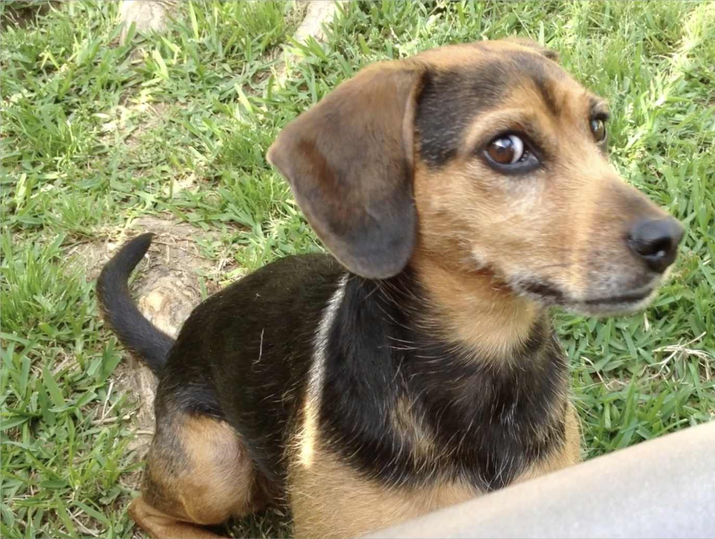
Body language that shows a dog is stressed, worried, or afraid
“Half moon” eye
Notes:
https://eileenanddogs.com/blog/2014/01/30/the-right-words-revealed/
In this picture you can see the white part of the dogs eyes. This is called a “whale eye” also called a half moon eye. This dog is nervous or unsure.
This is a danger sign!
Other danger signs include teeth showing, lips curled back or growling and snarling.

Slide 7
Body language that shows a dog is stressed, worried, or afraid
Yawning
Notes:
Image slide 7: https://www.rover.com/blog/dog-yawning-decoded/
In this picture the dog is yawning. Not because he is tired but because he is stressed.

Slide 8
Body language that shows a dog is stressed, worried, or afraid
Tail tucked between legs
Notes:
Image slide 8: https://petdt.com/dog-tail-between-legs/
In this picture the dogs tail is stiff and tucked between his legs because he is nervous and afraid.

Slide 9
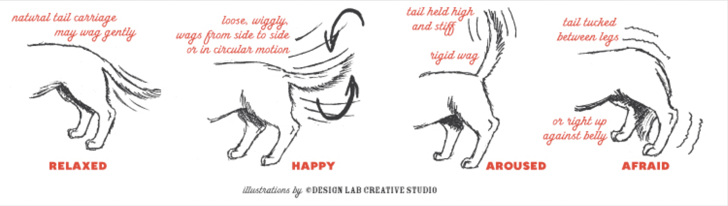
What does a tail wag mean?
Notes:
Karen van Haaften, DVM, DACVB. “Principles of Learning Part 1.” VSAC 478 Small Animal Behaviour. Class Lecture
A wagging tail is NOT ALWAYS an indication the dog is feeling friendly - does not always mean you are safe to interact with the dog
Most basic meaning: the dog is alert and willing to engage
• Except:
Circle tail: almost always friendly/happy
Tucked tail: almost always fearful

Slide 10
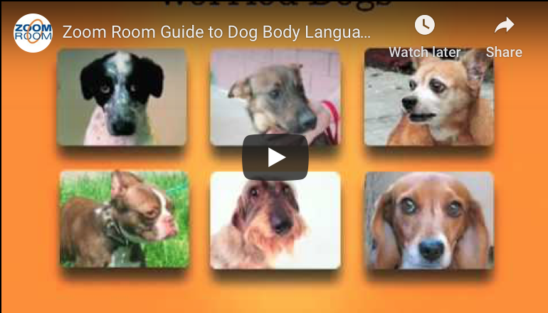
Video: Zoom Room Guide to Dog Body Language
Notes:
Here is another video showing dog body language in more detail
https://youtu.be/00_9JPltXHI

Slide 11
How to interact with a dog
DO’S ✔️
DONT’S X
Let the dog sniff your hand before petting the dog
Pet a dog under the chin, or on the neck and back in the direction of the fur
Talk calmly to the dog
Don’t get in a dog’s personal space; NEVER put your face near a dogs face
Don’t approach the dog when it is eating or sleeping
Do not take a dogs toy or bone away or reach into their food dish
Do not pull on the dog’s ears or tail
Do not climb on the dog or sit on the dog
Don’t yell or scream around the dog
Do not follow or chase a dog if it walks or runs away from you
Notes:
https://www.wholedoguniversity.com/dog-behavior/dog-language-kids/
Do’s and don'ts of interacting with a dog

Slide 12
Be Safe!
Notes:
Image slide 12: https://www.flickr.com/photos/lilita/4455993339/sizes/z/
https://doggonesafe.com/dog_detective
https://www.wholedoguniversity.com/dog-behavior/dog-language-kids/
Remember learning how to greet a dog and read their body language is the best way to prevent getting bit! Be safe!

