Slide 1
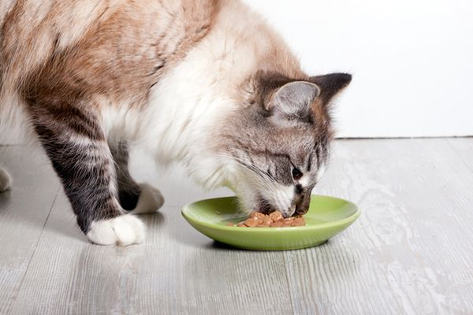
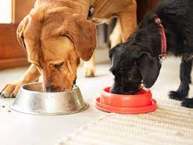
Let’s talk about food for dogs and cats

Slide 2

Brain storming exercise!
What do you think veterinarians do to make sure your pets are on a healthy diet?
What kinds of foods do you think are healthy for your pets?
Do you share your snacks with your pets?
What do you feed your pet?

Slide 3
What do you think veterinarians do to maintain health of your pets?
Veterinarians will ask questions about what you're feeding your pet
How much food do they eat every day?
What do they eat?
Do they get any human food?
Do they get cat or dog treats?
Keep track of your pet's weight and muscle status

Slide 4
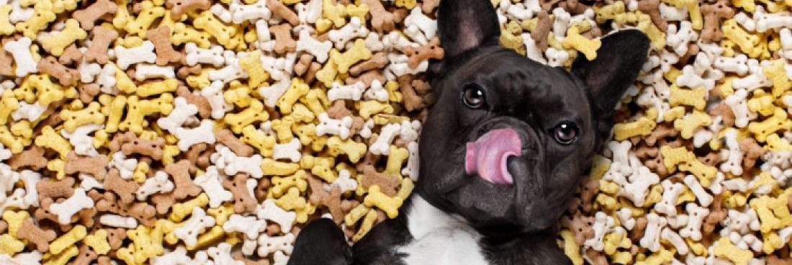
Why?
Because:
Too many treats leads to weight gain
Some table scraps are not healthy for your pets
Sometimes giving too much dog/cat food can lead to weight gain
If pets lose or gain weight too quickly or if muscles get smaller, this might mean your pet is sick

Slide 5
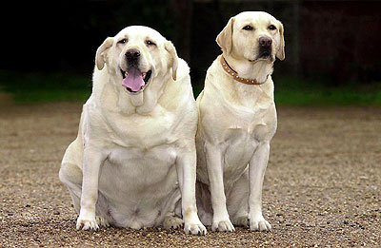
Problems with weight gain/weight loss
If our pets gain too much weight that can lead to illnesses
If your pets lose weight too quickly that could also be a sign that your pet is sick
Notes:
On the left is an obese dog while dog on the right is a dog with a healthy weight

Slide 6
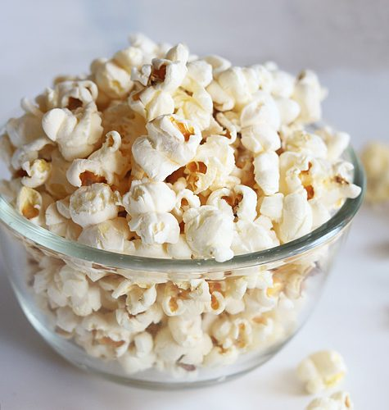
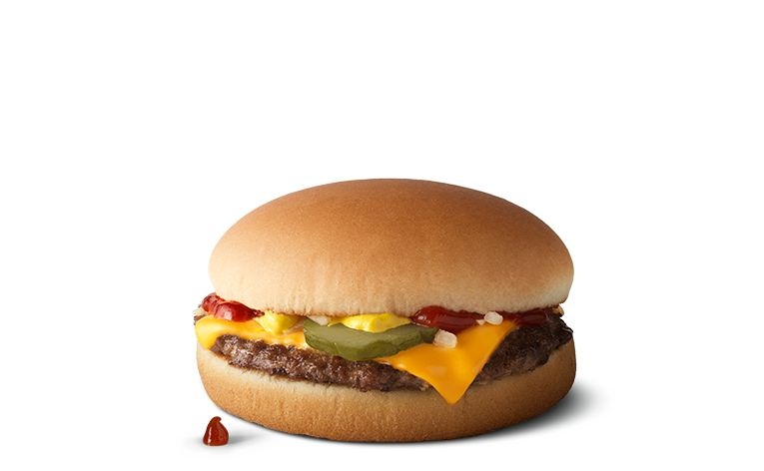
Did you know…
1 bag of popcorn for a 25kg dog= 3bags of popcorn for an average adult
5oz piece of cheese for a 5lb cat= 2 cheeseburgers for average adult

Slide 7
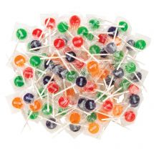
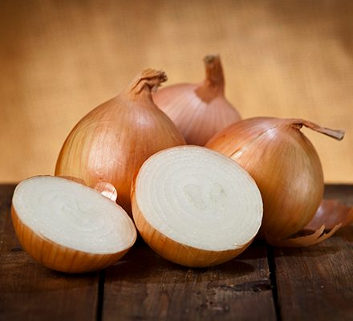
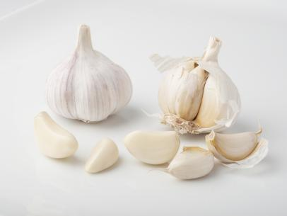

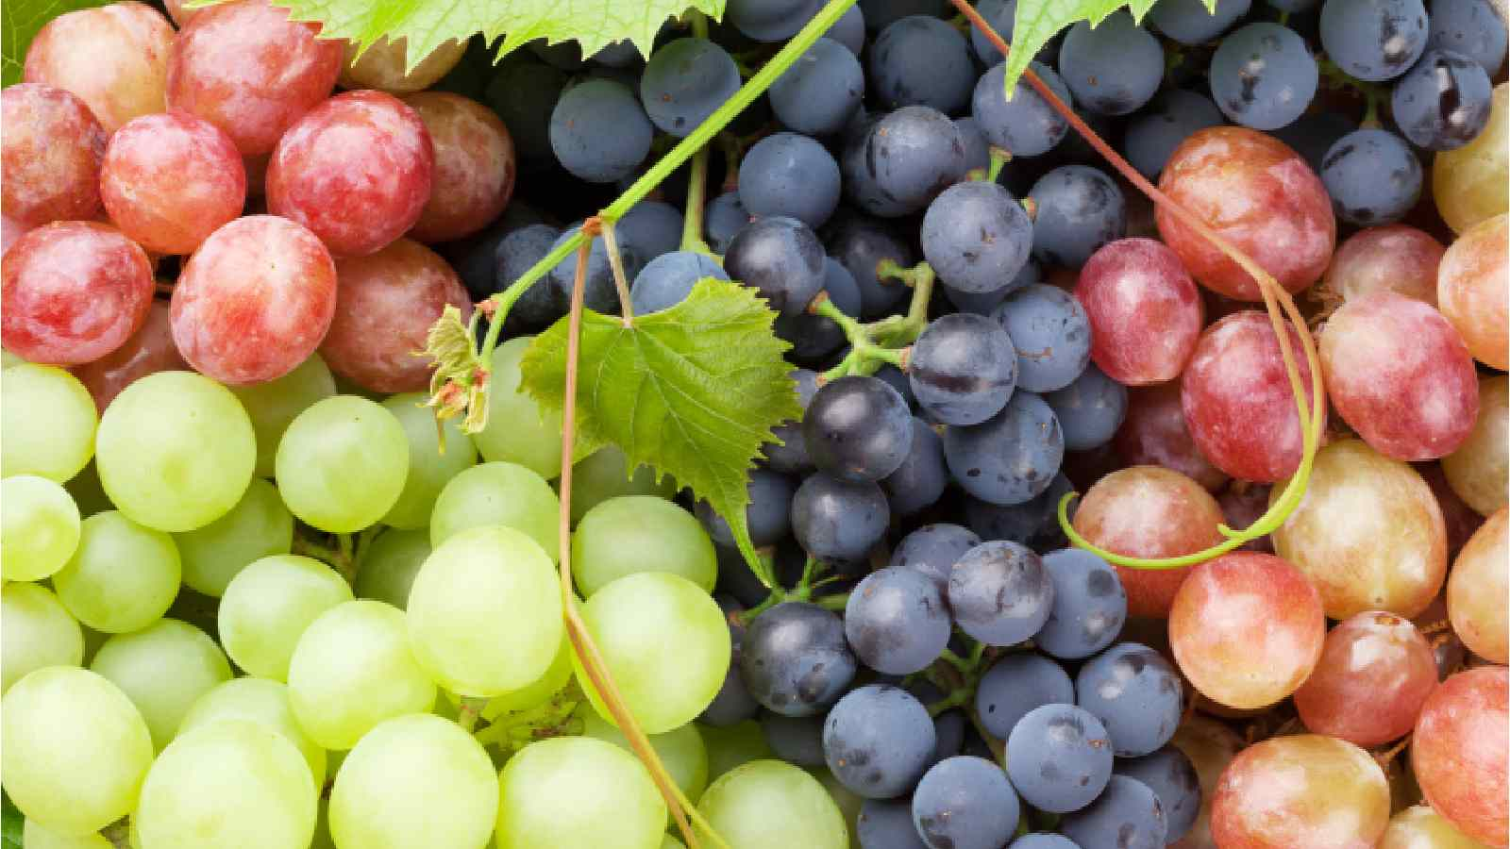
Examples of poisonous foods you should not give your pets
Candies or gum
Onions
Garlic
Chocolates
Grapes

Slide 8
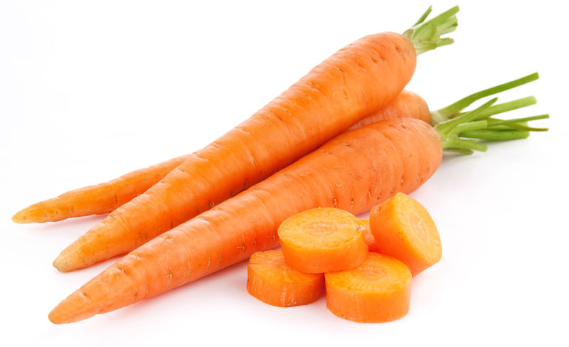
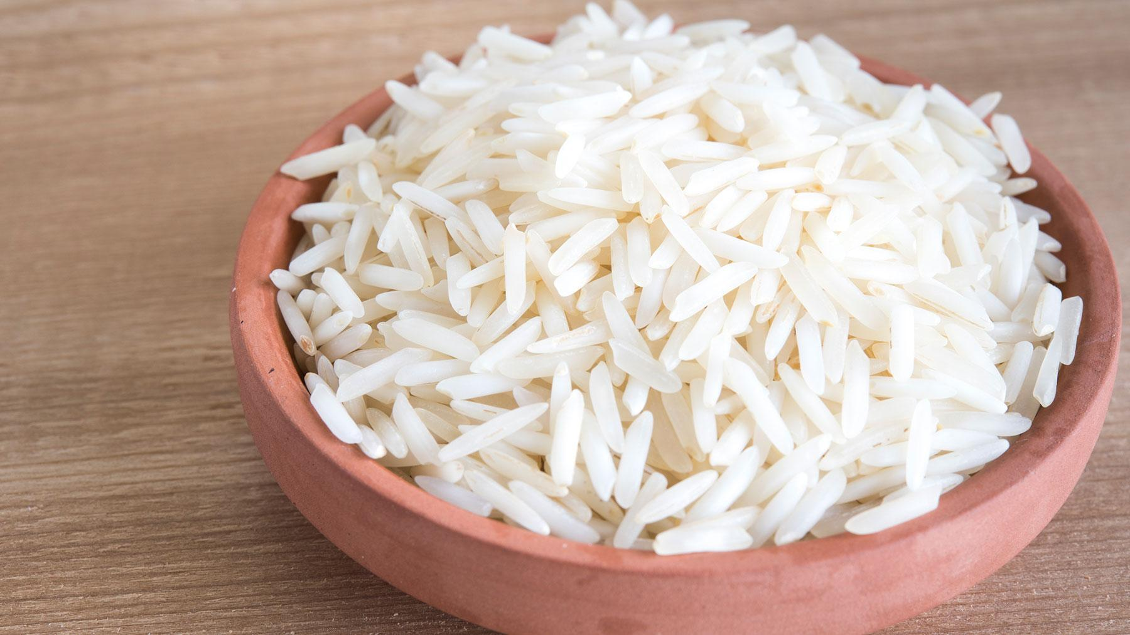
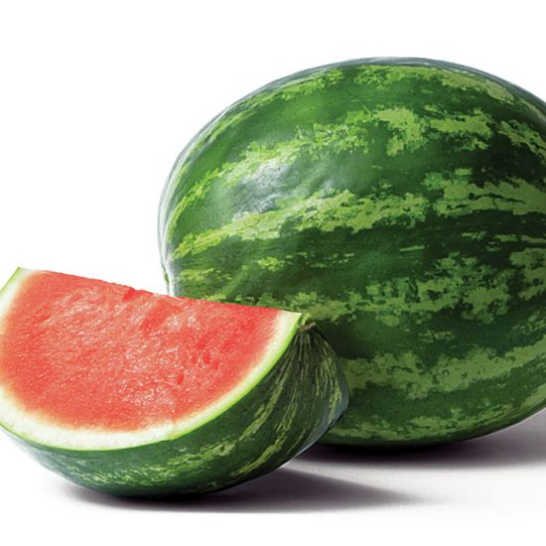
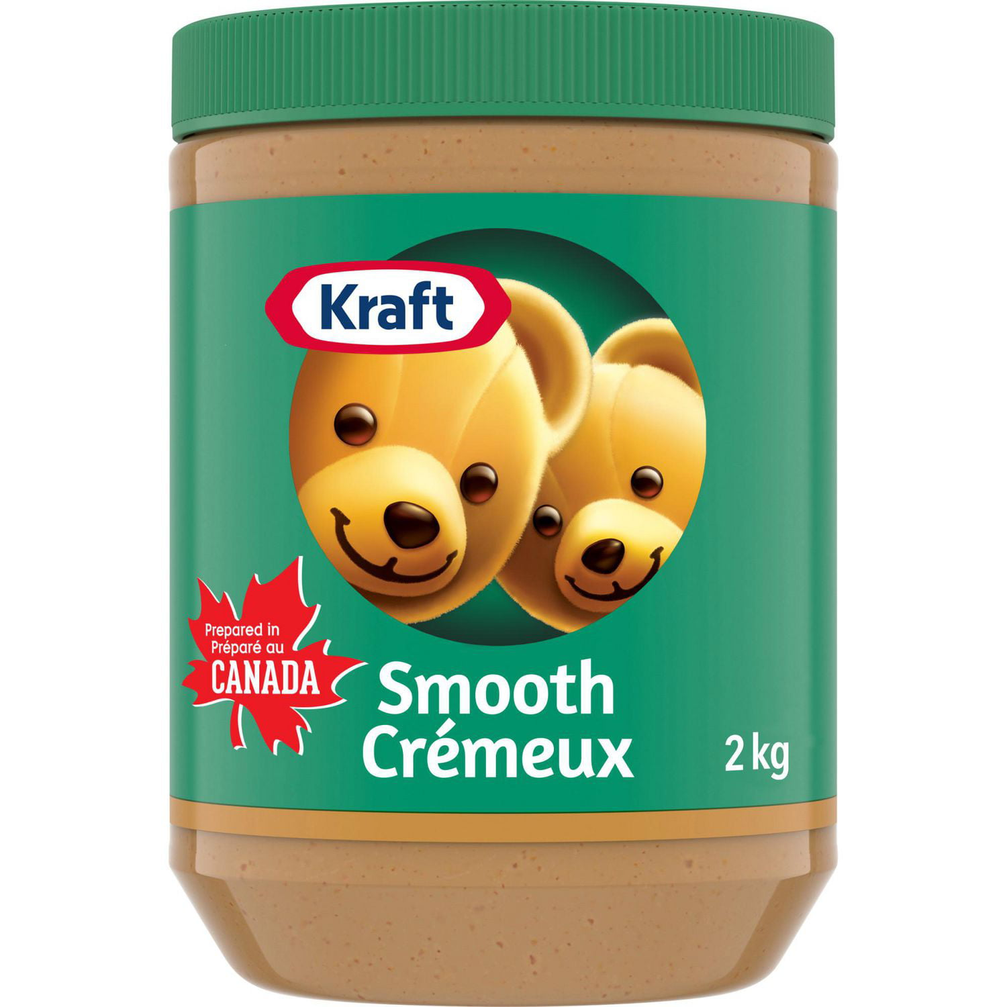
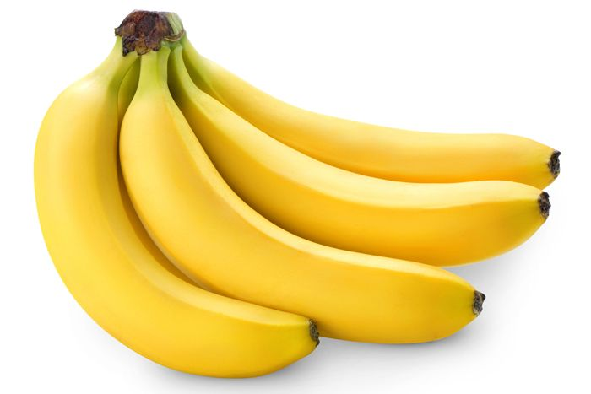
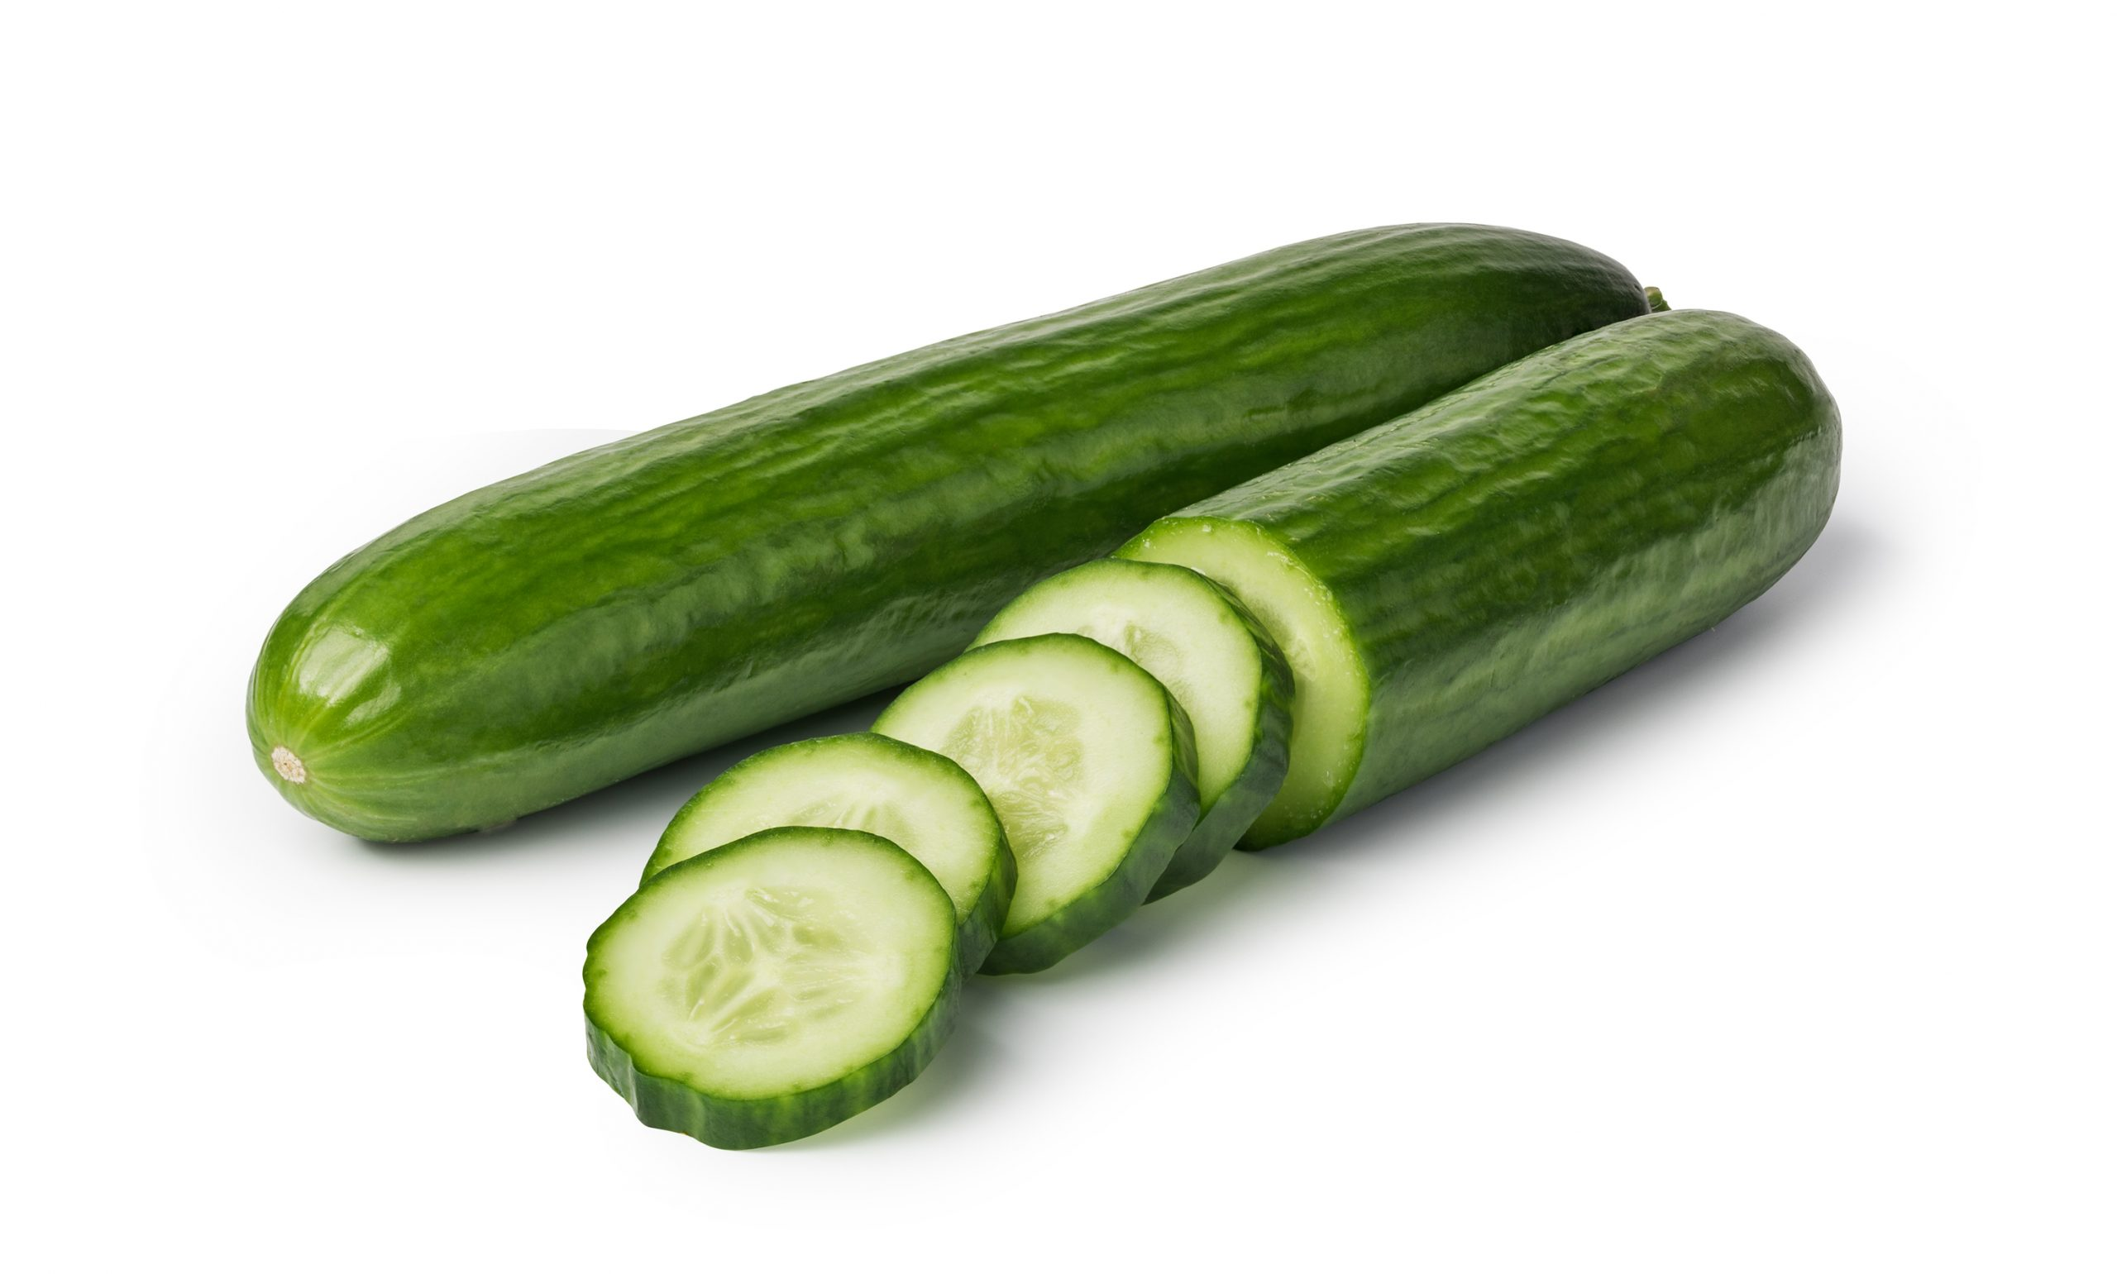
Examples of foods you can share with your pet as a snack
Carrots
White rice
Watermelon
Bananas
Cucumbers
Peanut butter

Slide 9
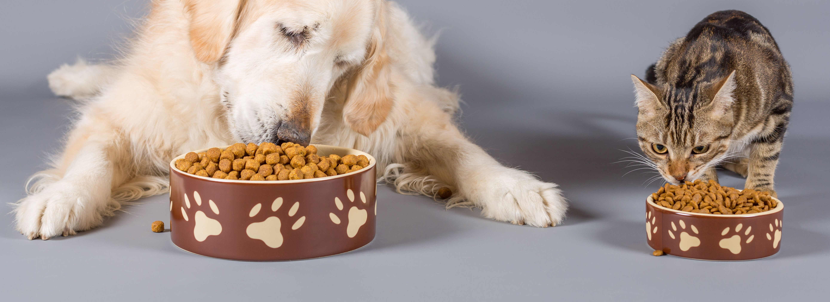
Dogs vs cats
Dogs are omnivores which means they are animals that eat both plants and meat
Cats are carnivores which means they eat only meat

Slide 10
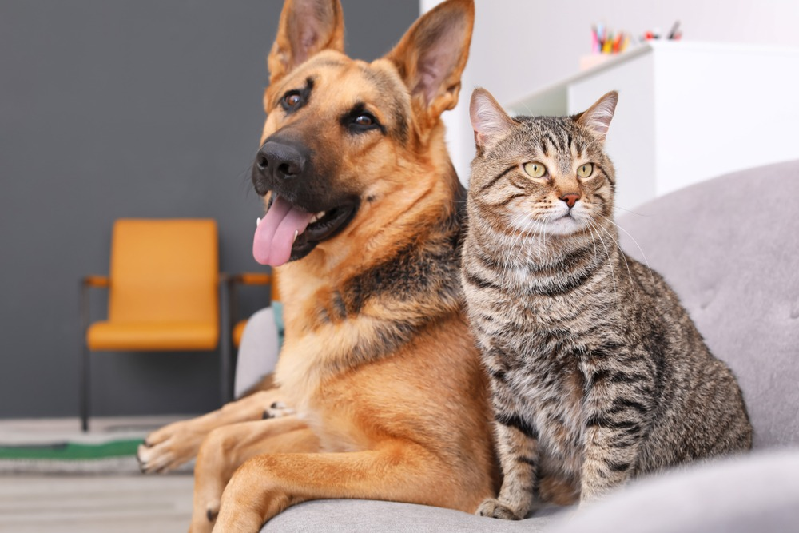
Time to work on the handout ‘Healthy Food Choices for Cats and Dogs’
Take away points:
1. Veterinarians play an important role in taking care of your pets nutritional needs
2. There are many foods we avoid offering our pets to keep them safe and healthy
3. Dogs and cats have different food needs to keep them healthy
Notes:
Teacher note: the list of toxic foods are not a complete list and there are other toxic substances for cats and dogs. The goal was to get students to start thinking about the importance of food. Thus, the lesson plan is greatly oversimplified. Please look at the teaching guide for some information regarding pet health.

