Slide 1


Dog Reproductive Health
How to keep dogs healthy by managing their reproduction in your home and community

Slide 2

Reproductive health
Dogs, just like humans and all other mammals reproduce through sexual intercourse
Sexual reproduction is important in maintaining the diversity of genes in a population
It allows for the mixing of DNA from both the mother and the father resulting in unique individual offspring
Notes:
Re9.3

Slide 3
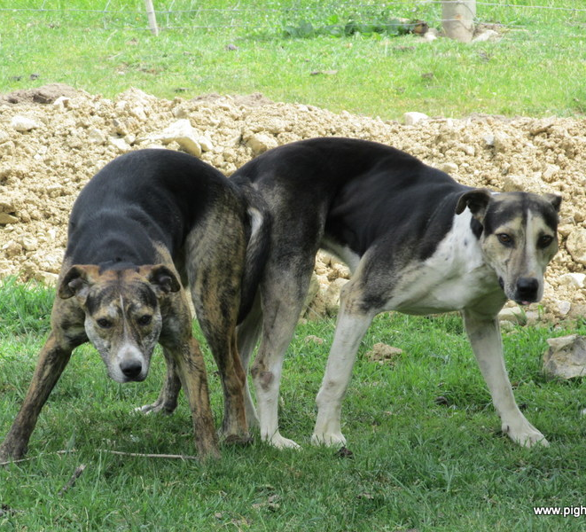
“HELP! MY DOGS ARE STUCK TOGETHER!”
Have you ever seen two dogs like this before?
What did you think was happening?
Notes:
Re9.3
Has anyone seen anything like this in the community?
This is called the tie, or the copulatory lock. Even though it looks funny this is a completely normal part of dog reproduction

Slide 4
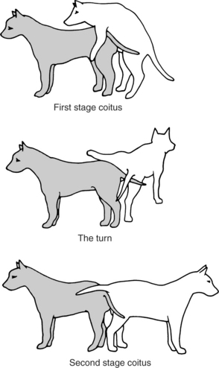
The “Tie”
Canine sexual intercourse has two phases
First the male mounts the female from behind
After a period of time the male will dismount and swing leg over the female and turn to be back to back to the female
At this time the dogs are tied together in a copulatory lock, they cannot separate themselves
Do not try to separate the dogs
The lock can last from 10 minutes to 1 hour
Pulling the dogs apart before they are ready can result in injuries to both the dogs and possibly yourself
Keep the dogs in a calm and quiet area and allow for them to become unlocked on their own
Notes:
Re9.3

Slide 5
Recognizing heat cycles in dogs
Dogs reach sexual maturity at between 6 and 24 months – the later ages associated with larger breeds (small dogs have first heat earlier)
The most common sign associated with a female dog in heat is “spotting”
bleeding from the vulva
Did you know that females in heat emit pheromones that male dogs can detect from kilometers away?
Dogs in heat should be provided shelter, food and water, and kept away from other dogs until the heat has passed
Notes:
9.3
While the bloody discharge seen from a dog in heat may make you think of a women’s menstrual cycle, the bleeding occurs in different parts of the reproductive cycle. While most women will not get pregnant while they are bleeding (but it is still possible), dogs have an increased chance of becoming pregnant when bleeding

Slide 6
Recognizing heat cycles in dogs
Signs of early heat, (lasts 7-10 days)
Swollen vulva, bloody vaginal discharge, urine marking
Behaviour changes: nasty with other intact females, interested in males (but not receptive to breeding just yet)
Signs of heat: (usually lasts 3-10 days)
A very swollen vulva, mammary gland development, blood spotting
Behaviour: Teasing males, males are attracted to the female, frequent licking of the genitals, urine marking, flagging of tail, dropping of back, and restlessness
Notes:
9.3
Male dogs will come from miles around when they sense a female dog in heat, this is a major cause of roaming in dogs, and intact male dogs will pack up and fight over females in heat if they can smell her and roam free to get to her. This can be one of the primary times when dogs might become dangerous to humans due to their motivation to access the in heat female and breed with her

Slide 7
How many puppies can a female dog have in a year?
Unspayed females can have 2-3 litters of puppies a year
With the average litter size being around 7 puppies, this means that over 20 new dogs could be added to the population every year
Spaying and neutering dogs is one of the best ways to manage dog populations in communities
Too many dogs in a community results in poor health for the dogs, damage to the surrounding ecosystems, and the potential for dangerous encounters with humans
Dog overpopulation in a community brings about orphaned dogs without a safe living environment, short life expectancy decreased dog welfare
How do you think dog overpopulation affects local ecosystems?
Notes:
9.3
‘Dog overpopulation’ does not have a fixed definition; rather, it refers to a community having more dogs than are manageable given currently available resources.
Does your community have a dog overpopulation problem? How do you know? What are the indicators?
Local ecosystems = imbalanced, loss of native species, disease spread

Slide 8
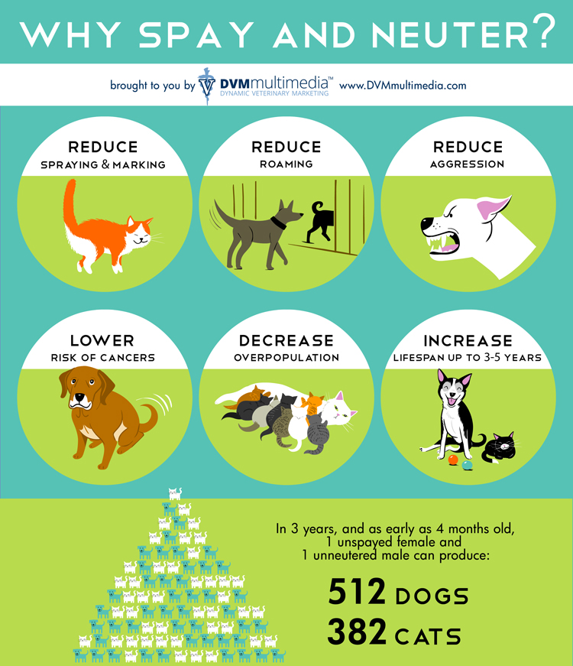
Benefits of Spaying and Neutering
Spaying and neutering dogs not only helps with population control, but there are also health benefits
Females : less risk of uterine infections, reduced risk of several types of cancers, less likely to roam
Males: reduced risk of several types of cancers, less likely to roam
Spayed and neutered dogs tend to have longer lifespans in comparison to intact dogs
Notes:
9.3
Dogs that roam are much more likely to be hit by cars and get into other sorts of trouble
Female cancers include: ovarian cancer and uterine cancer
Female dogs can get an infection of the uterus called a pyometra, this is a life threatening condition and often needs a surgery to fix

Slide 9
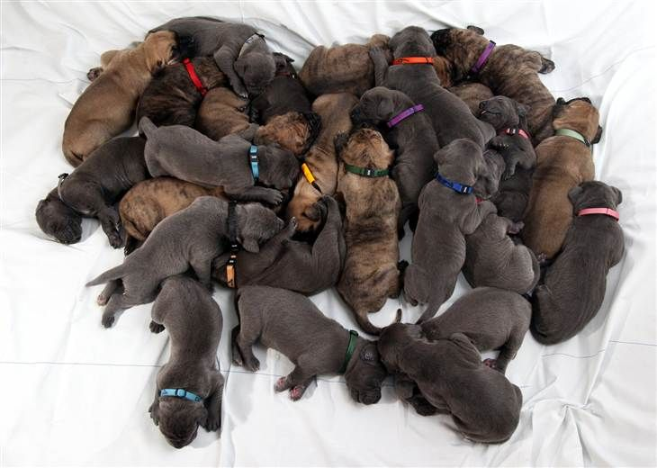
Caring for a pregnant dog
Average dog pregnancy length is 57-72 days from the mating event
Switch her to a puppy diet or a similar high energy diet
Being pregnant takes a lot of energy!
Female dogs can gain up to 30% of their body weight during pregnancy
If possible, meet with your veterinarian
Vets will help you make the best plan possible for your unique dogs needs
An x-ray can be taken late in gestation to give an estimate on the number of puppies in the litter
Notes:
9.3
Being pregnant is hard work, it is also a time in a dogs life where she can be quite vulnerable

Slide 10
Caring for a pregnant dog
Allow her to continue to exercise, but be aware that she will probably have less energy near the end of her pregnancy
Don’t push her to do physical activity that she does not want to engage in
Have a plan ready for when she whelps
Have a safe, warm, and quiet area ready
Have emergency contacts (such as a veterinarian or knowledgeable people in the community) at hand so you can get help quickly if you need it
Notes:
9.3
Being pregnant is hard work, it is also a time in a dogs life where she can be quite vulnerable

Slide 11
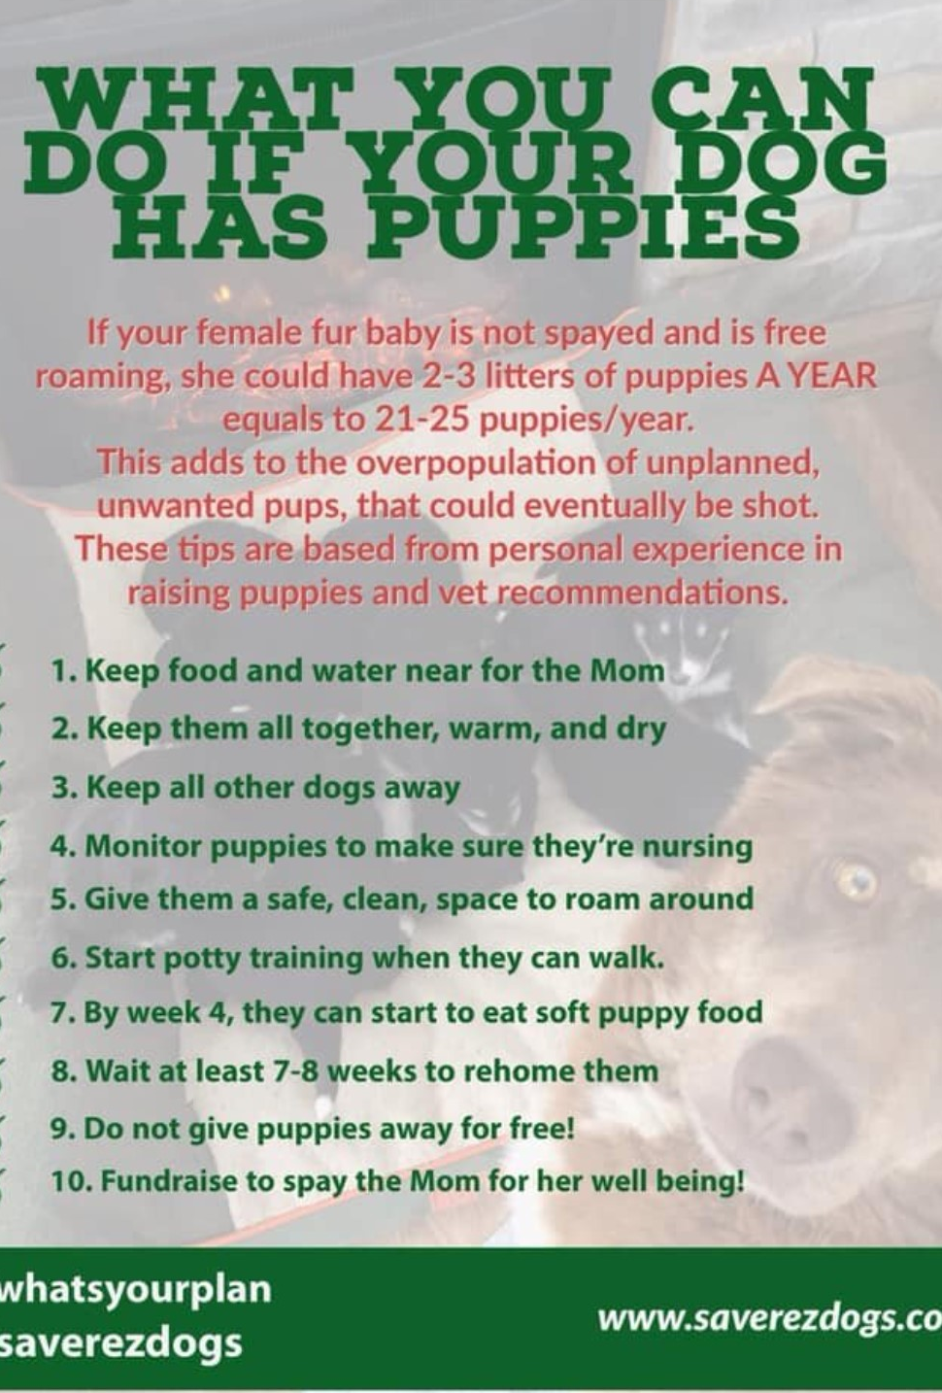
Care for the mother and puppies
The most energy demanding time for the mother is the first 1-4 weeks of providing milk for her puppies
She should be fed multiple times a day with high energy food
Keep tract of the mother’s weight → she should not lose more than 10% of her body weigh during lactation
Puppies cannot control their own temperatures very well when first born, it is important to keep them warm and dry

Slide 12
What have you learned?
Write an action plan for your community to support dog reproductive health
What is the primary concern you have with dog reproductive health?
What resources from outside the community are needed to address this concern?
What is the first step to address this concern?
What would the full action plan include?
How would you know that the plan is working?
Notes:
AP9.12:
Design, implement, and evaluate three eight-day action plans that demonstrate responsible health promotion related to comprehensive approaches to safety, non-curable infections/diseases, romantic relationships, healthy food policies, addictions, tragic death and suicide, chronic illness, and sexual health.

