Slide 1
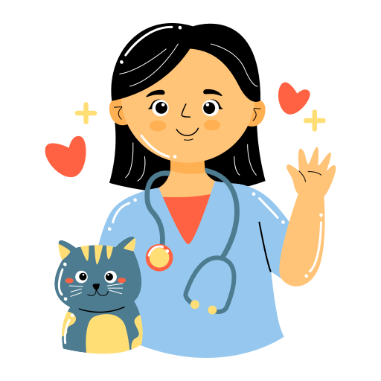
Veterinary Medicine - What tools do they use?
What do veterinarians use to do their job?

Slide 2

What is a veterinarian?
A veterinarian is a doctor for animals!
Just like how you go to the doctor when you are sick, animals do too!
FUN FACT:
Veterinarians also take care of wild animals like tigers, polar bears, frogs, fish, and more!

Slide 3

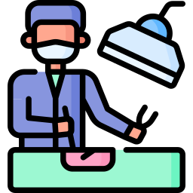
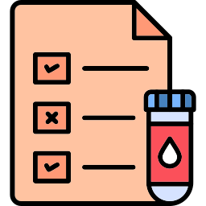
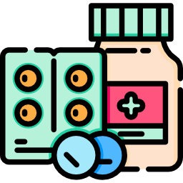
What do veterinarians do?
Perform check ups to make sure animals are healthy
Perform surgery to fix something inside an animal
Run bloodwork and other tests to figure out why animals are sick
Give animals medicine to treat them when they are sick

Slide 4
So what do they use to do all this…?

Slide 5
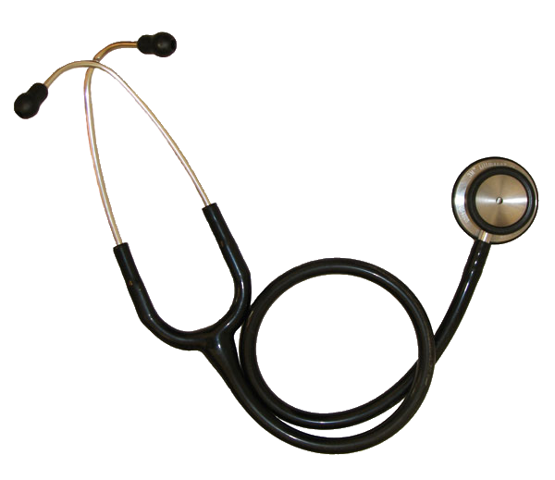
Stethoscope
Just like doctors for humans, vets use this to listen to animals’ hearts and lungs to make sure they're working properly.
It's one of the most important tools they use to make sure an animal is healthy!

Slide 6
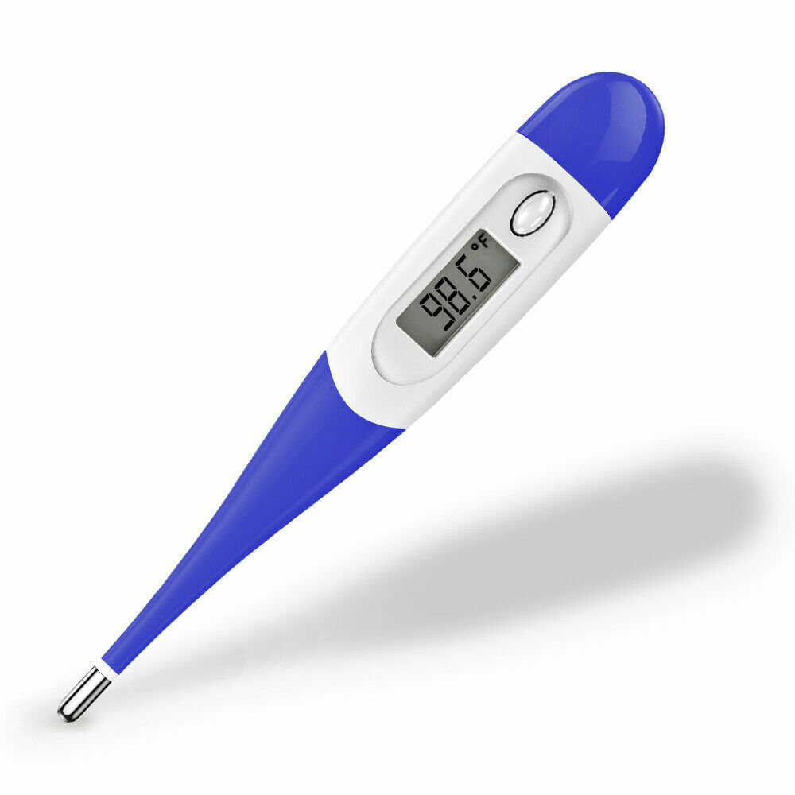
Thermometer
Veterinarians use thermometers to check an animal's body temperature.
This helps them see if the animal has a fever, which can be a sign that they are sick or have an infection.

Slide 7
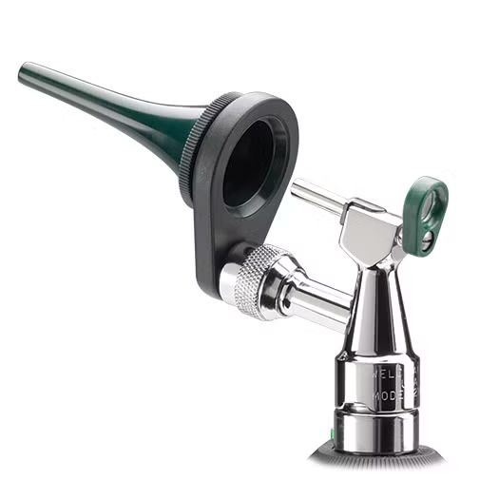
Otoscope
Veterinarians use otoscopes to look inside an animal’s ears.
An otoscope has a light and a magnifying lens that helps the vet see deep into the ear canal. This helps them check for problems like ear infections, ear mites (tiny bugs that can live in animals' ears), or any blockages.

Slide 8
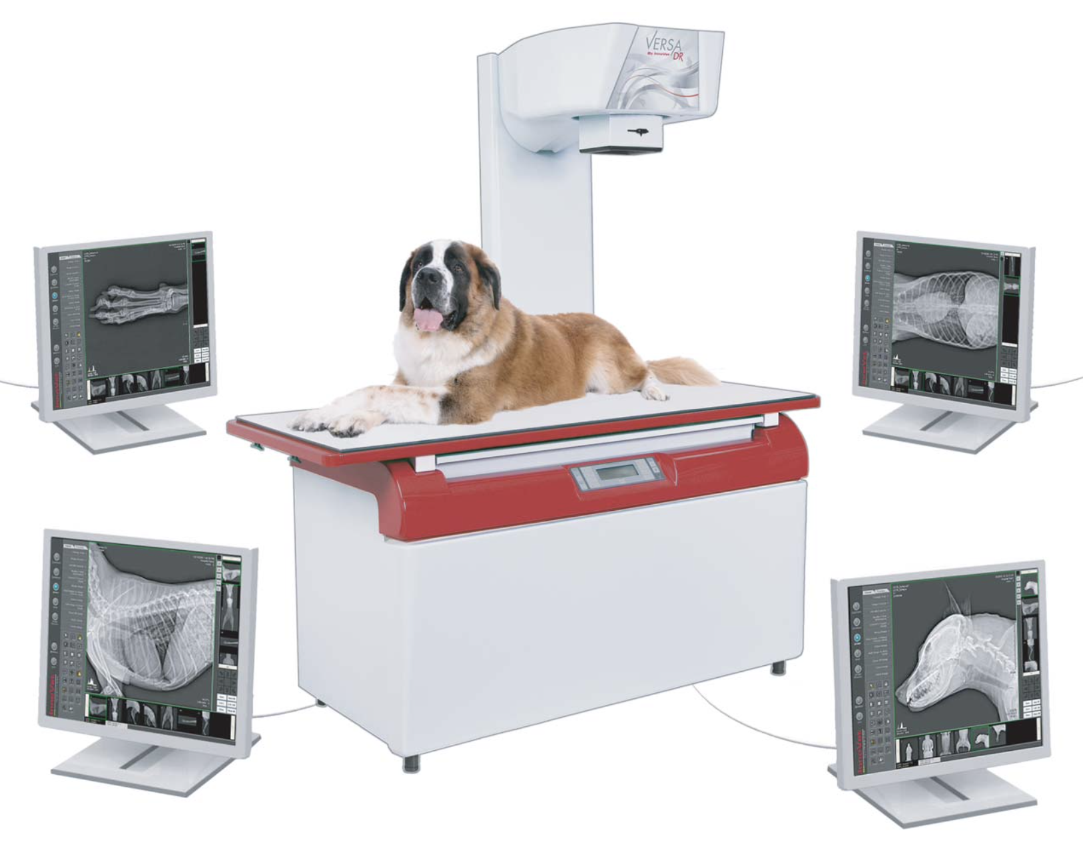
X-Ray Machine
Veterinarians use X-ray machines to take pictures of the inside of an animal’s body. These pictures, called X-rays, help vets see things like bones, organs, and tissues.
This is useful when an animal has a broken bone or swallowed something they shouldn't have.

Slide 9
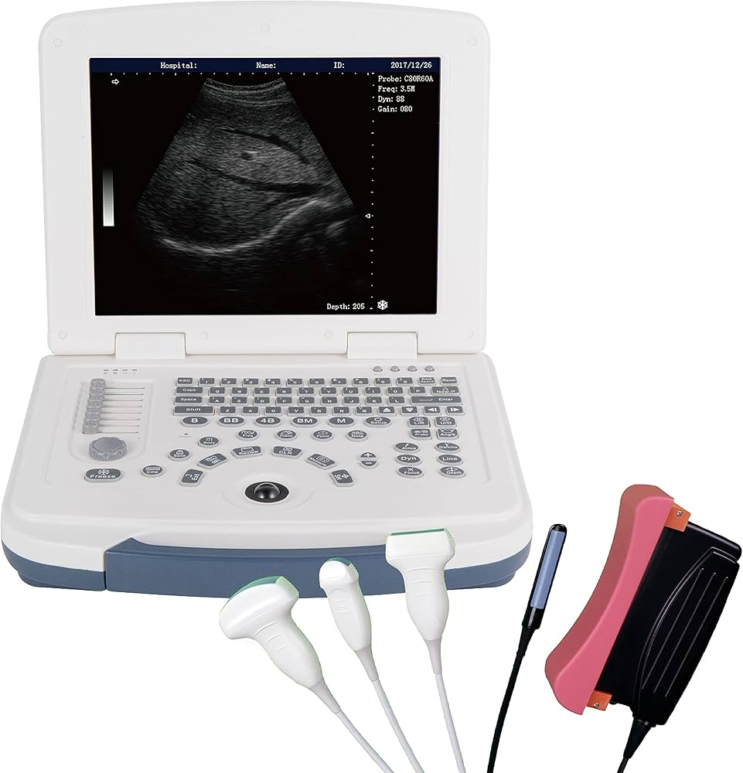
Ultrasound Machine
Veterinarians use ultrasound machines to create images of the inside of an animal’s body using sound waves.
Unlike X-rays, which show bones, ultrasounds are better for looking at soft tissues like organs.

Slide 10
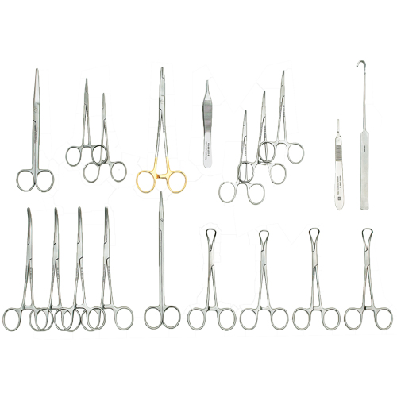
Surgical Instruments
Veterinarians use surgical instruments when they need to perform surgery on an animal.
Surgery is when a vet has to operate on the animal's body to fix something that can’t be treated with medicine alone.

Slide 11
And many more!

Slide 12
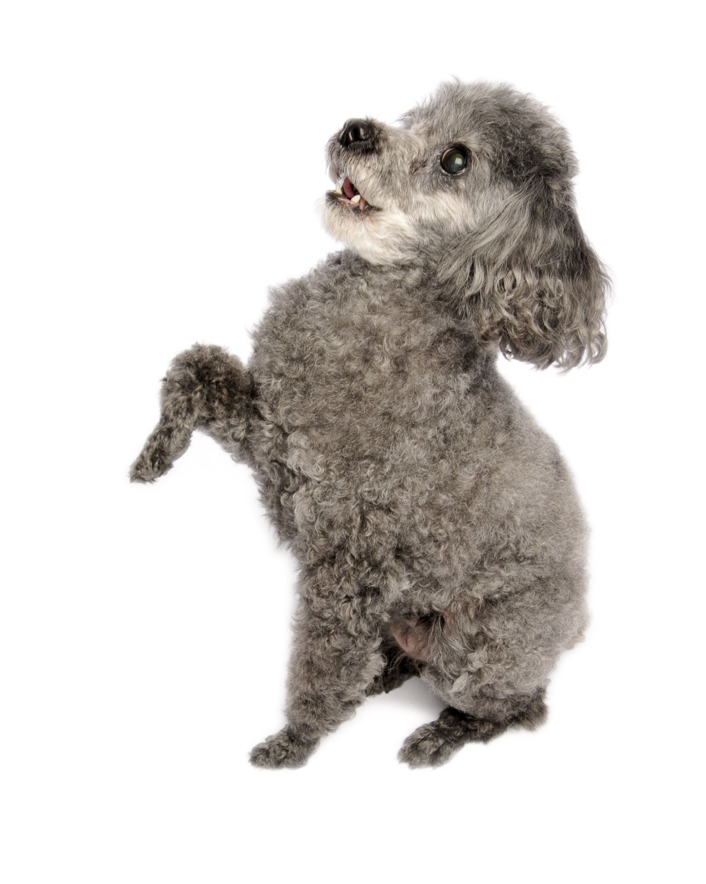
Now that we know some of the tools veterinarians use, it’s your turn!
This is Coco, a 3-year-old Toy Poodle that got ran over by a car!
She hasn’t been able to use her left front leg when she walks.
What do you think would be a good tool we could use to figure out what’s wrong?

Slide 13
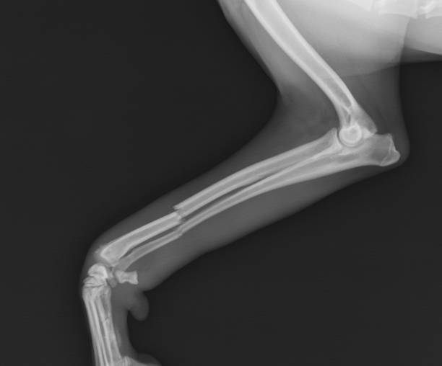
X-Ray Machine
Since Coco hasn’t been using her leg, we want to see if she has a broken bone!
You took an x-ray of Coco’s front leg and it turns out your suspicions were correct! Coco has a broken bone!

Slide 14
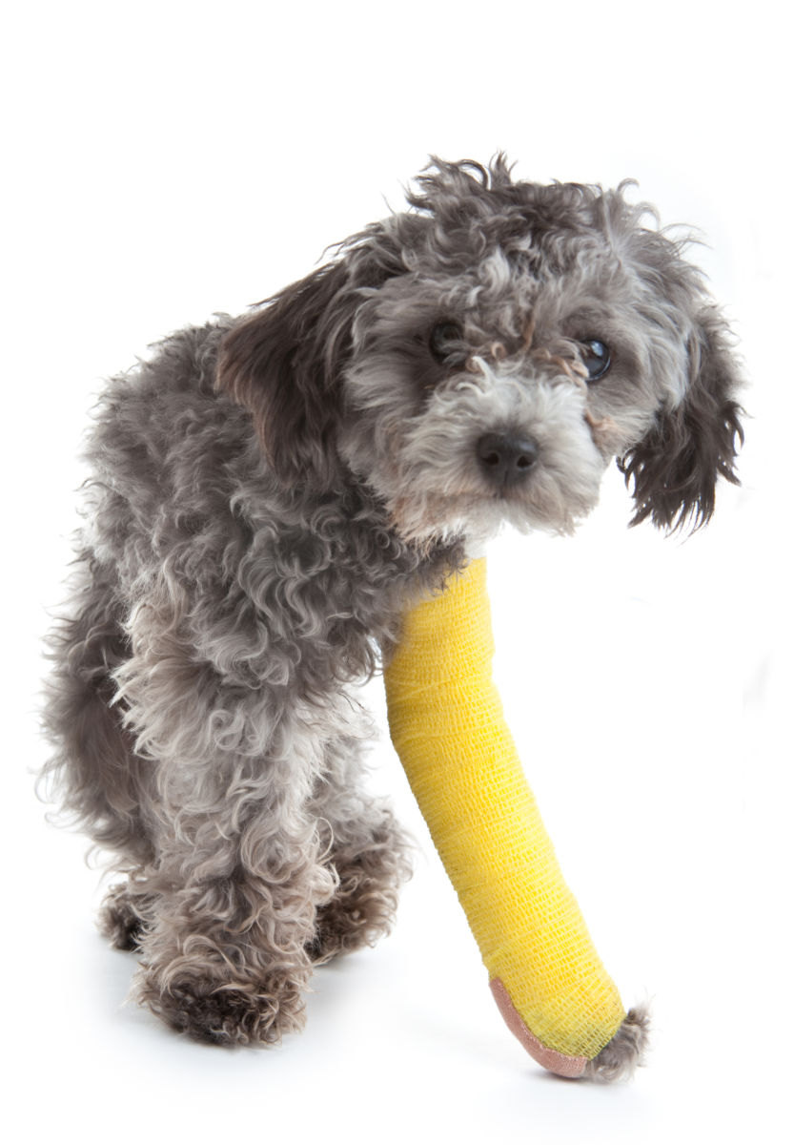
Because you were able to diagnose Coco, you put her broken leg in a cast and she is now on her way to recovery!

Slide 15
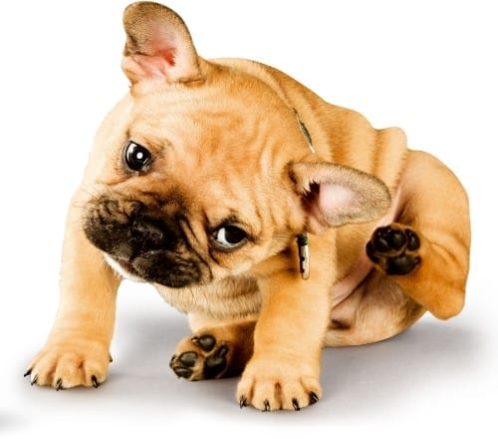
Let’s try again!
Gary is an 8-week-old French Bulldog.
His owner says that he has been scratching at his ears all week and they smell pretty yucky.
What do you think would be a good tool we could use to figure out what’s wrong?

Slide 16
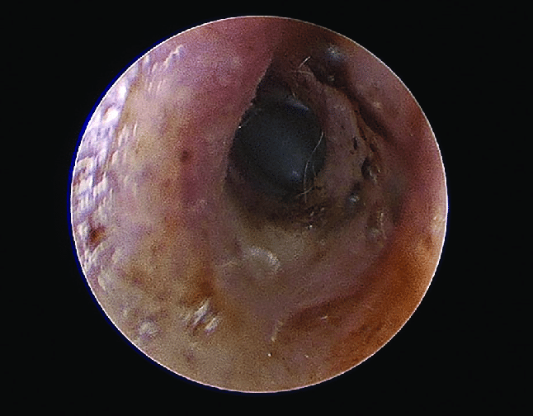
Otoscope
Since Gary seems very bothered by his ears, we want to look into them and see what’s going on with an otoscope.
EW! Gary’s ears have lots of gunk in them. It seems like he has an ear infection!

Slide 17
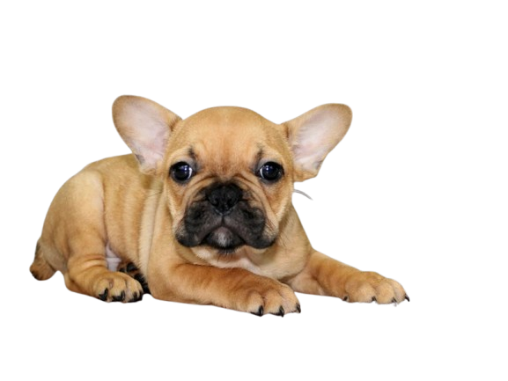
You cleaned out Gary’s ears and gave him some medicine! He has stopped scratching and his ears are no longer stinky!

Slide 18
Good job!
You now know what veterinarians use to do their job!

