Slide 1
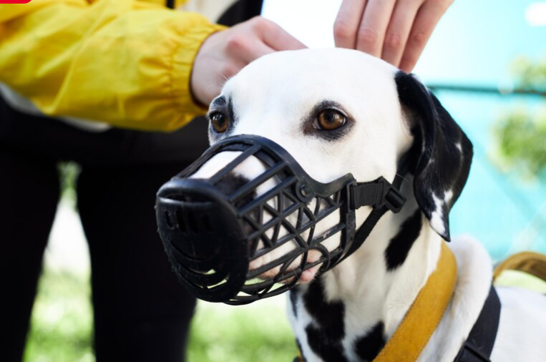

Slide 2
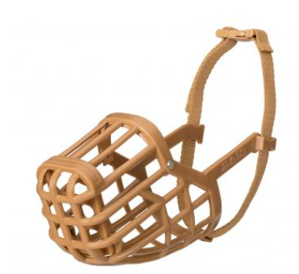
Supplies Needed:
A muzzle, preferably a basket style
Tasty Treats
Patience

Slide 3
Training Timeline:
Days 1-3 : Introducing the muzzle, letting the dog sniff it and eat treats through it.
Days 3-6 : Sliding the muzzle onto the nose, letting it sit there for 3 seconds and then giving a treat.
Days 6-10 : Buckling and leaving the muzzle on for 1-2 minutes, as tolerated, while giving praise and treats.
Weekly: Treats and 2-minute muzzle sessions in new environments.
Training
Timeline

Slide 4
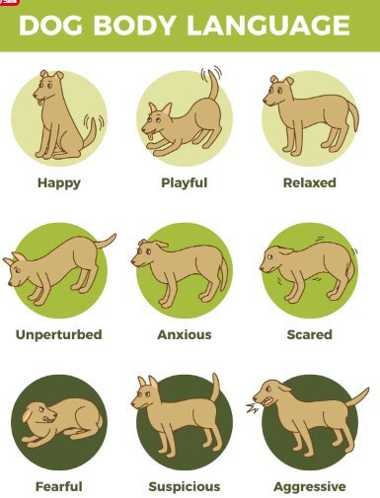
Redirecting a Fear Response
Managing
Stress
We want muzzle training to be as positive as possible while minimizing stress so its important to recognize body language while training.
As the muzzle was placed, Jaxon began to pull away. I immediately removed the muzzle and gave a treat to redirect his fear response to a positive experience.
Do not physically restrain the dog to place the muzzle, the dog should want to participate for the reward.

Slide 5
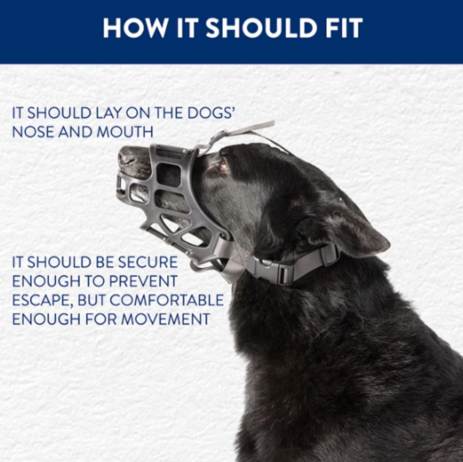
Securing the muzzle
Start off with the buckle as loose as it will get so the dog becomes comfortable with the ‘click’ noise.
Once the dog is comfortable with the muzzle being on their head, it is important to ensure you can tighten it to be secure. It should be snug and not able to slide off.

Slide 6
Putting a muzzle on
an anxious dog
In the next clip, you will see me go to place the muzzle and Jaxon moves away from me. I continue to go slow and place it on him even as he lays down.
He was not showing any signs of aggression, so I continued. It is important to read all body signals to stay safe.
I then clip the muzzle, and Jaxon begins to pull his face away from me.
Note how I take it off immediately and redirect the fear response with a treat. He needs more training sessions to be comfortable with the muzzle secured to his face.

