Slide 1
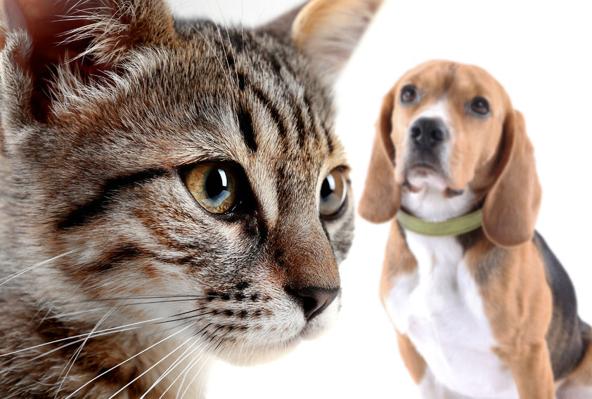

ANIMAL BEHAVIOUR & TRAINING
How to Train Your Pet for Better Behavior and Human-Animal Bond
By: Rose Duminuco of WCVM

Slide 2

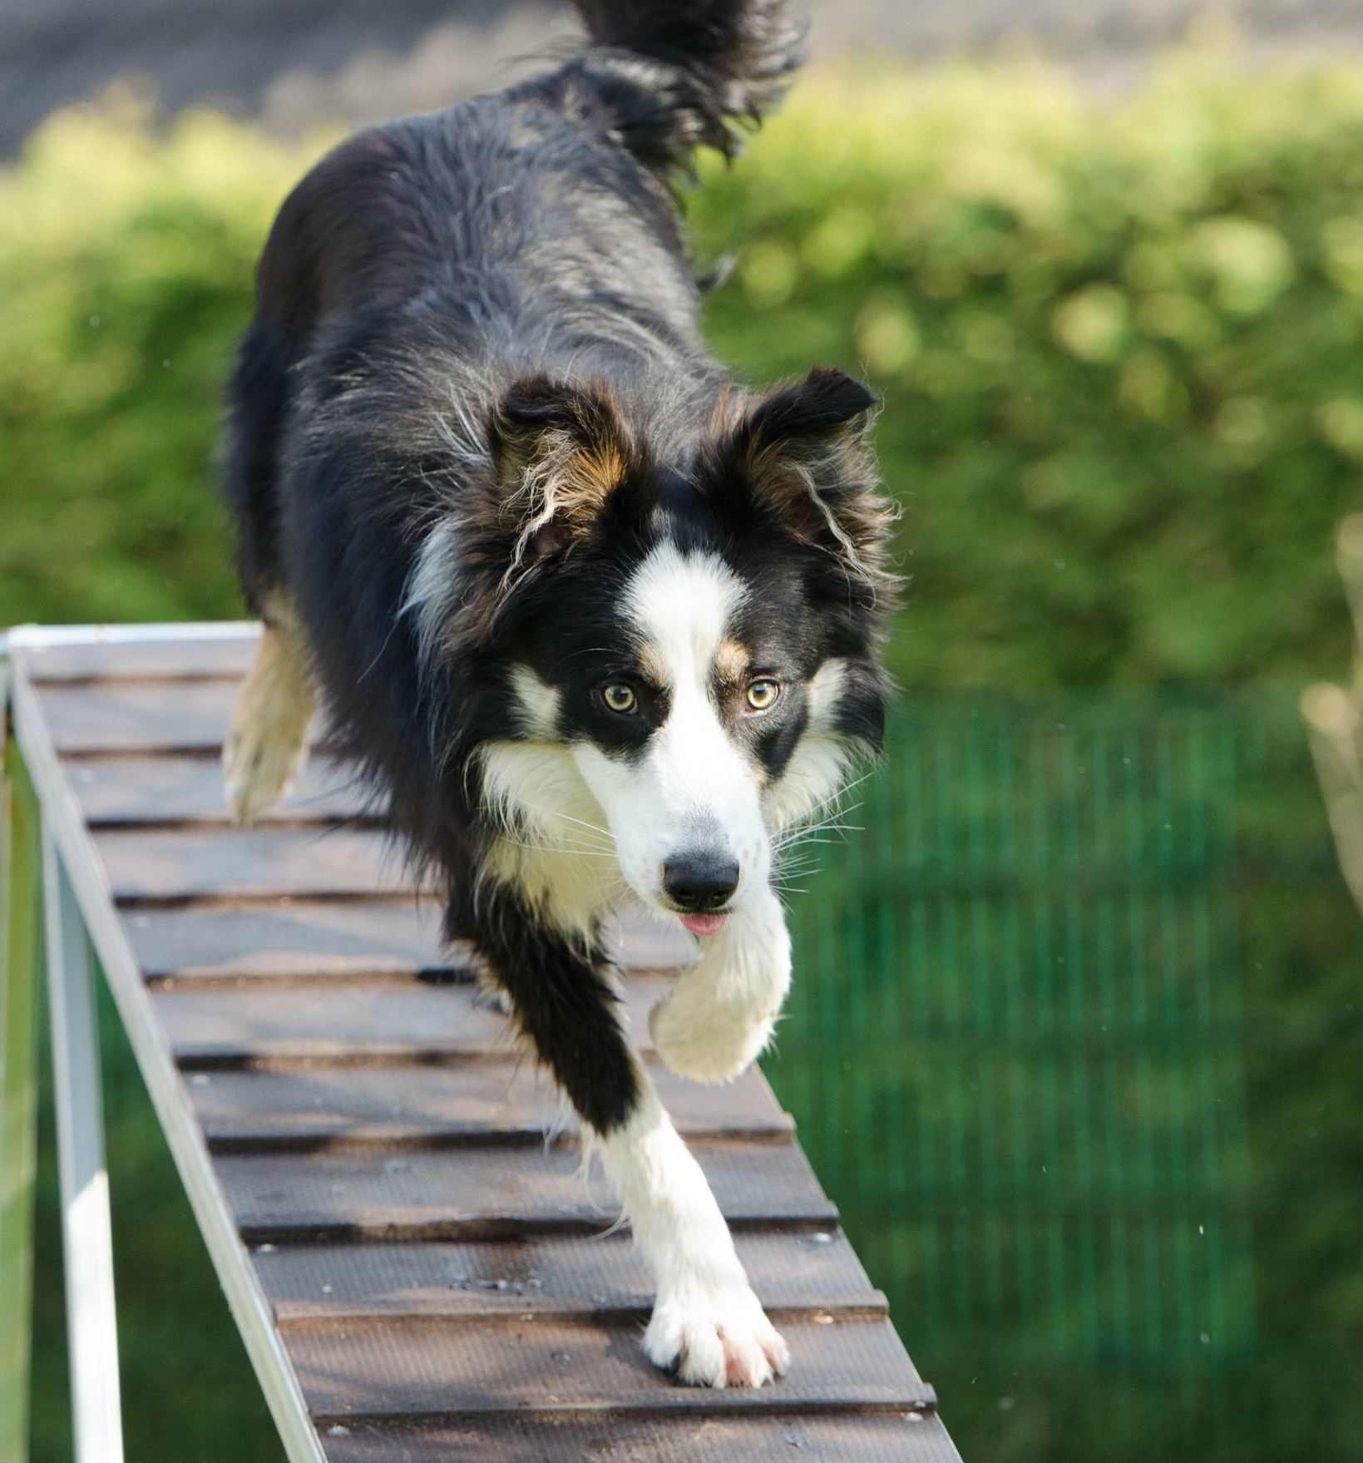
WHAT IS ANIMAL TRAINING ?
Training is a TOOL to bring out the behaviours you DO what your pet to display
A method to help your pet LEARN in a way that it understands what is acceptable
A way to IMPROVE or CHANGE undesirable behaviors in your pet

Slide 3
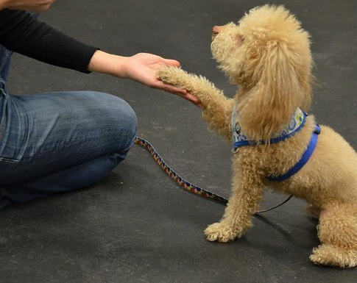

POSITIVE REINFORCEMENT
REWARDING your pet with something it VALUES when it displays the behaviour you want
STRENGTHENS the human-animal bond
REDUCES anxiety, fear and stress in your pet

Slide 4
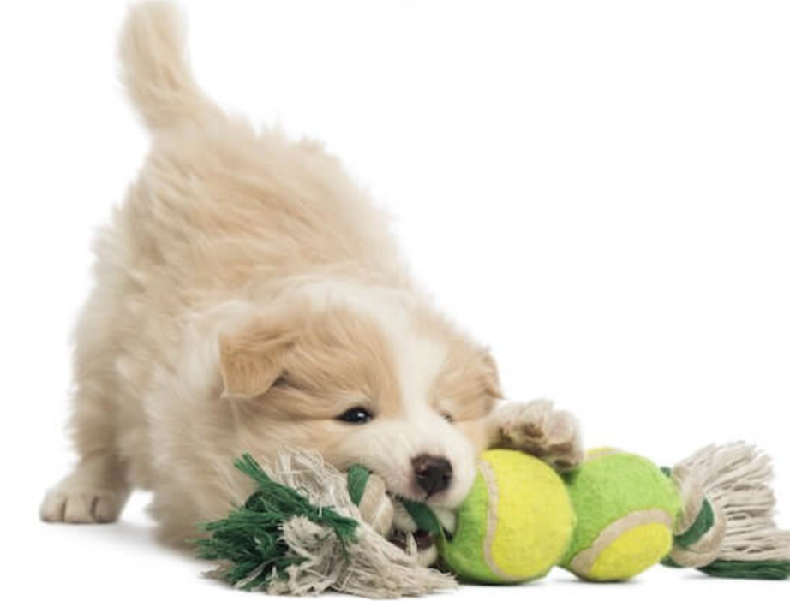

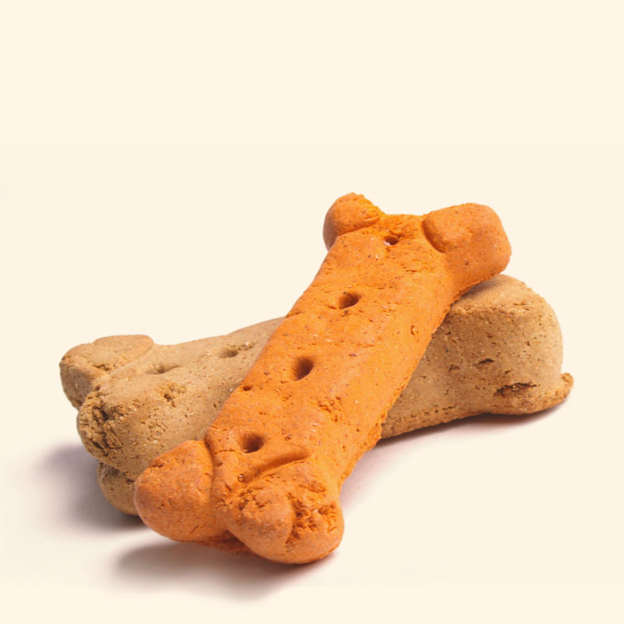
REWARDING YOUR PET
Praise & Affection
Delicious Treats
Favorite toys

Slide 5
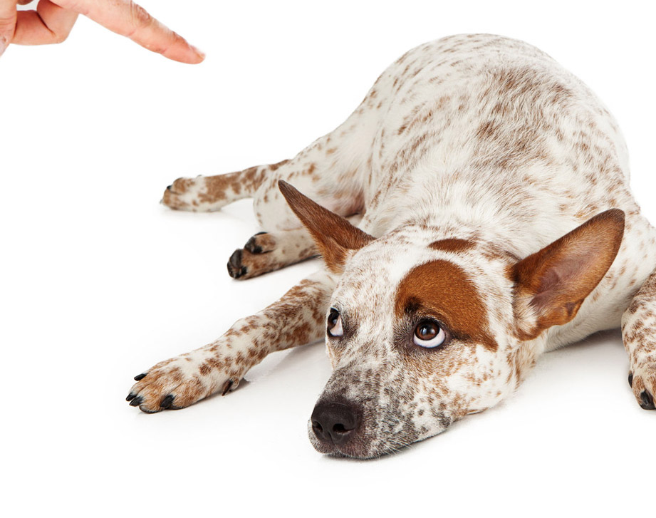

PUNISHMENT
METHODS
Doing something AVERSIVE to your pet when it displays a behavior you do not want
RUINS the human-animal bond
CREATES anxiety, fear and stress in your pet

Slide 6
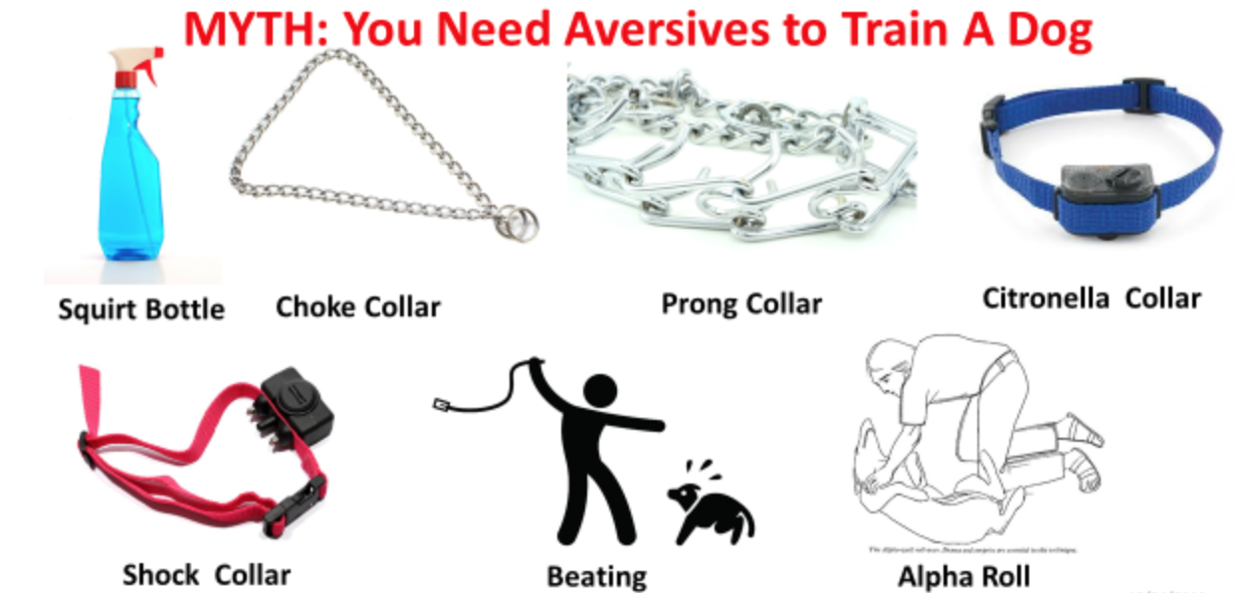
THE WRONG TOOLS FOR TRAINING YOUR PET

Slide 7
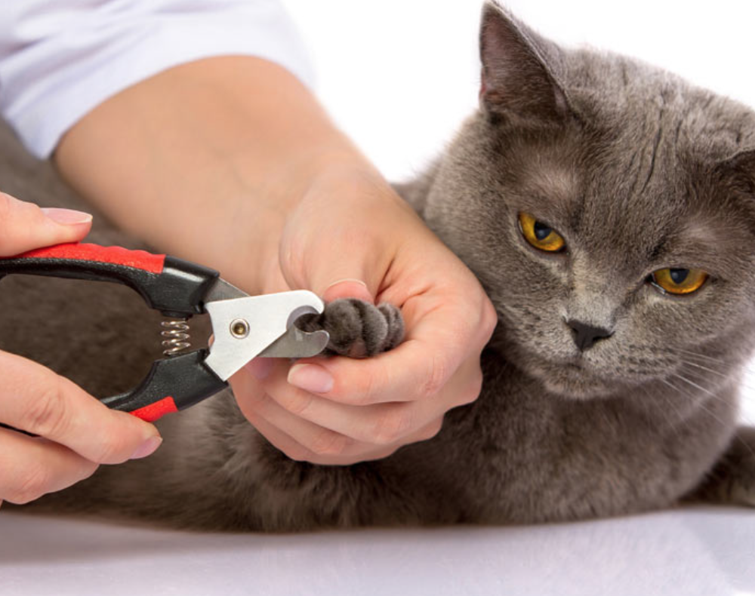
WAYS TO USE POSITIVE REINFORCEMENT
RETURNING to you when you call their name
STAYING BESIDE YOU instead of pulling on the leash on walks
Being tolerant of NAIL TRIMS and other important grooming procedures

Slide 8
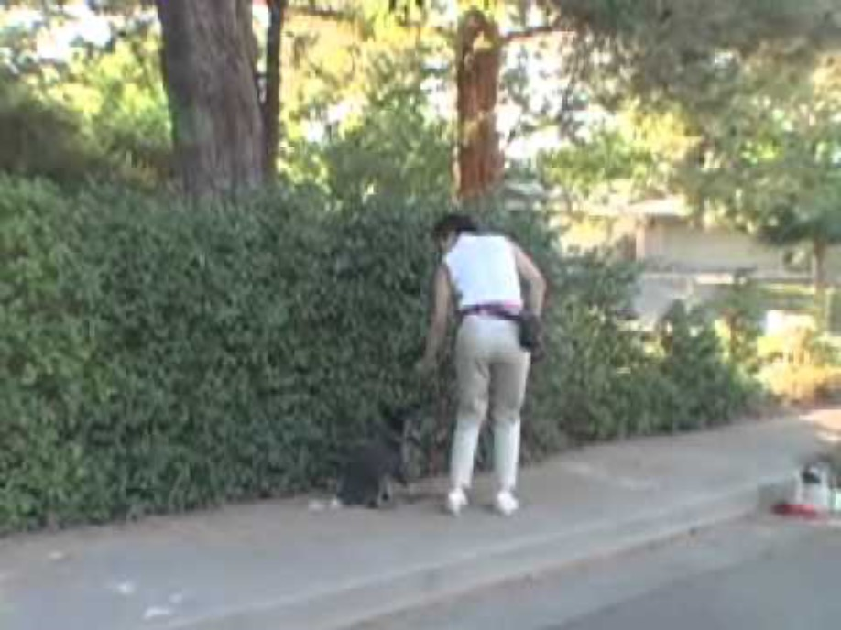

Slide 9

TRAINING IS A LEARNING ACTIVITY
Your pet needs TIME to learn
Training involves some WORK and EFFORT for both you and your pet
Pets learn best when they are RELAXED and COMFORTABLE

Slide 10
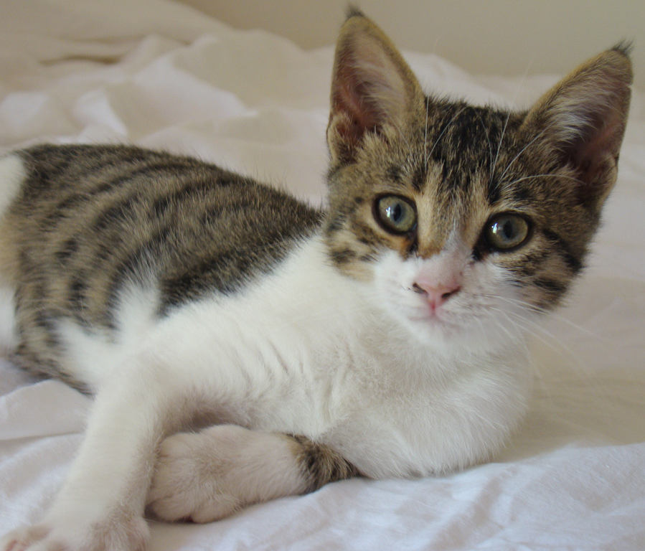
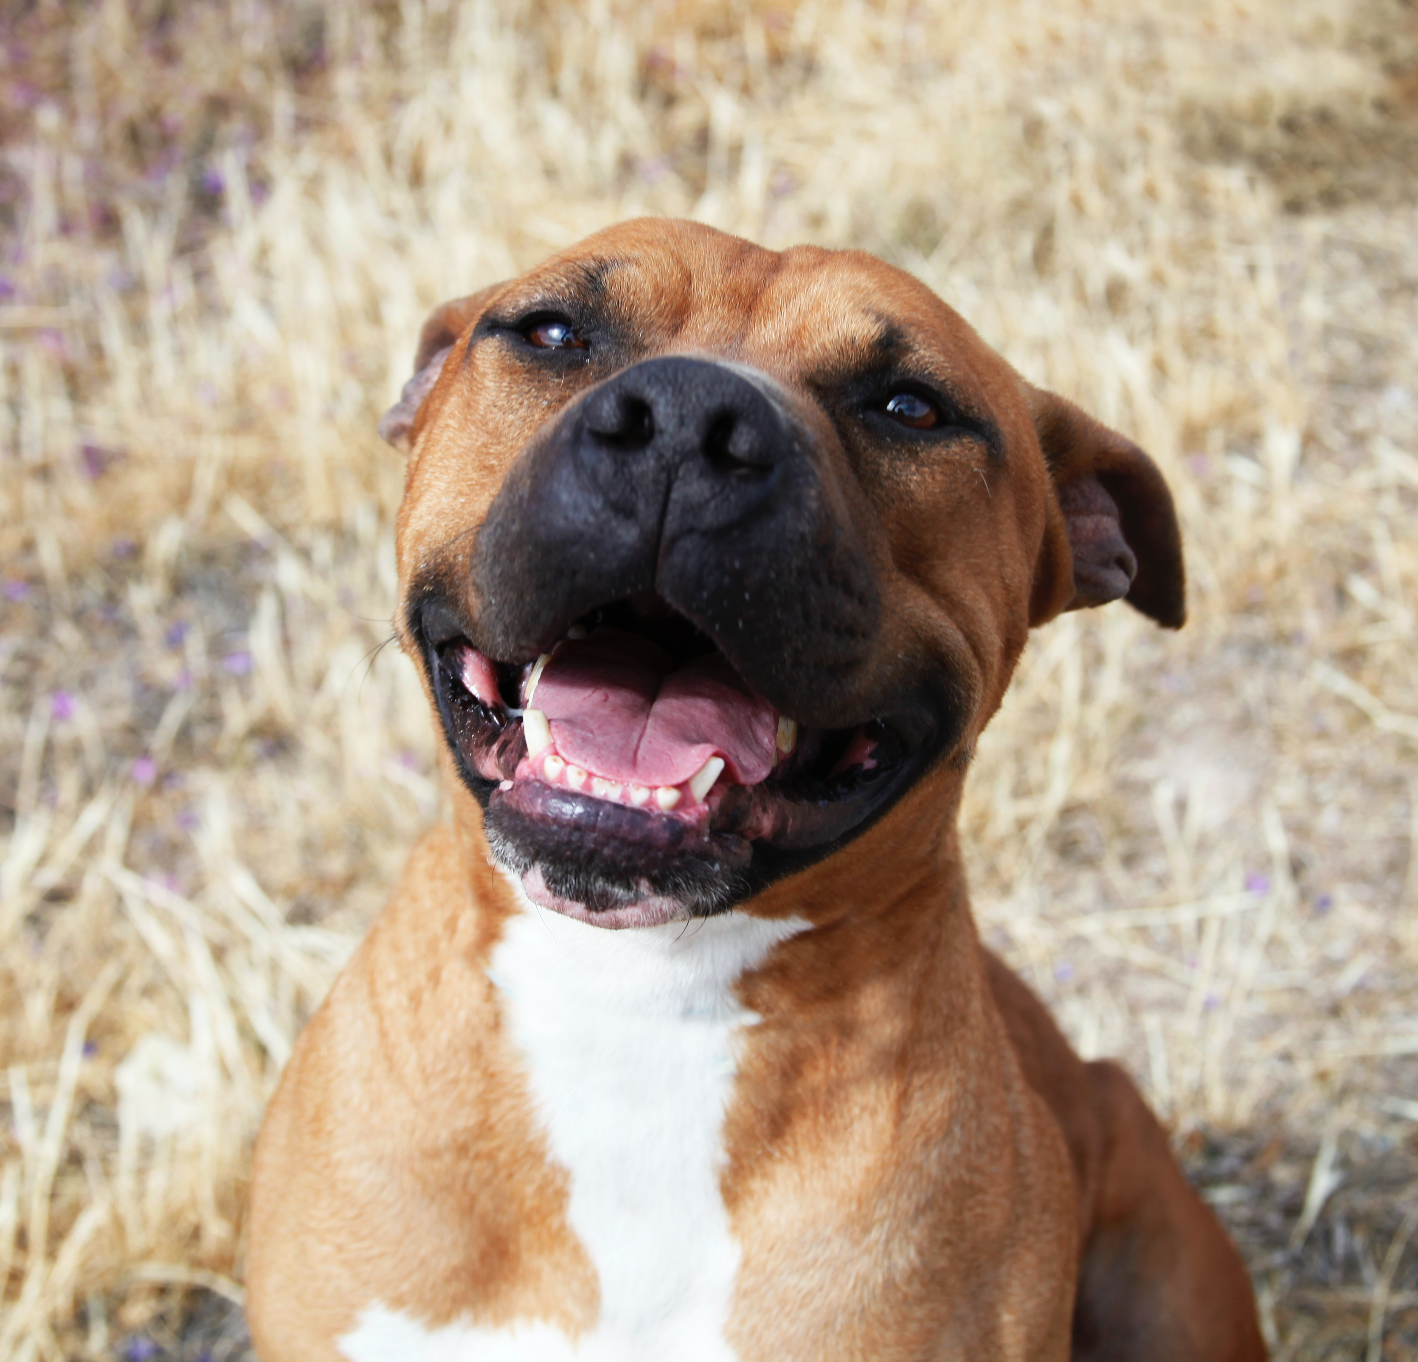
IMPORTANCE OF RECOGNIZING STRESS/FEAR
RECOGNIZE when your pet is stressed so you can influence your pets emotional state in a POSITIVE manner – using treats, toys, or gentle handling

Slide 11

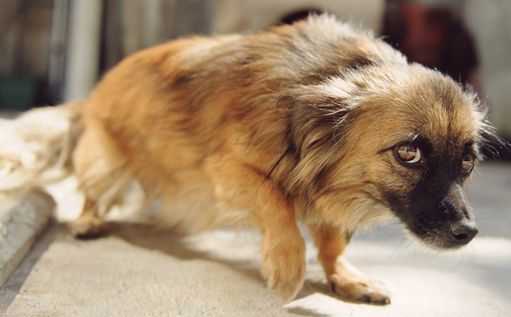
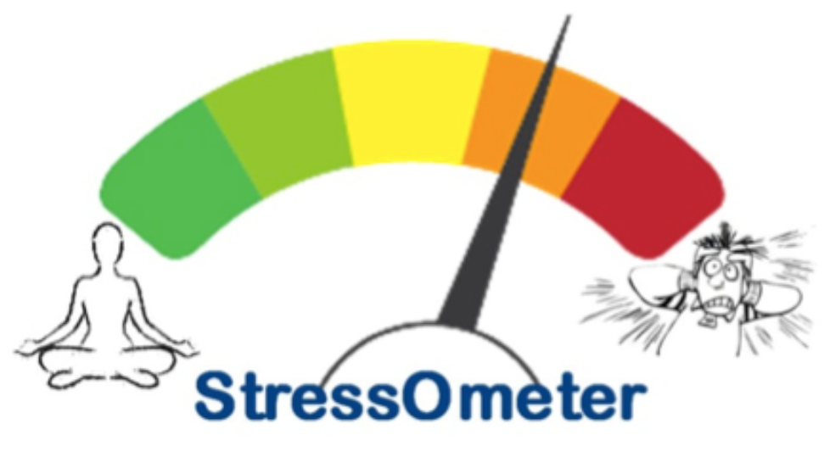
IMPORTANCE OF RECOGNIZING STRESS/FEAR
RECOGNIZE when your pet or other animal is stressed to keep yourself SAFE when you interact with them
This PREVENTS the potential situation of the animal biting or attacking you out of fear

Slide 12
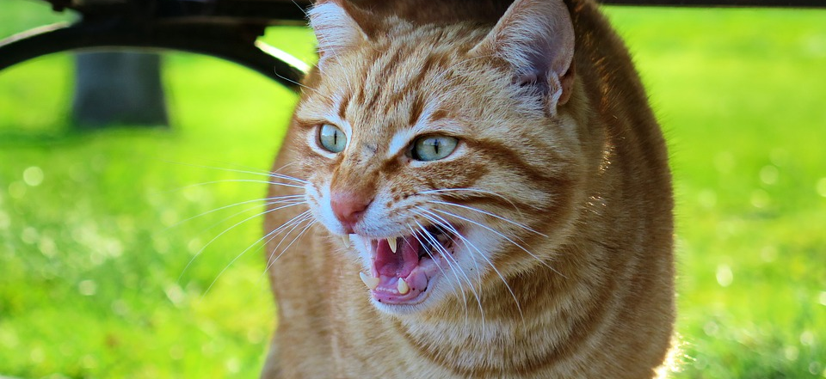
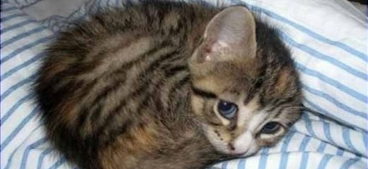
WHAT STRESS LOOKS LIKE: CATS
HIDING or APPEARING FROZEN
DILATED PUPILS (EYES)
HAIR & TAIL FLUFFED UP
EARS POINTED FLAT DOWN
HISSING / GROWLING
ATTEMPT TO BITE OR SCRATCH
URINATING OUTSIDE LITTER BOX

Slide 13
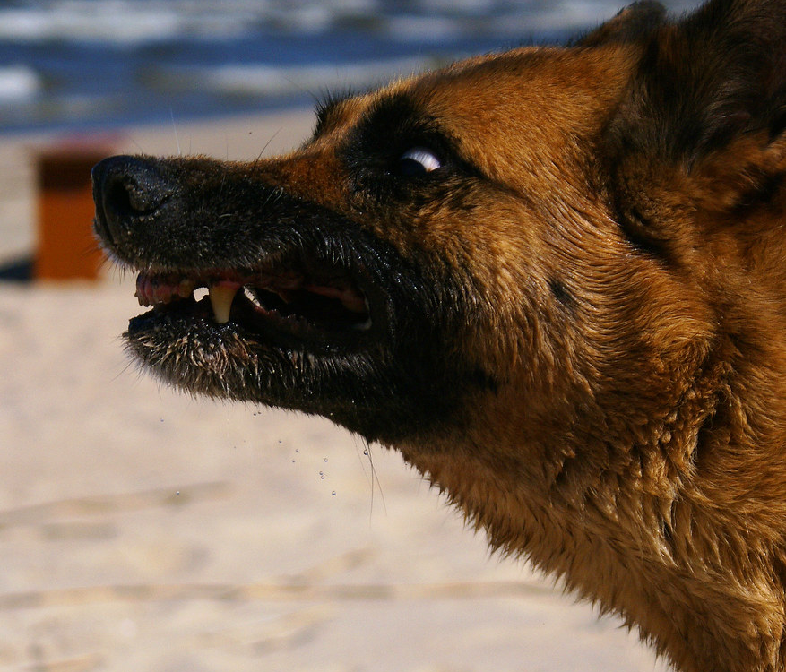

WHAT STRESS LOOKS LIKE : DOGS
EXCESSIVE LIP LICKING
CONSTANT YAWNING
TENSE BODY AND FACE
TUCKED TAIL
SHOWING BELLY
FEARFUL STARE
EARS POINTED DOWN
GROWLING
ATTEMPT TO BITE/LUNGE

Slide 14

HOW CAN WE PREVENT UNWANTED STRESS AND FEAR RESPONSES IN OUR PETS ?

Slide 15

THE SOCIALIZATION PERIOD
KITTENS: 3-7 WEEKS OF AGE
PUPPIES: 3-16 WEEKS OF AGE
Unique time when YOUNG ANIMALS are able to EASILY form POSITVE RELATIONSHIPS with unfamiliar people, animals, objects and experiences

Slide 16
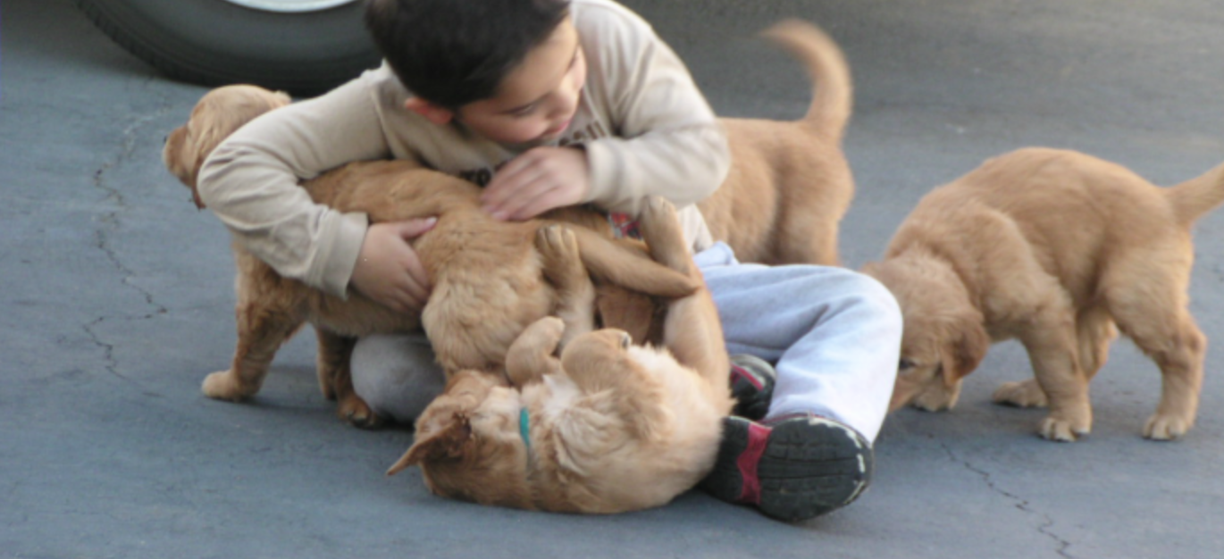
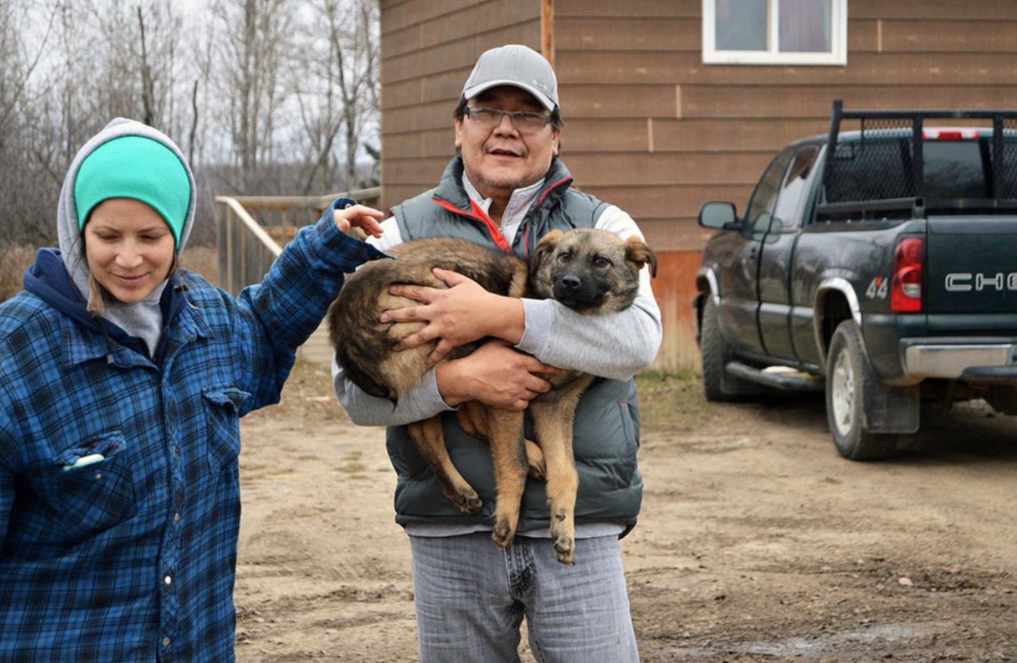
Socialization is an OPPORTUNITY to prevent fear-based behaviour problems later in life by providing POSITIVE experiences early on

Slide 17
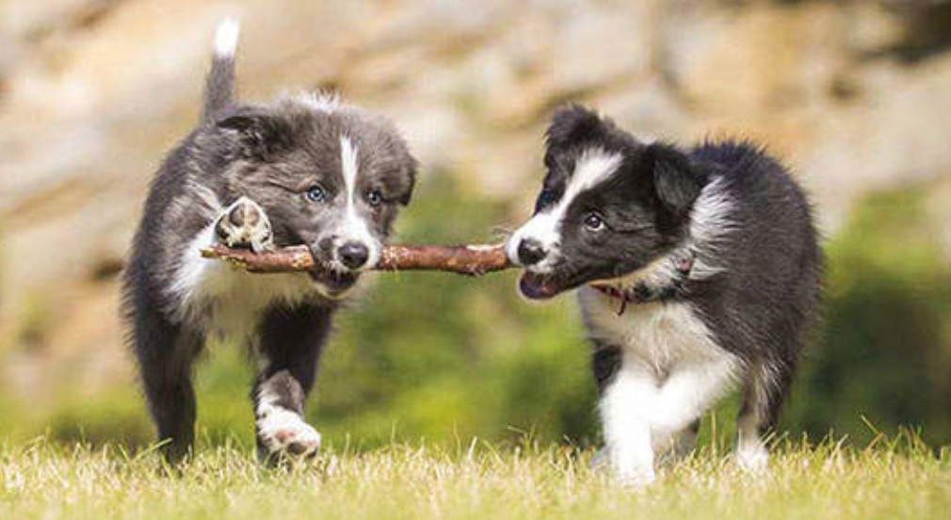
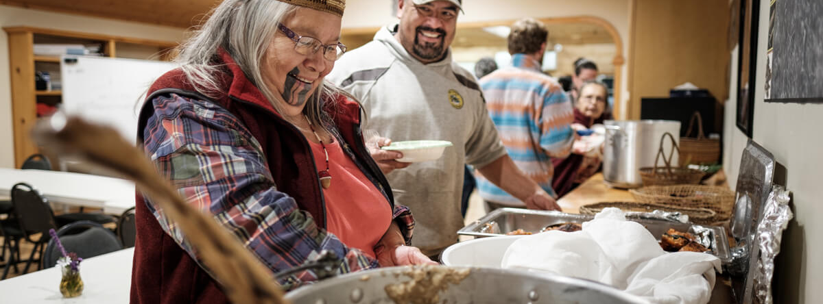
GENTLE AND CONSIDERATE HANDLING
MEETING OTHER PETS
MEETING UNFAMILIAR PEOPLE
BEING IN DIFFERENT ENVIRONMENTS

Slide 18

BALANCED APPROACH
Socialize your puppy or kitten with HEALTHY (ideally vaccinated) animals
We are looking for POSITIVE experiences
Choose locations carefully and AVOID places where there are:
- Predatory wildlife
- Sick animals
- Dead animals or carcasses
- Dangerous traffic

Slide 19
USE
Use POSITIVE REINFORCEMENT daily to reward your pet when it does what you prefer
AVOID
Always avoid PUNISHING your pet when it does something you do not like – this method ruins the bond between you and your pet and creates fear
KNOW
RECOGNIZE signs of stress in your pet and animals so you can make the best decision and keep yourself safe
PREVENT
Make sure to SOCIALIZE young animals so they are not fearful as adults

Slide 20
THANK YOU
FOR LISTENING !

Slide 21
REFERENCES USED:
Dr. Sophia Yin (https://drsophiayin.com)
Puppy and Kitten Socialization (https://veterinarypartner.vin.com/default.aspx?pid=19239&catId=102901&id=8941891) and (https://www.vin.com/apputil/content/defaultadv1.aspx?pId=12886&catId=57126&id=7054692)
Positive Reinforcement: (https://www.companionanimalpsychology.com/2017/02/what-is-positive-reinforcement-in-dog.html) and (https://www.frontiersin.org/articles/10.3389/fvets.2020.00508/full?fbclid=IwAR3w5pDFzIIF4CC3SHXcfIUsCN7s05tGFzqpdl6SAyrF3nxMwAcP29hgyhw) and
(https://www.sciencedirect.com/science/article/abs/pii/S1558787817300357)

Slide 22
RECOMMENDED
TRAINING WEBSITES:
Dr. Sophia Yin (https://drsophiayin.com)
Kristen Crestejo (https://www.youtube.com/user/Krissykris1468)
Puppy and Kitten Socialization (VIN Website)

