Slide 1
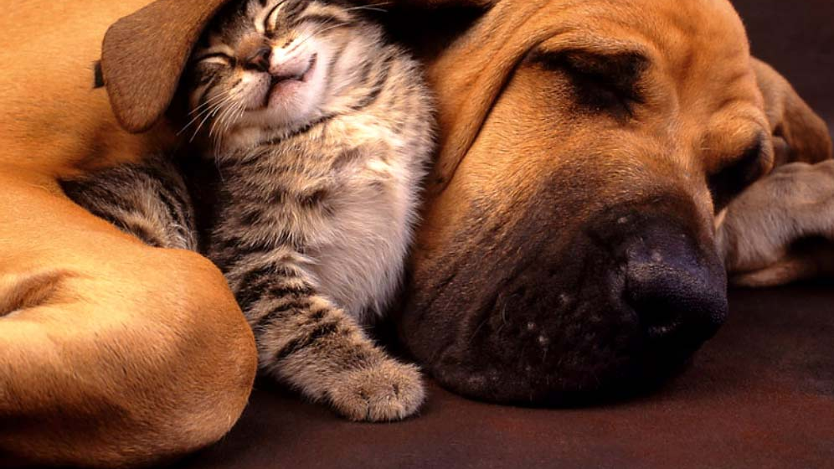
Training your pet!
Tips and tricks on how to get your pet to follow simple commands and be an enjoyable companion in your home
Learning module created by Jacey Nyberg, 4th year veterinary student
May 2024
This Photo by Unknown Author is licensed under CC BY

Slide 2
Learning objectives:
By the end of this module, students will be able to:
1. Understand what are good and bad behaviors in pets
2. Use positive reinforcement to teach your pet basic commands
3. How to use the same techniques for every pet in your home

Slide 3
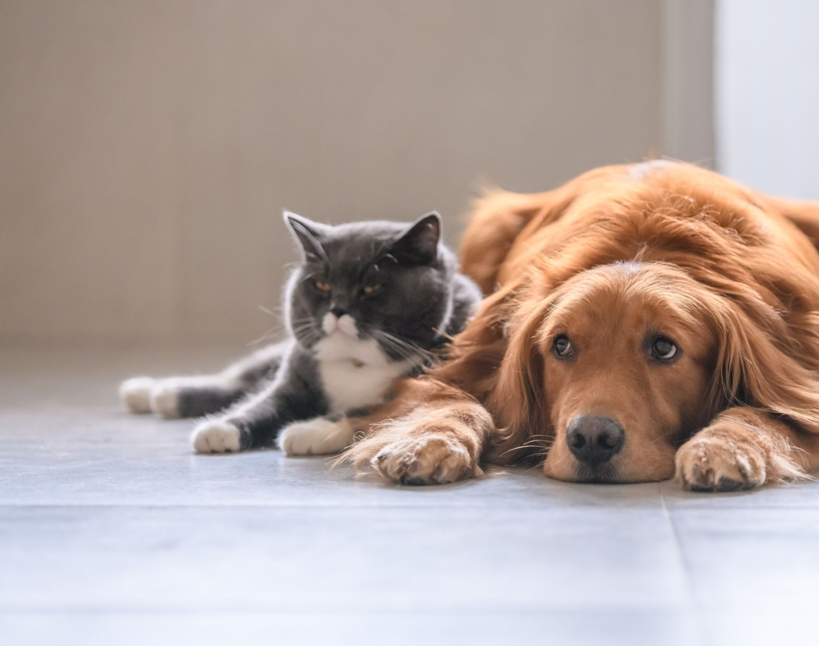
1.1 What behaviors do your pet(s) show at home?
Notes:
Audience engagment

Slide 4

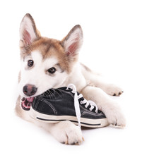
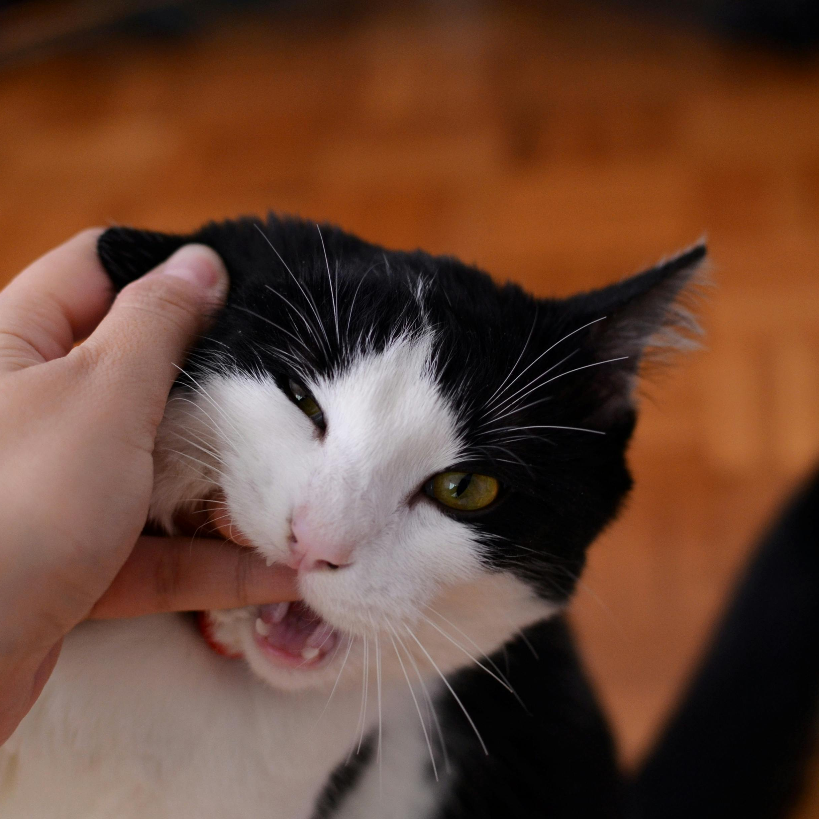
1.1 What do we notice about these pets?
Dog is jumping and pulling on the leash Puppy is chewing on someone’s shoe Cat is biting a person
Do any of your pets do this? And if so, how does it make you feel?

Slide 5
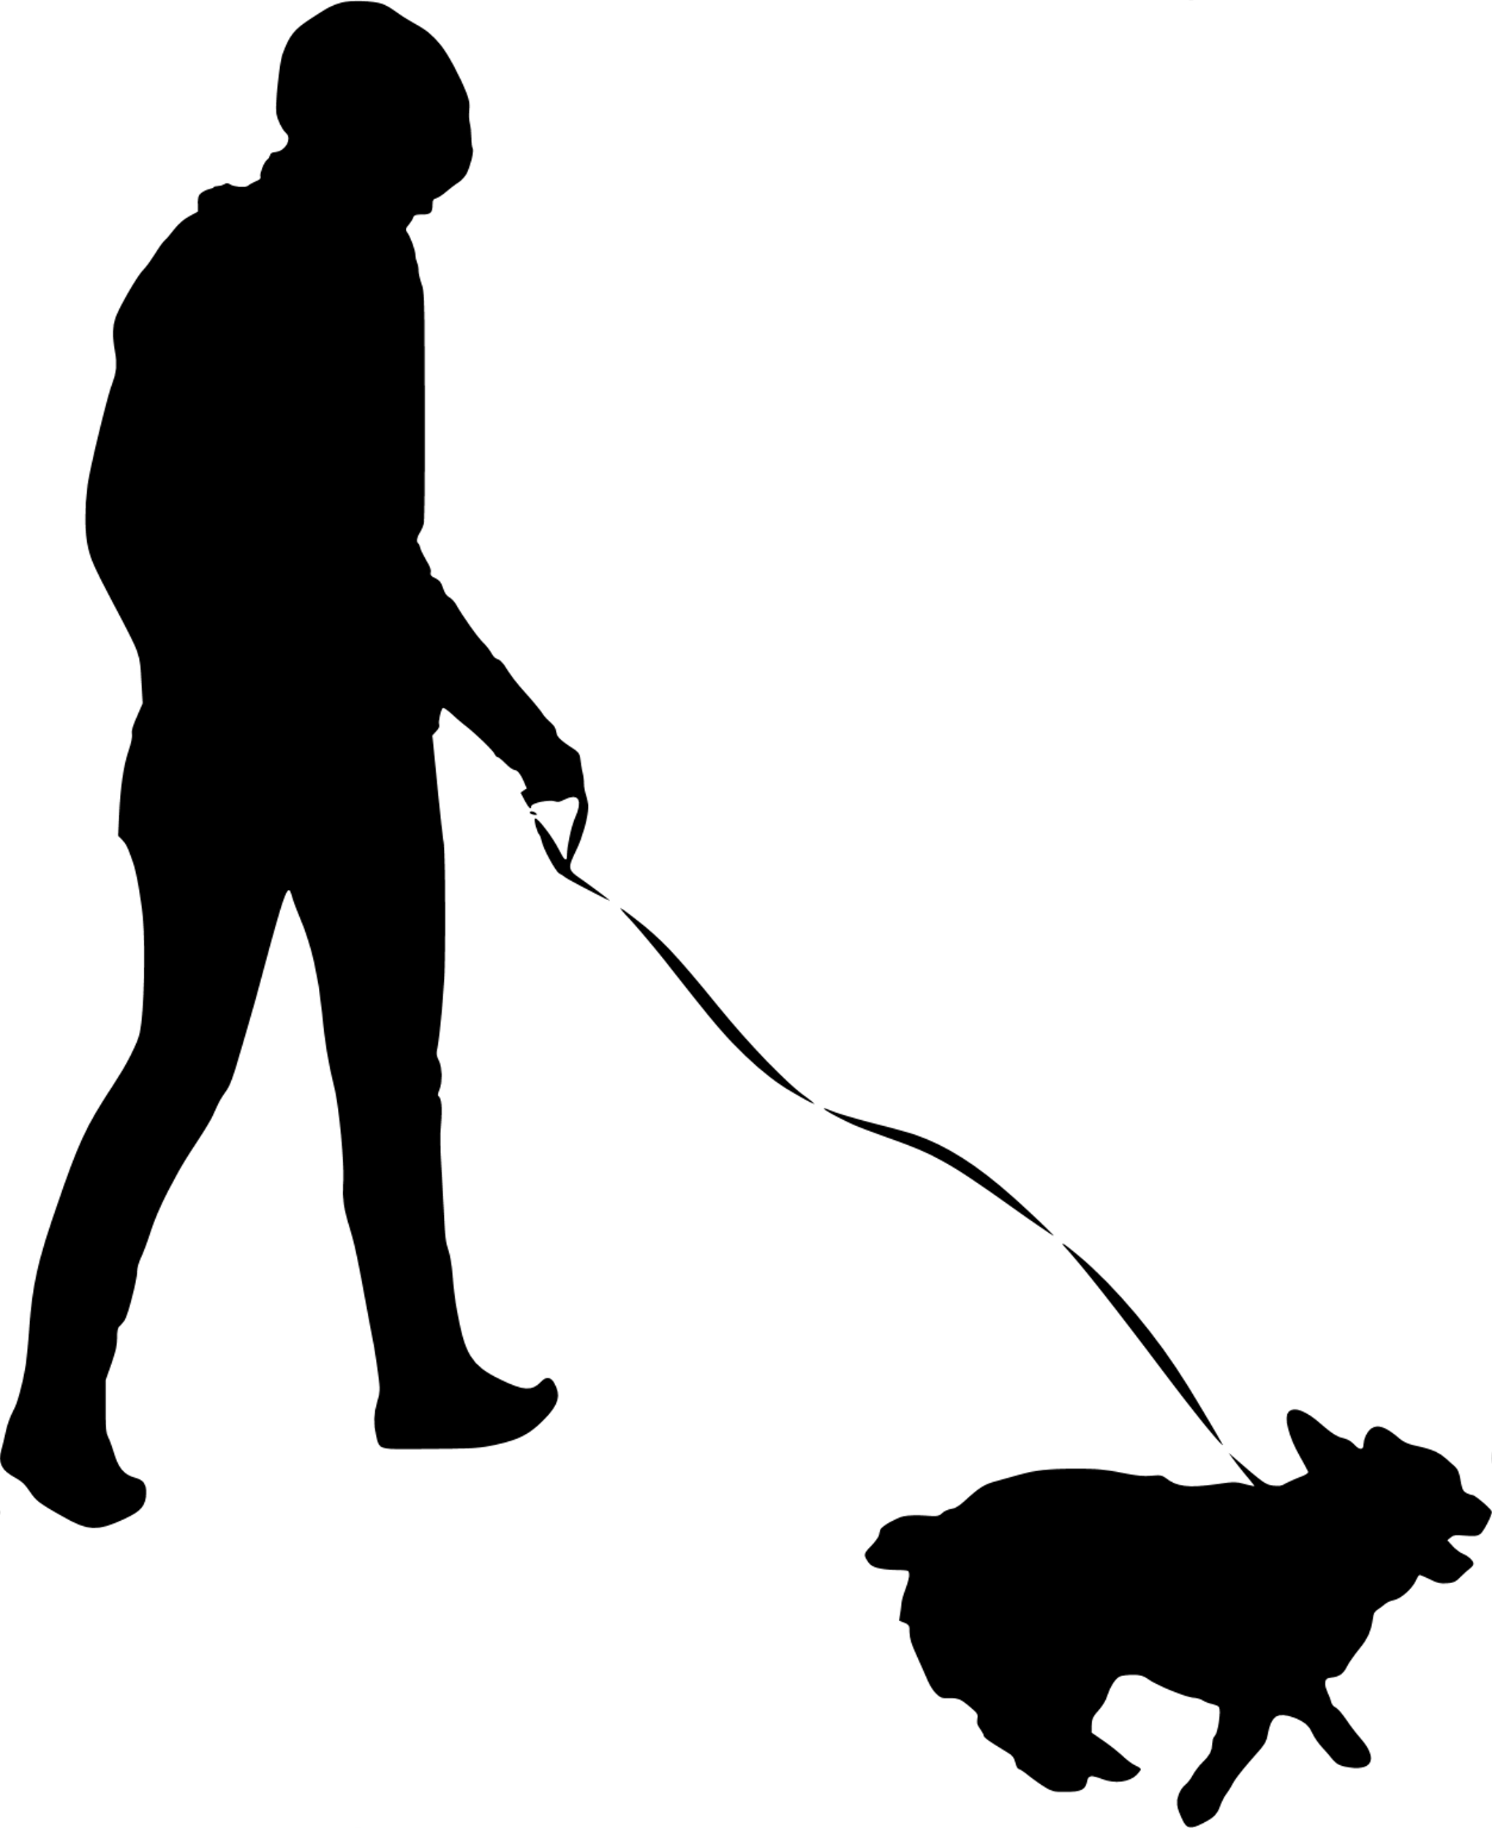
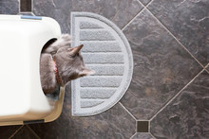
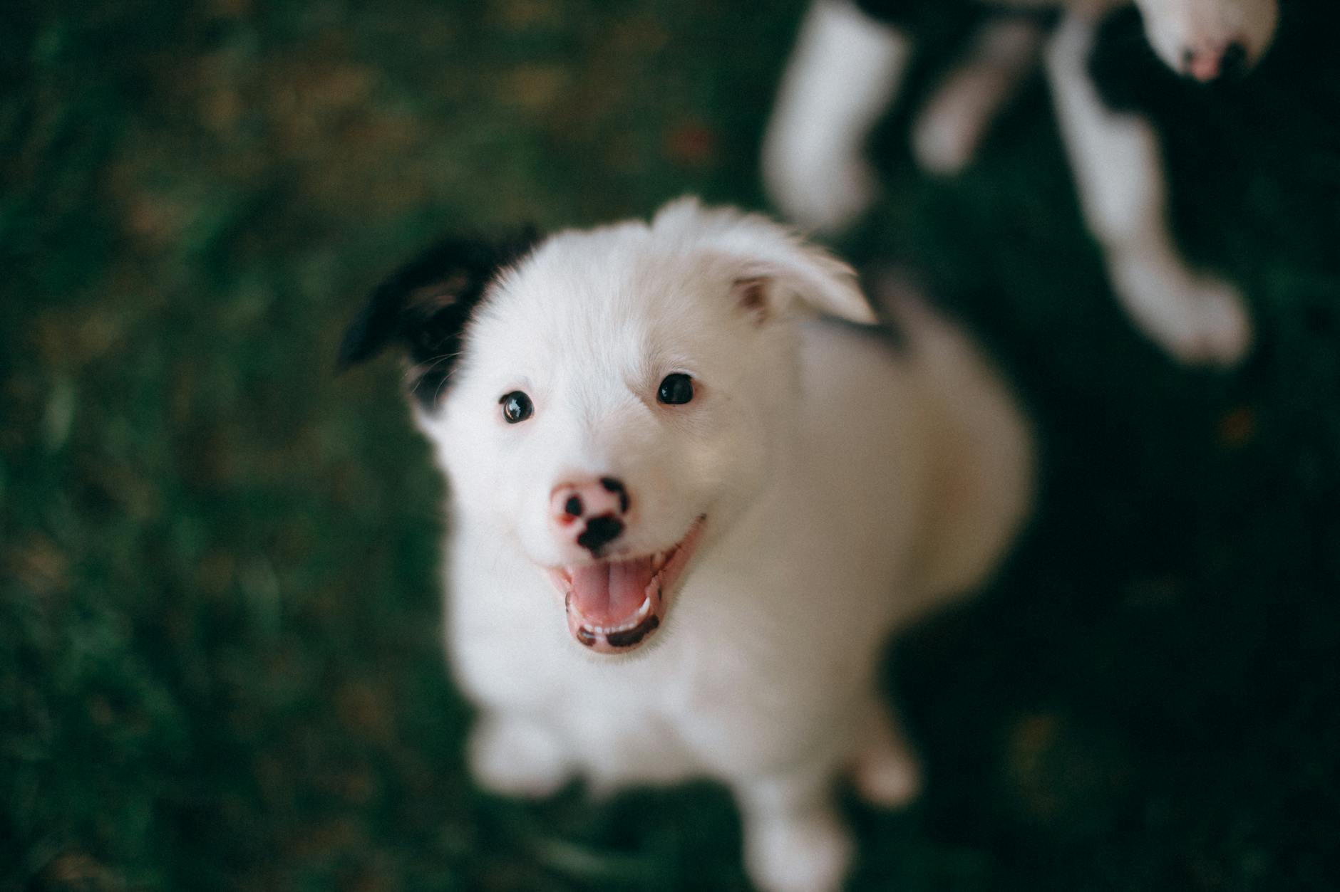
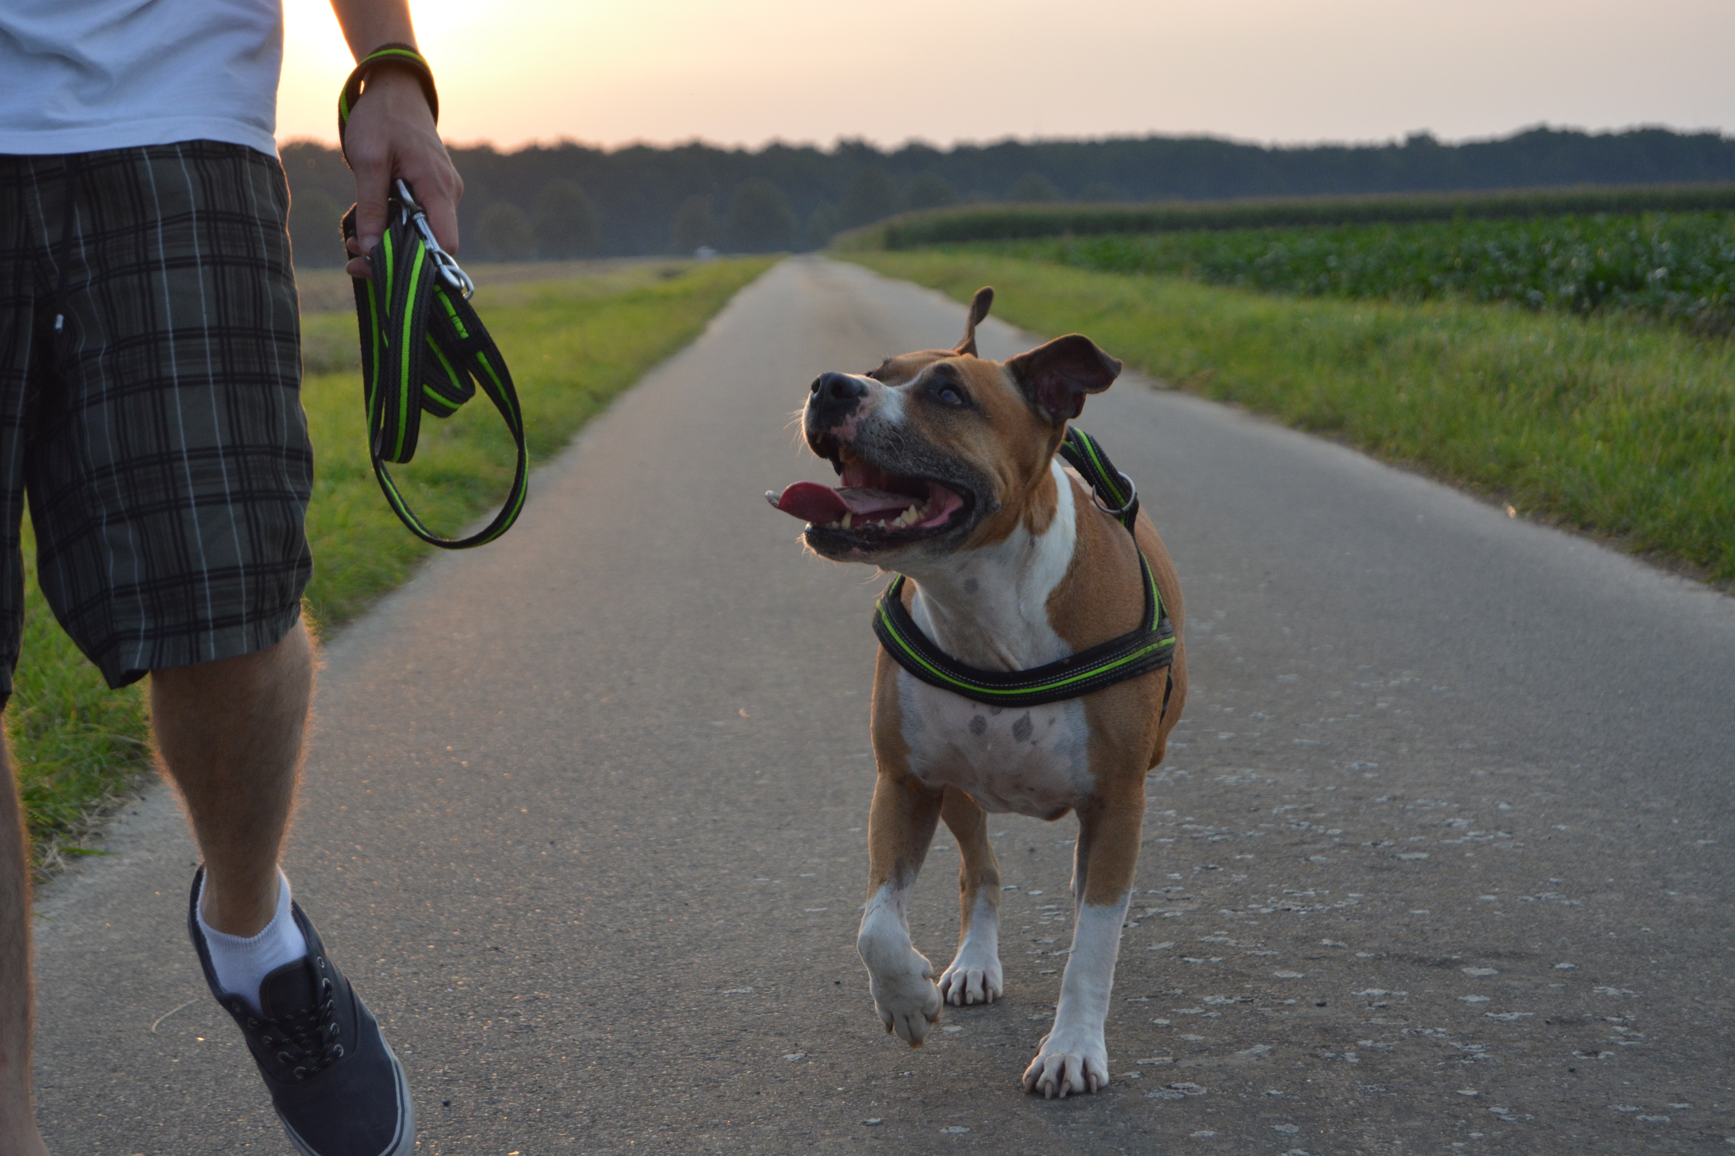
1.2 What is good pet behavior?
Good pet behavior includes traits and habits that make sure the pet has manners when around other animals and people, making them a joy to be around.
Some good behaviors include:
Walking on a leash calmly
Follow basic commands such as ‘sit’, ’stay’, and ‘come’
Friendly and curious about other pets and people
No accidents in the house
Notes:
What do we notice about each of these photos?
Puppy looking at owner with friendly gaze and sitting nicely
Dog walking without a leash and paying attention to owner
Dog walking on a leash and not pulling but walking calmly instead
Kitty using the litter box instead of in the house

Slide 6
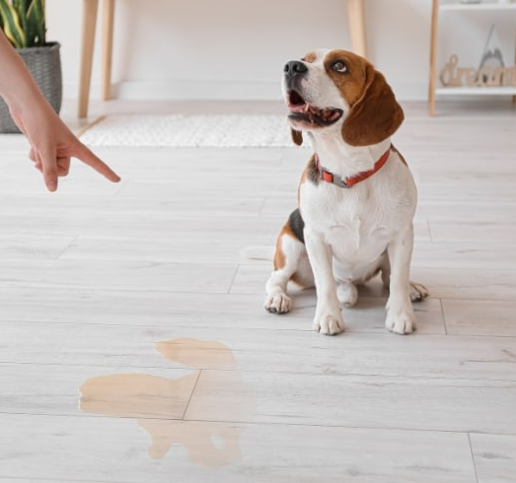
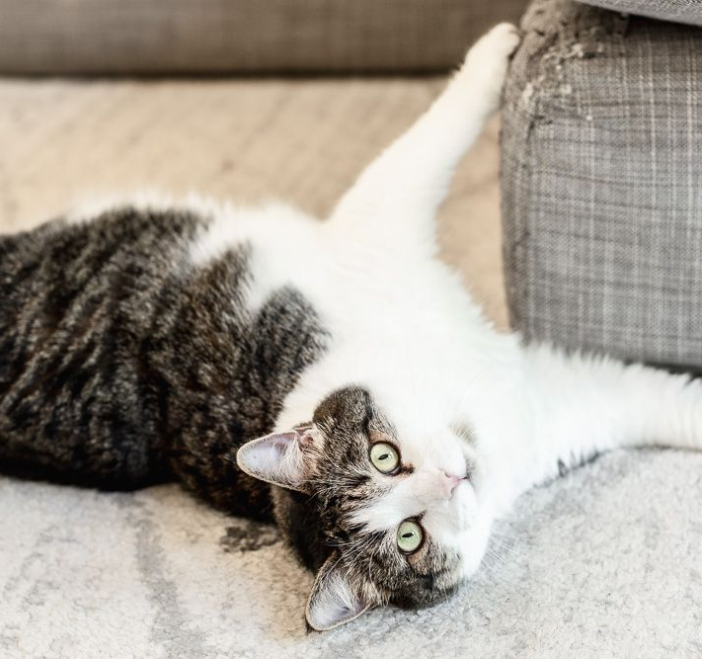
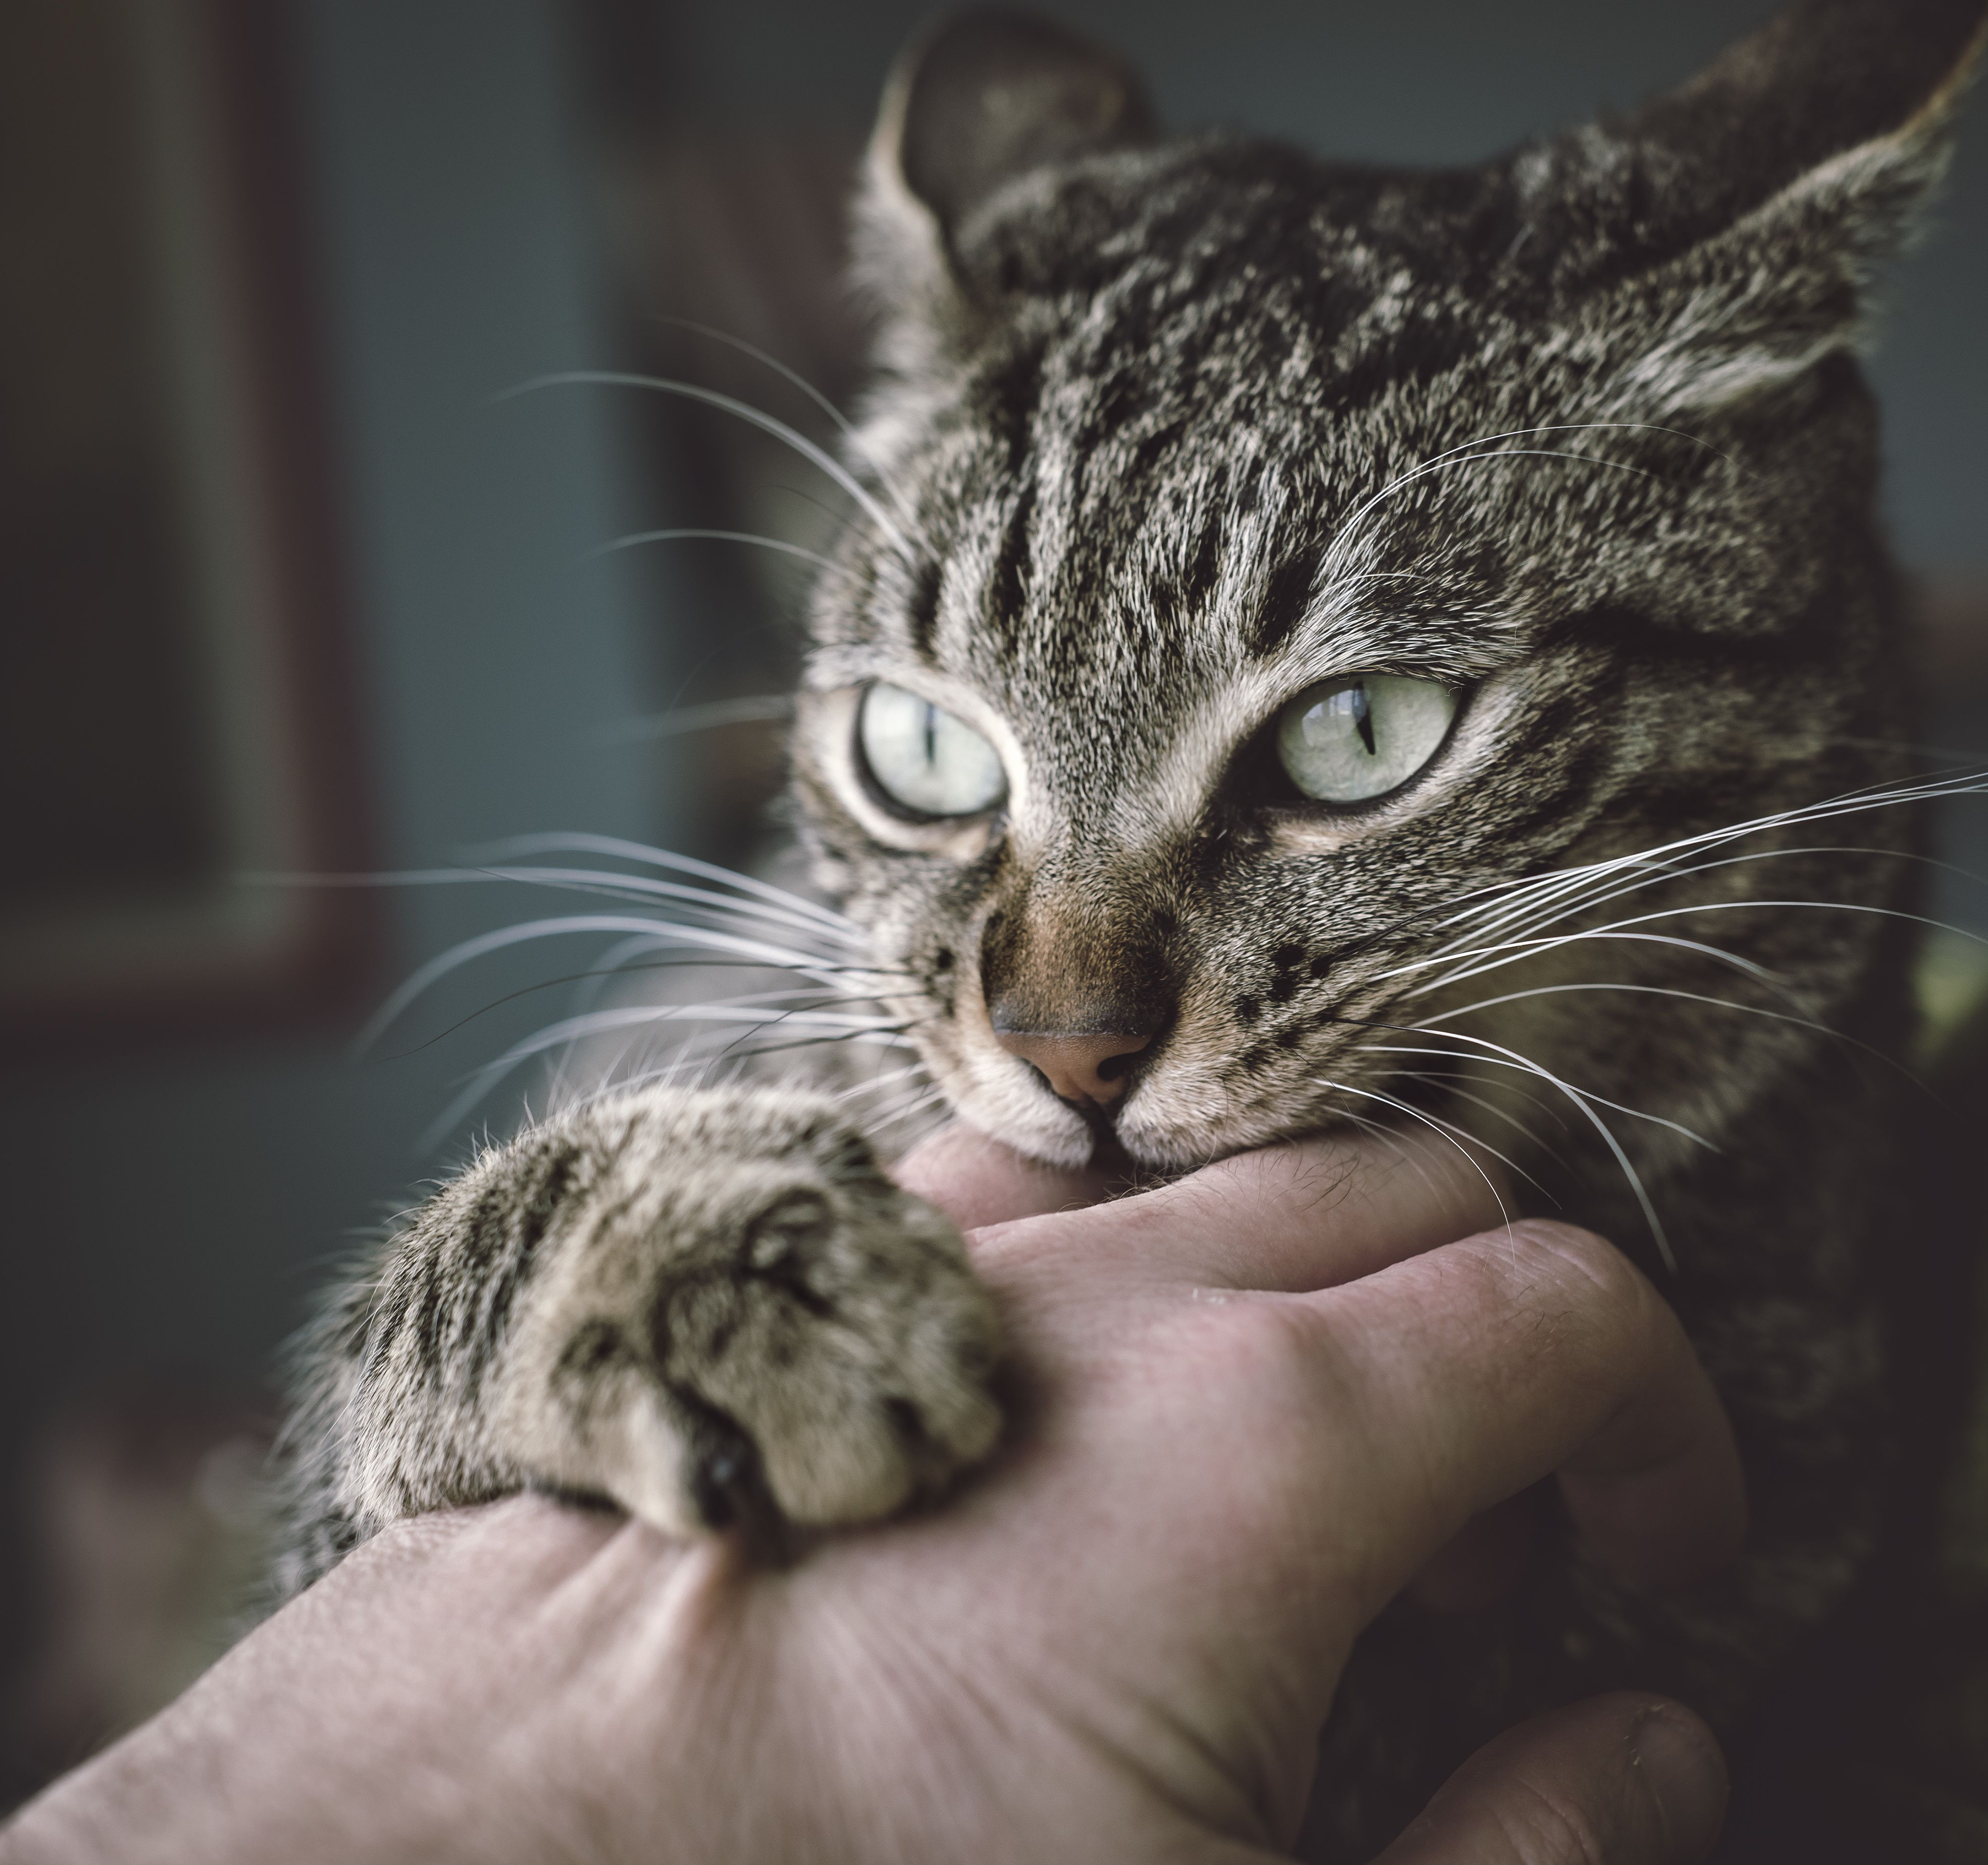
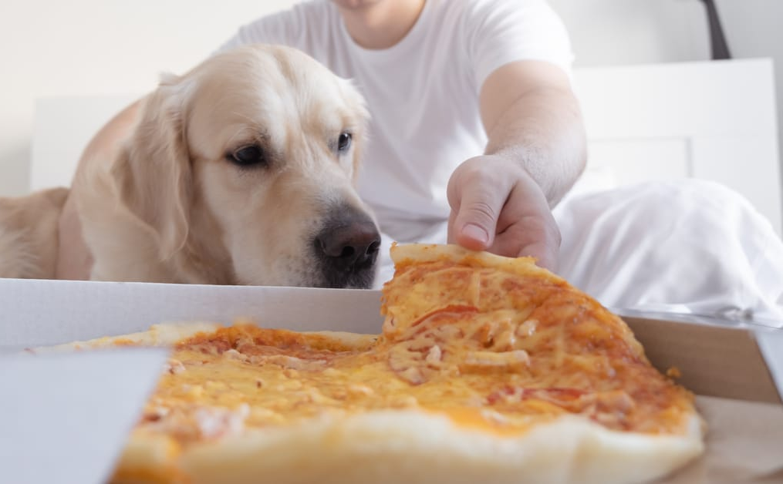
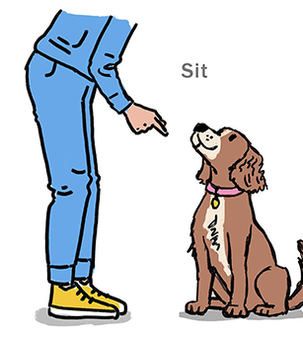
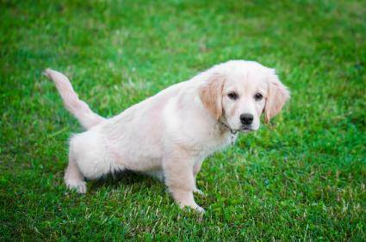
1.2 Interactive learning!
Which of these behaviors should we teach our pets and which of them should we try to work on?
Notes:
Point to a picture and have the students guess

Slide 7
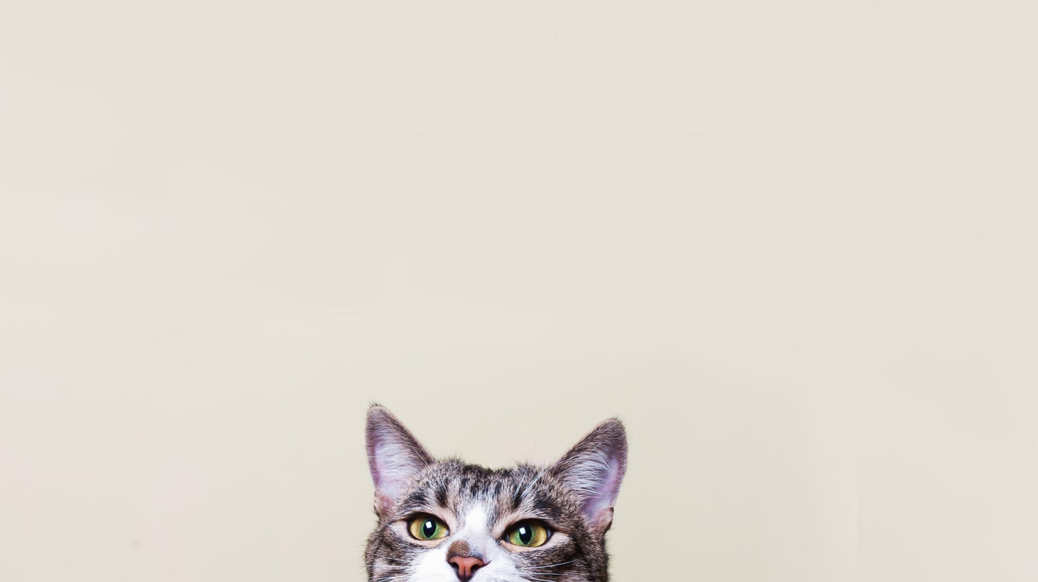
2.1 How can we train our pets to have good manners?

Slide 8
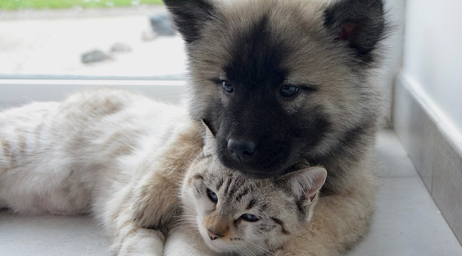
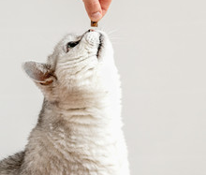
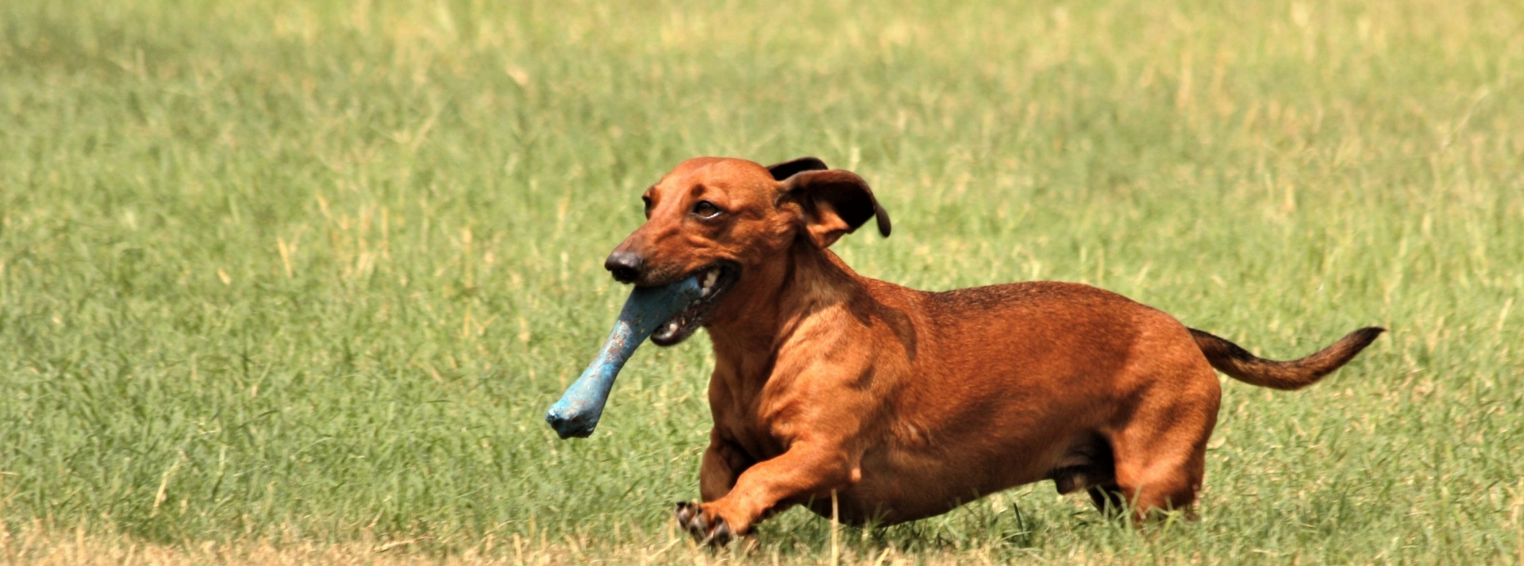
Positive Reinforcement!

Slide 9
2.1 What is Positive reinforcement?
Positive reinforcement means providing fun, exciting, and/or favorable rewards to our pets after completing a task or good behavior.
We can use many tools as a reward, including:
Treats
Toys and play time
Praise (with our voices and petting)
Attention

Slide 10
2.2 How to practice positive reinforcement
Choose a command or behavior you would like to work on with your pet.
  For example: start with a simple command such as ‘sit’
Grab your pet’s favorite thing whether that is a yummy treat or the toy they play with the most
Begin by getting your pets attention with the treat or toy. Try using a positive tone in your voice to get your pet excited.
Once you have your pet’s attention, you can say the word ‘sit’.
  To help your pet sit you can hold the treat or toy over their head until they lean back into a sit OR we can gently push on their back near their tail until they obey the sit.
As soon as your pet sits, give them the treat and say; ‘good sit’.
Continue these steps over and over until your pet learns to sit by only saying the word ‘sit’
These steps can be done with any command or behavior!
Notes:
Teacher can demonstrate the steps using an animal or stuffed toy

Slide 11

Here’s a video to help guide you on using positive reinforcement
https://www.youtube.com/watch?v=h5ycwqDIV9g
Notes:
5-minute video demonstrating kids teaching their own animals basic commands

Slide 12
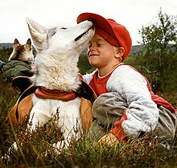
2.3 Why do we want to use positive reinforcement?
Encourages good behaviors and manners
  Getting rewards and love for tasks makes learning enjoyable for pets. When we use rewards, pets are more eager and willing to join in training sessions.
Builds trust with the owner
  Pets get excited and have more fun with their owners if they get rewarded to to the right thing.
Reduces fear from people
  We want to build trust and good experiences with our pets so they can feel happy and safe around you.
Improves learning
  If we were to use punishment to train, we can scare our pets. Positive reinforcement helps them feel less afraid and anxious so they can focus on learning.
This Photo by Unknown Author is licensed under CC BY-SA
Notes:
Encourage good behaviors and manners
Getting rewards and love for tasks makes learning enjoyable for pets. When we use rewards, pets are more eager and willing to join in training sessions.
Builds trust with the owner
Pets get excited and have more fun with their owners if they get rewarded to to the right thing.
Reduces fear from people
We want to build trust and good experiences with our pets so they can feel happy and safe around you.
Improves learning
If we were to use punishment to train, we can scare our pets. Positive reinforcement helps them feel less afraid and anxious so they can focus on learning

Slide 13
3.0 Training tips for different pets
3.1 Dog training
3.2 Cat training
3.3 Other furry (and not so furry) friends

Slide 14

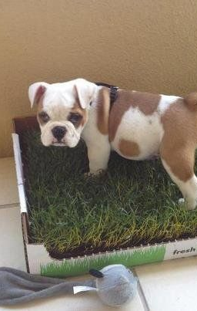
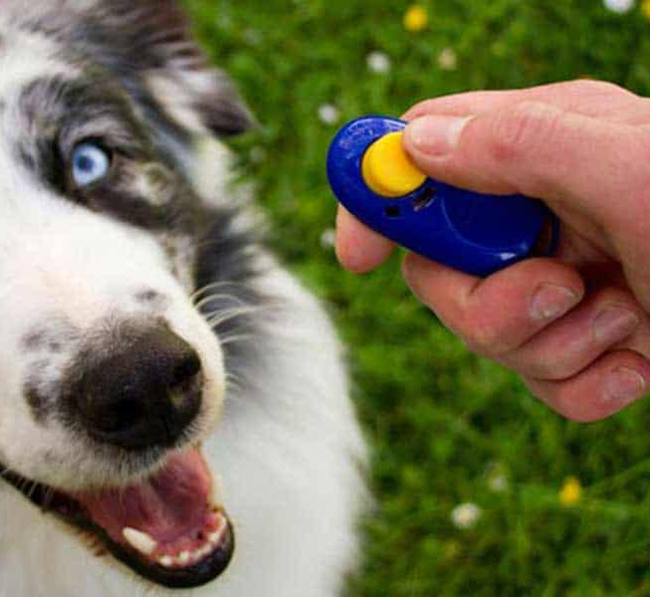
3.1 Training dogs
What are some commands and manners that you think are important for dogs to know?
Try using yummy but low calories treats such as:
  Freeze-dried meat (chicken, beef, lamb)
  Carrots
  Puppy training treats
  Even their own dog kibble (in small amounts)
Use excited and happy voices when praising!
Start training when they are young or as soon as you get your pet
  Dogs especially learn the most when they are puppies and should be socialized before they reach 16 weeks of age
After our pets understand a command, we can start to use clickers to replace treats
This Photo by Unknown Author is licensed under CC BY-SA
Notes:
sit’, ‘stay’, ‘come’, no jumping up, no biting people or chewing on anything other than a toy, walking calm on a leash, no indoor accidents

Slide 15
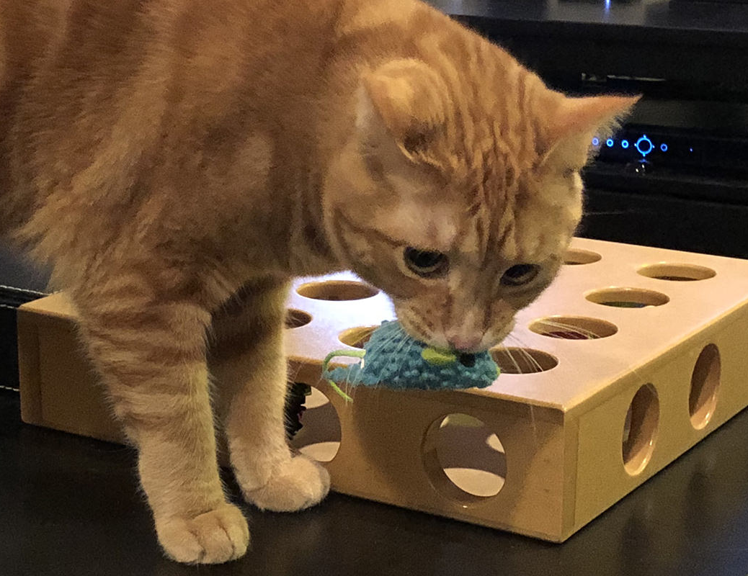
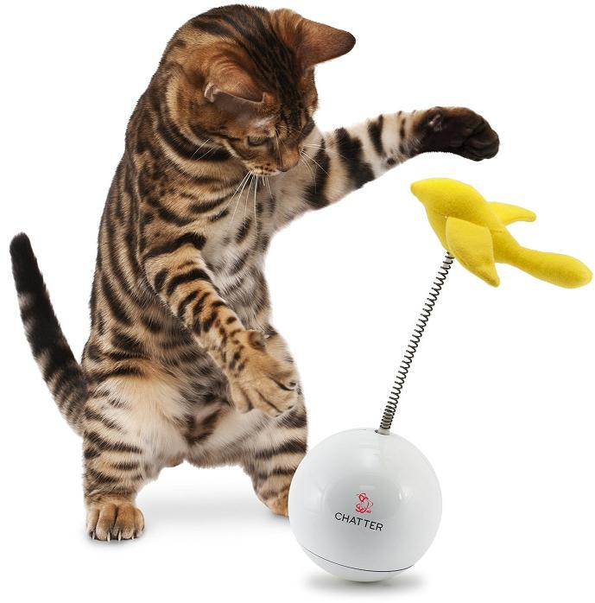
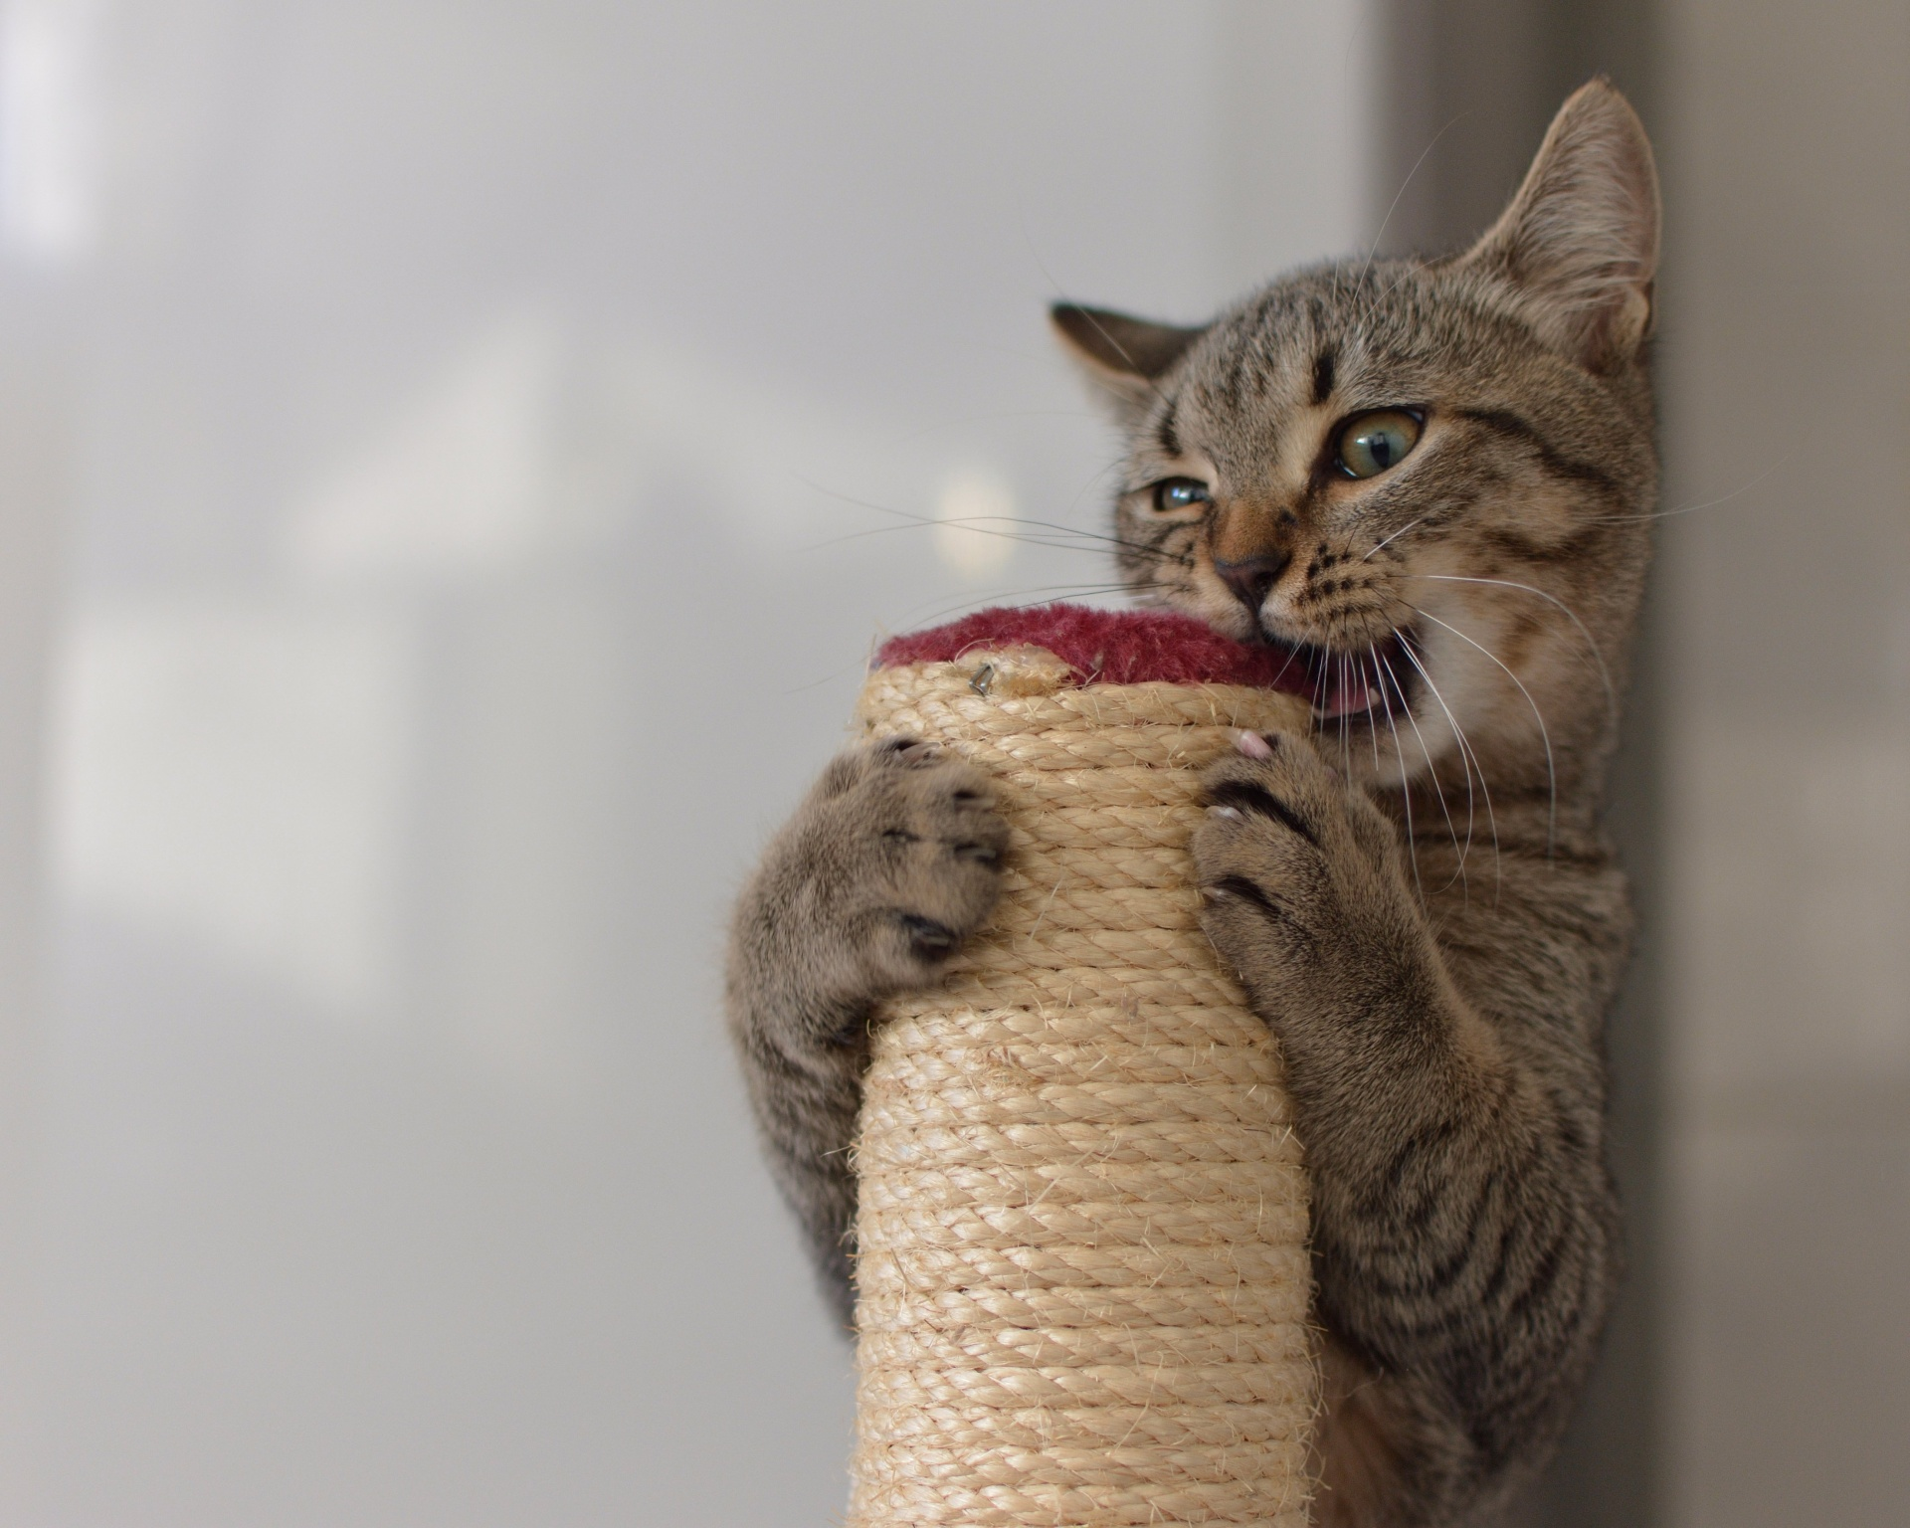
3.2 Training cats
Training cats looks very similar to dogs! However, our cat friends may need some extra time to learn a new trick.
With cats, it is important to use their natural curiosity but respect their space when teaching commands
  We want cats to feel calm and relaxed when learning something new
Providing enrichment activities such as scratch posts, interactive toys like laser pointers, and puzzles for cats can help stimulate their minds to work
This Photo by Unknown Author is licensed under CC BY-NC-ND
This Photo by Unknown Author is licensed under CC BY-SA-NC

Slide 16
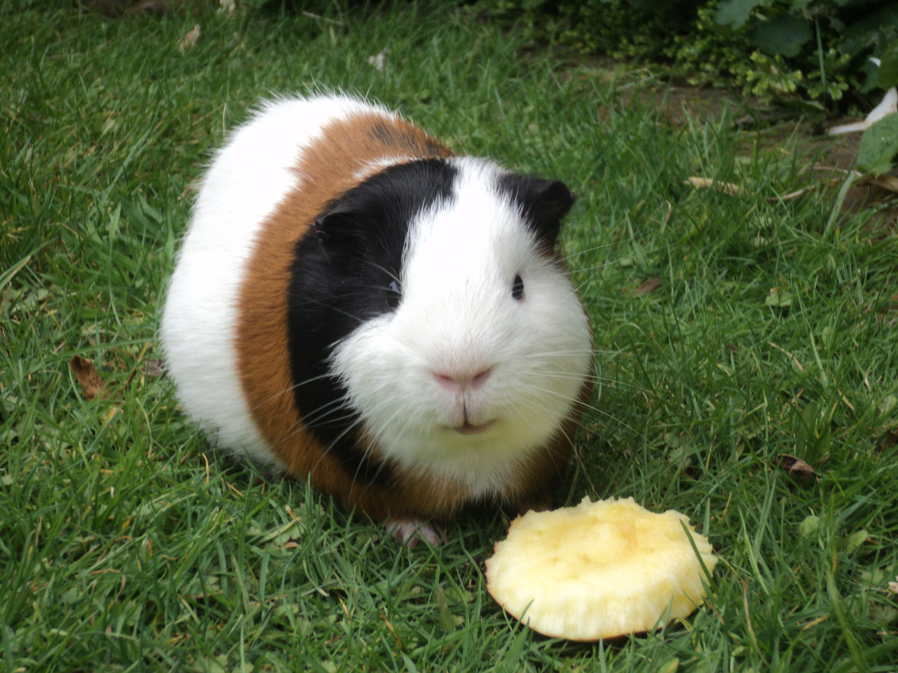
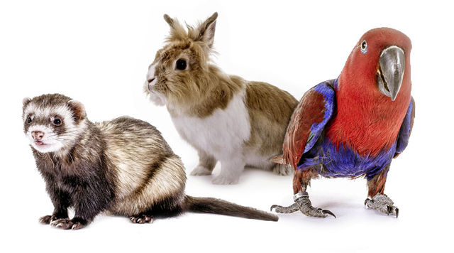
3.3 Other furry (or not so furry) friends
Other pets, such as guinea pigs, hamsters, birds, reptiles, etc. can also be trained to do certain things
Often with these types of pets we need to be calm and move slow, so we don’t induce fear when handling them
But, like dogs and cats, positive reinforcement is the way to go!
Each pet has their own individual likes and dislikes. It’s important to spend time with your pet and learn what they enjoy before forcing interactions with them.
This Photo by Unknown Author is licensed under CC BY-SA

Slide 17
Remember!
We only give the reward after the pet does the task!
Be patient!
Just like you, your pets are always learning and may take some time to figure things out
Keep practicing with your pet
We want to be consistent, so your pet doesn’t forget
STAY SAFE!
We never want to engage with an animal that is showing aggression or look like they may hurt you. Always have adult supervision when training a pet.

Slide 18
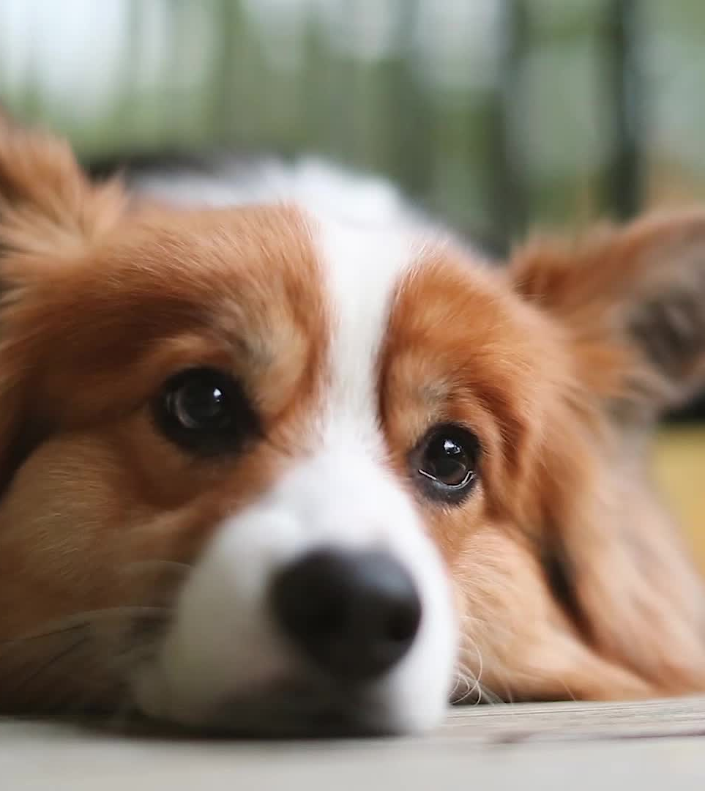
Now, your turn!
Try using the steps provided to teach your own pets at home
Videotape or write down the things you did to teach your pet a command and come back with the results!

Slide 19
For other pet training tips, check out these websites:
Dog training:
  https://www.akc.org/expert-advice/training/12-useful-dog-training-tips/
Clinical behaviour specialists:
  https://vmc.usask.ca/services/clinical-behaviour.php
Cat training:
  https://www.hillspet.ca/en-ca/cat-care/training/can-you-train-a-cat
Exotic pet training:
  https://www.allcrittersvet.com/blog/training-exotic-pets-techniques-for-bonding-and-teaching-basic-commands/
5 tricks to train your dog:
  https://www.youtube.com/watch?v=1FUqREededA

