Slide 1
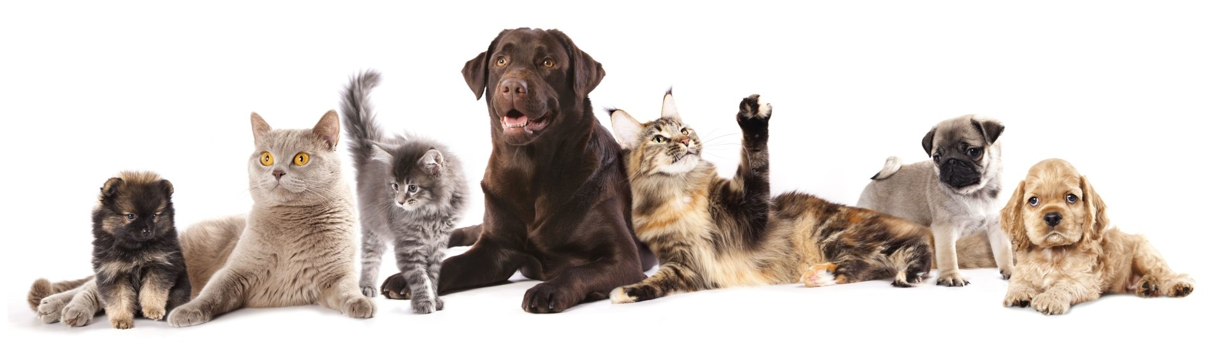

Common Poisons of Dogs and Cats

Slide 2


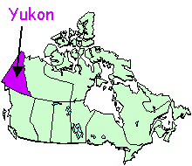
Who am I?
Notes:
My name is Madison Logan. I grew up in northern Canada in Whitehorse, Yukon.

Slide 3
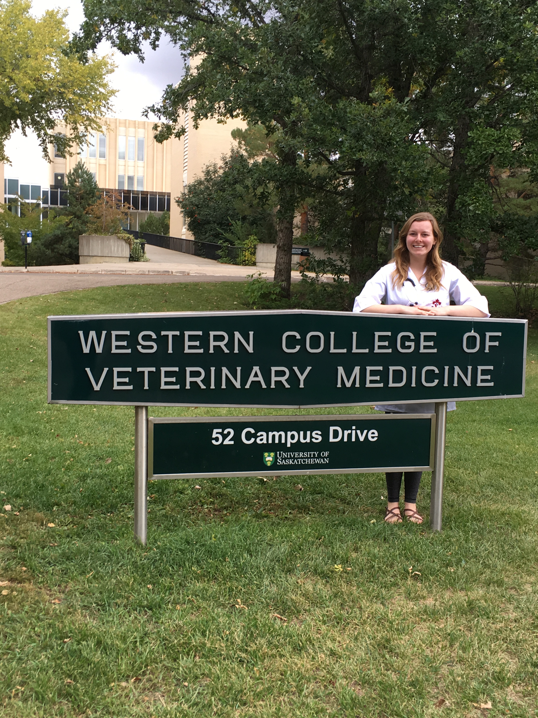
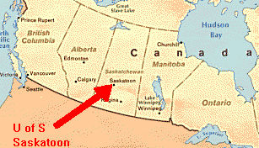
Where I go to school
Saskatoon, Saskatchewan
Notes:
. I am a fourth year veterinary student going to school in Saskatoon at the Western College of Veterinary Medicine.

Slide 4
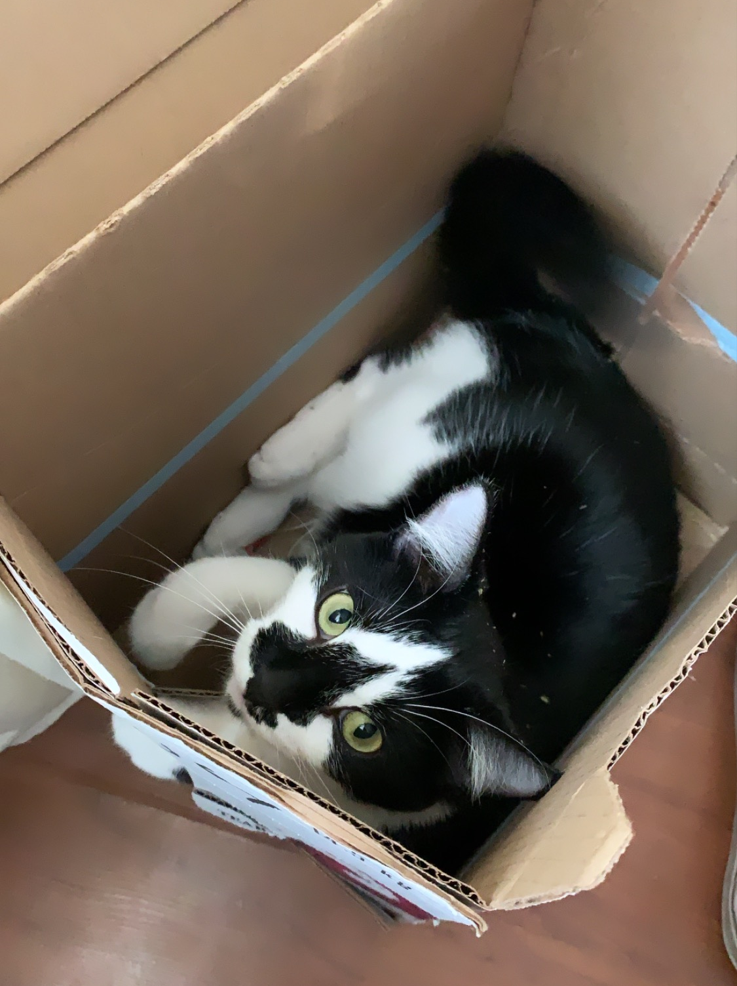
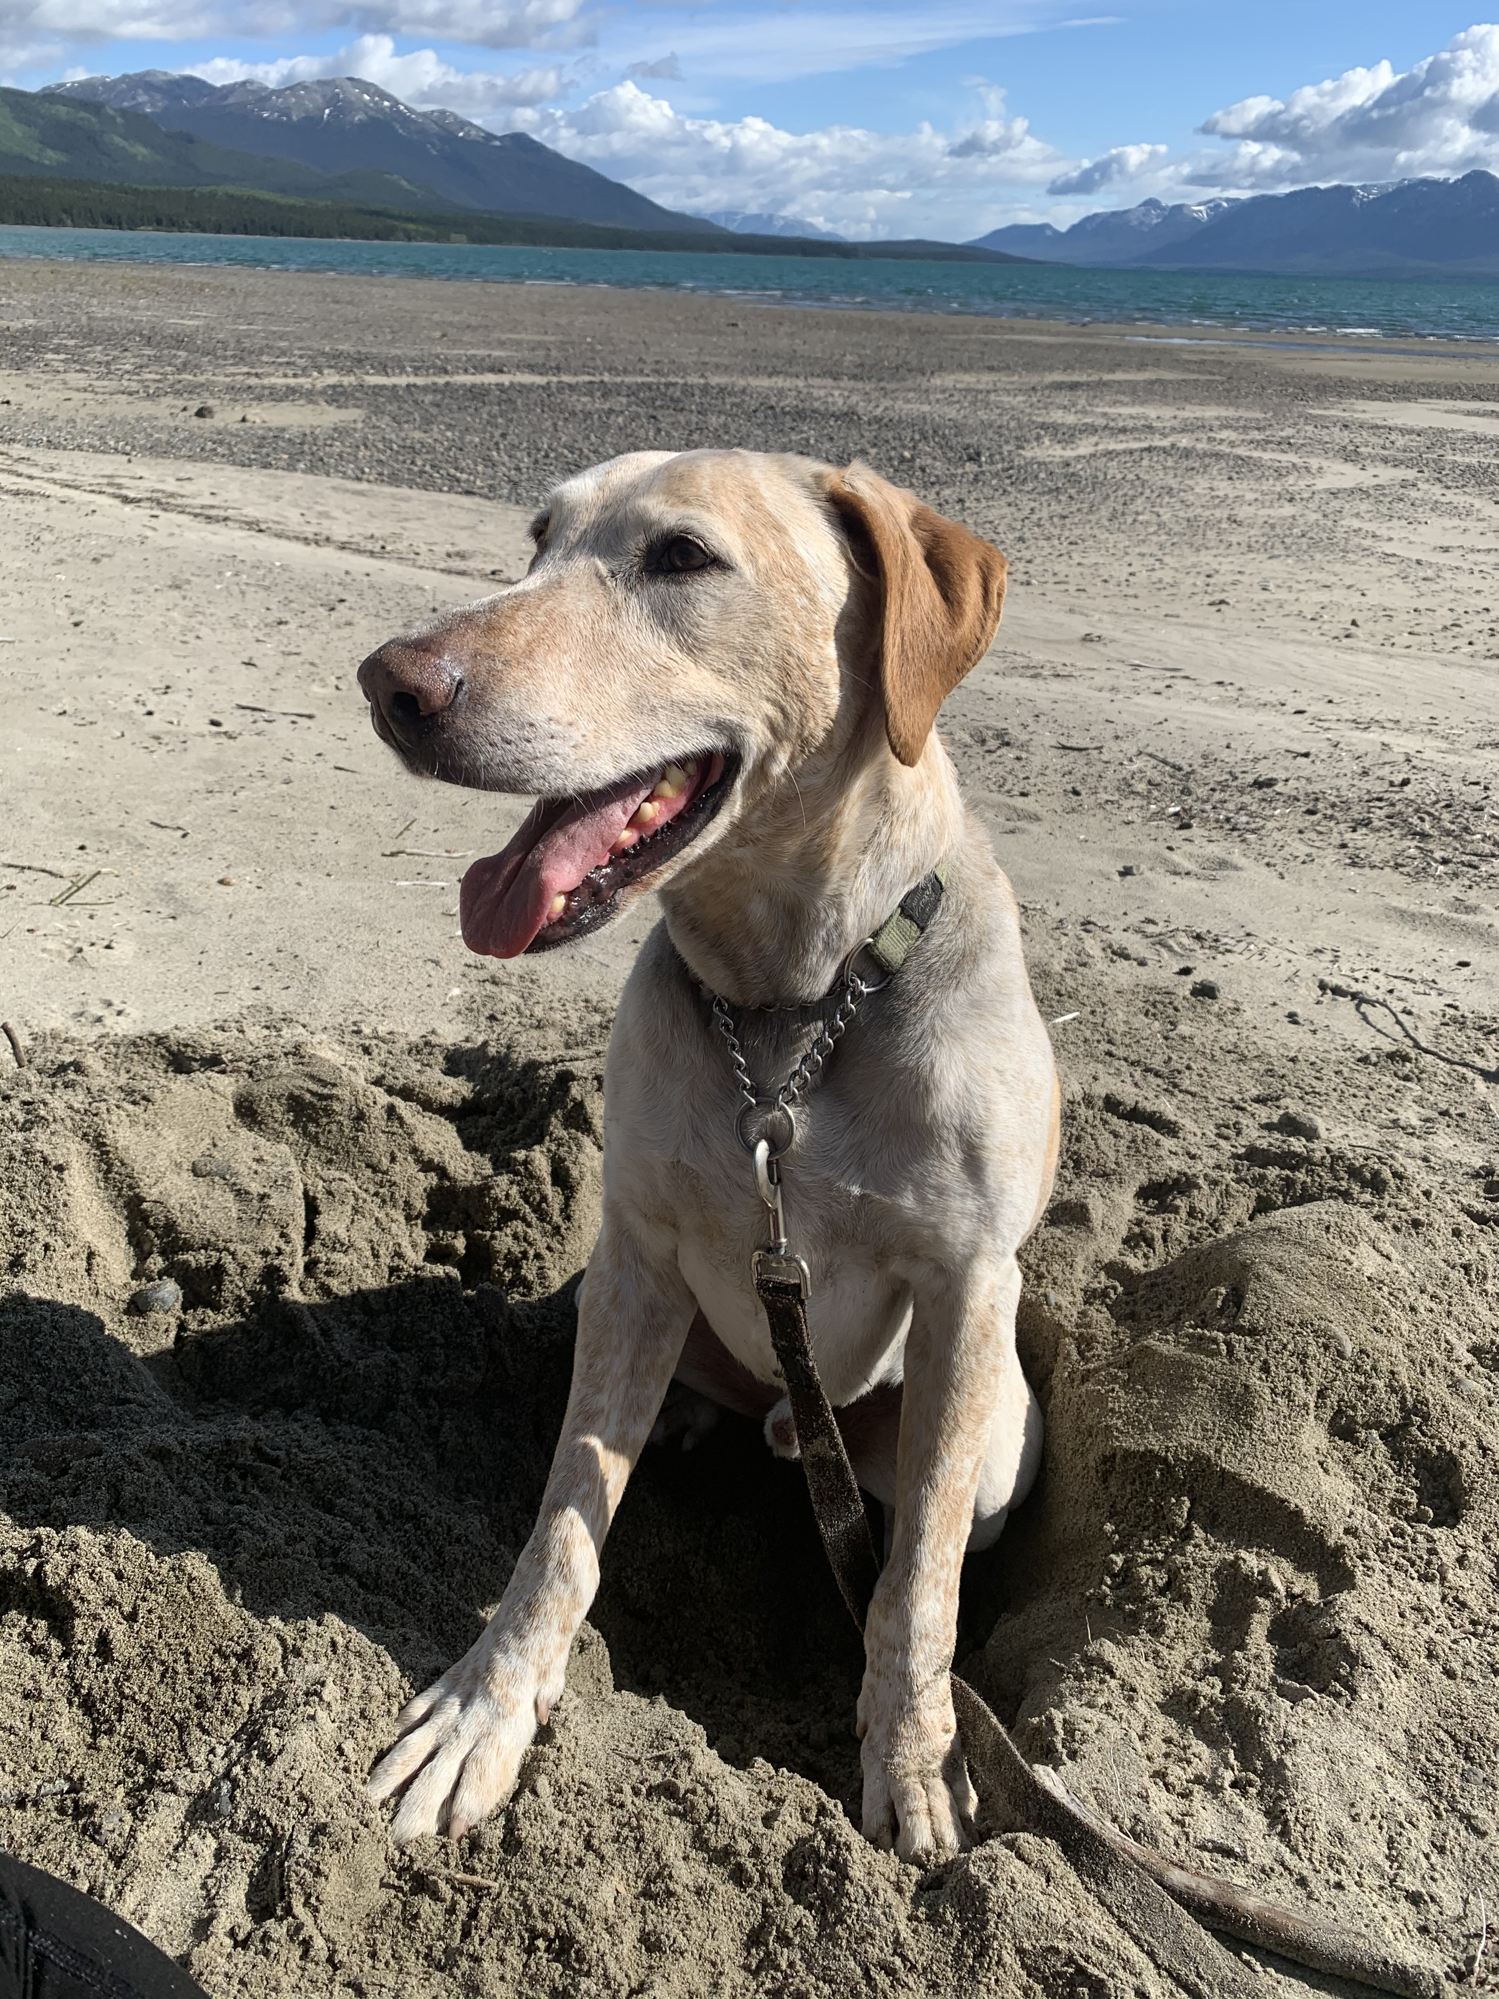
My Pets
Bess
Lono
Notes:
I have 2 pets – 1 cat named bess, and 1 dog named Lono.

Slide 5
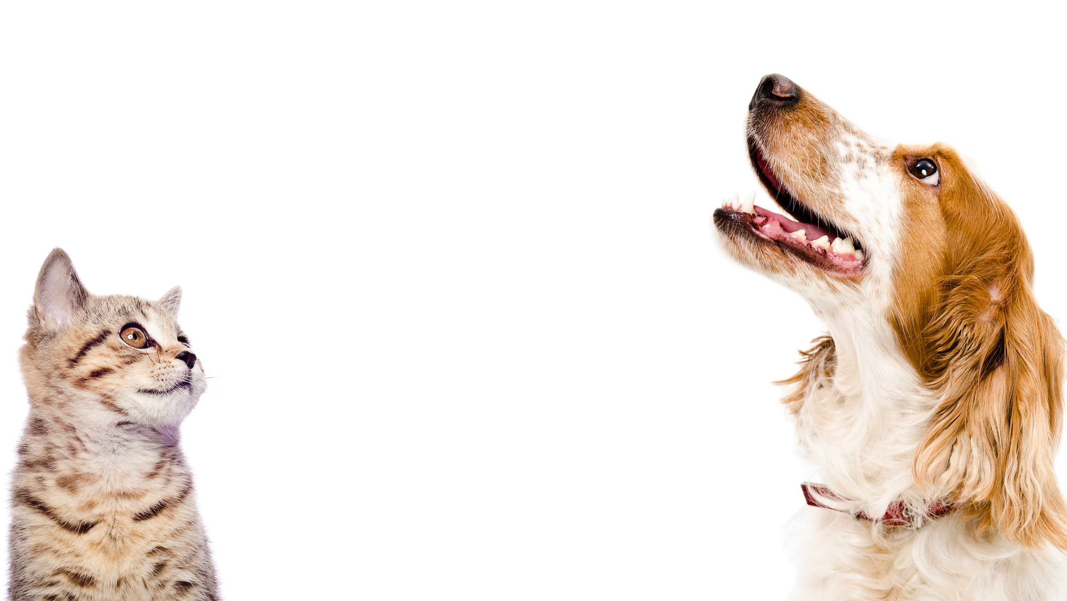
Common things in our houses that can be dangerous or poisonous to cats and dogs
Notes:
oday we are going to be talking about common things that are poisonous to animals
These are things that some of us already have in our houses
It is important to know what poisonous items we have in our houses that can make animals sick
By knowing these poisons, we can keep our pets safe

Slide 6
Words to know
Poisonous = is word used to describe a substance that causes harm when it enters the body or touches the skin
Toxin = is a naturally occurring poison that causes damage to body systems and can be life-threatening even in small amounts. Toxin is another word used for poison.
What things do you think about when you hear the word Poison?
Notes:
Before we start, let’s go over some vocabulary together.
“Poisonous” = is word used to describe a substance that causes harm when it enters the body or touches the skin
“Toxin” = is a naturally occurring poison that causes damage to body systems and can be life-threatening even in small amounts. Toxin is another word used for poison.
What things do you think of when you hear the word “poisonous”? -snakes, plants, mushrooms, bugs, household cleaners

Slide 7
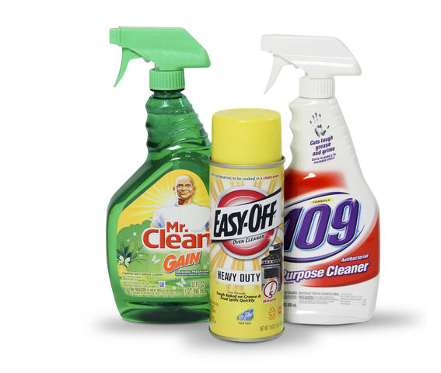
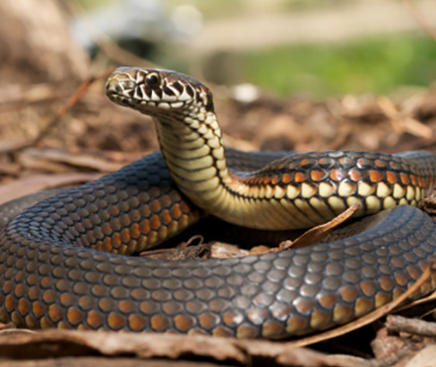

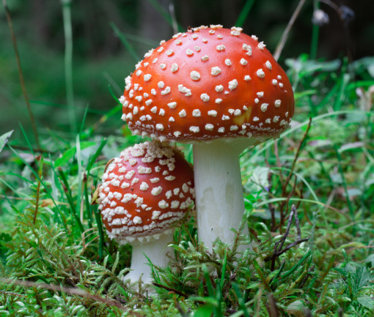
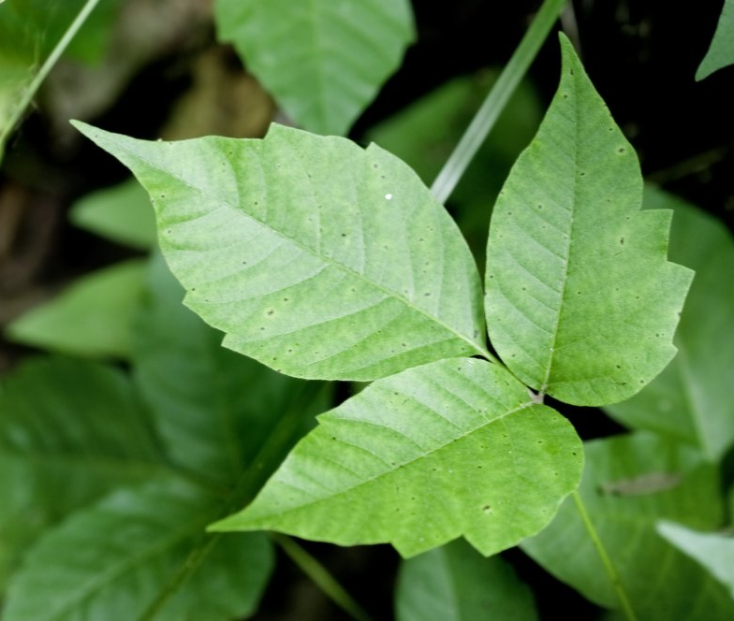

Slide 8

Toxicology = is an area of science and veterinary medicine that studies the effects and detection of poisons in animals
Notes:
“Toxicology” = is an area of science and veterinary medicine that studies the effects and detection of poisons in animals
Now let’s talk about some of the most common poisons of dogs and cats – try to think as we go along if you have any of these items in your home.

Slide 9
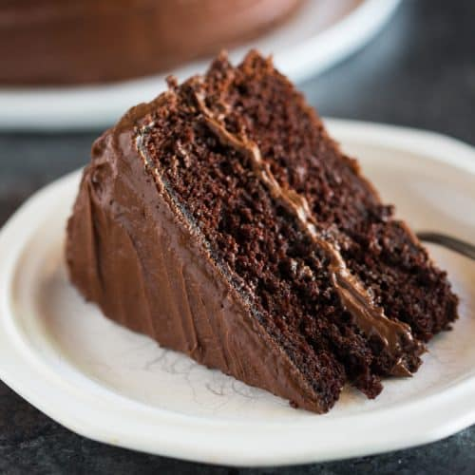

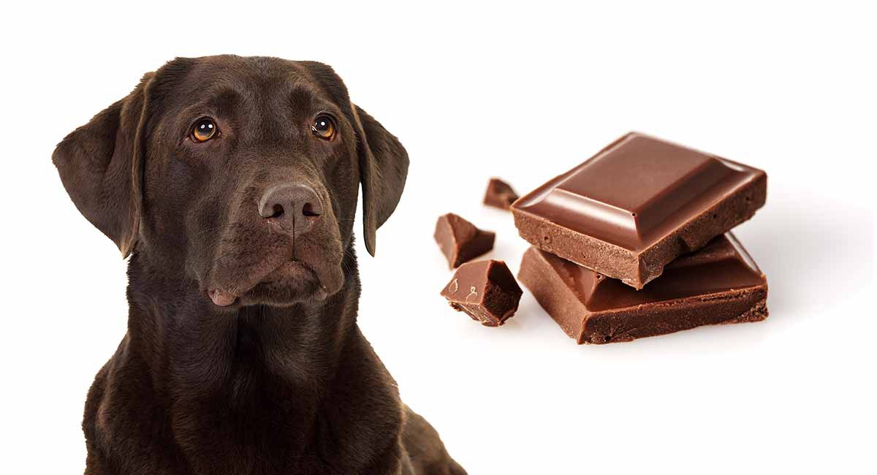

Chocolate
Common toxin
Notes:
Chocolate is a common poison to dogs – some of you may have heard of this one being dangerous for dogs before
though chocolate is safe for humans to eat., it can make dogs very sick

Slide 10
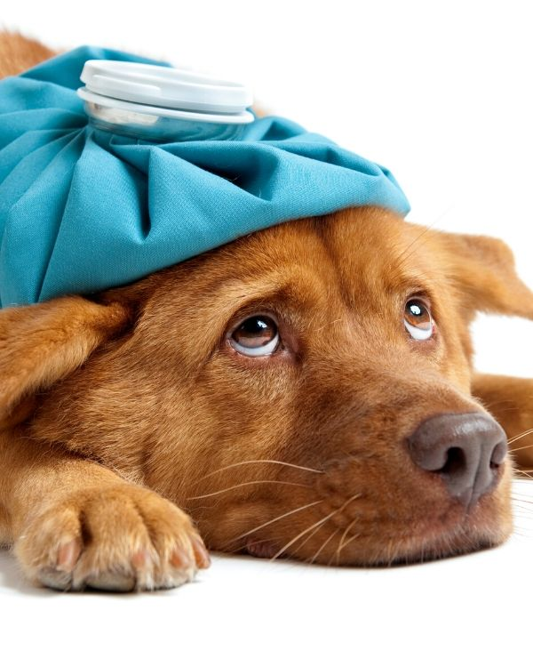

Chocolate
Upset stomach
Changes heart rate
Notes:
There is a chemical in chocolate that dogs’ bodies cannot process and this can cause upset stomach and changes in heart beat and heart rhythm
Chocolate poisoning is seen more commonly around certain holidays – what holidays do you think these are?

Slide 11
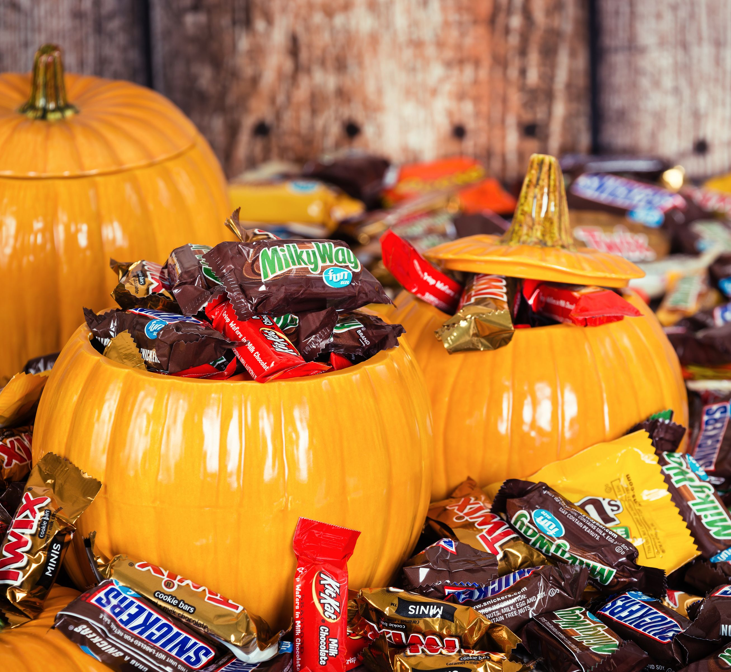
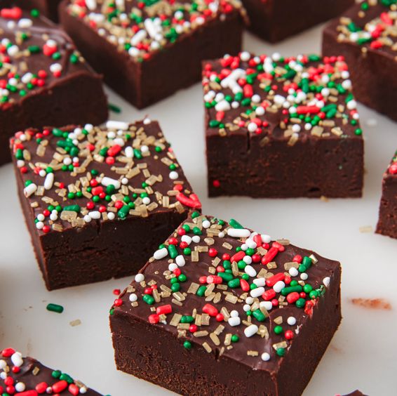

Holiday Chocolates
Notes:
Christmas, Halloween, Valentine’s day
These are holidays known for giving and receiving lots of chocolate –so dogs get sick more commonly around these times of year from eating chocolate

Slide 12
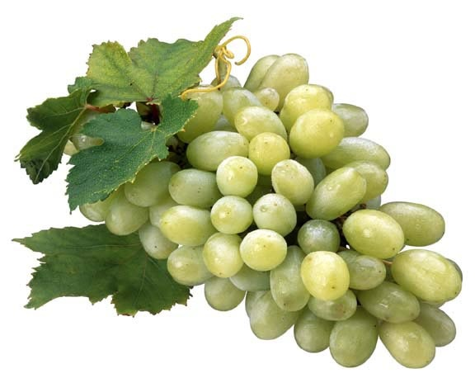
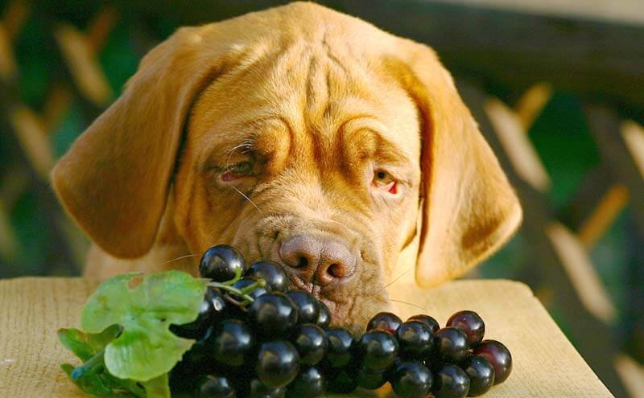
Grapes
Toxic to dogs
If grapes are toxic to dogs what other food could be toxic?
Notes:
grapes are a less common known toxin for dogs
I didn’t know about grapes being toxic to dogs until I started university
The exact toxin in grapes is unknown
Grapes can cause damage to internal organs, making dogs very sick
Some dogs are more sensitive than others. You could give one dog 100 grapes and it might not get sick BUT you could give another dog 1 grape and he/she could be very sick.
It is hard to know what number of grapes is poisonous so it is better to avoid feeding any grapes to all dogs
My question for you: If grapes are poisonous to dogs what other food very similar to grapes do you think would also be poisonous?

Slide 13
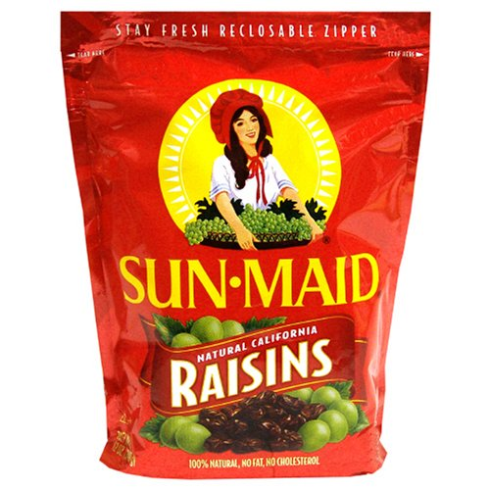
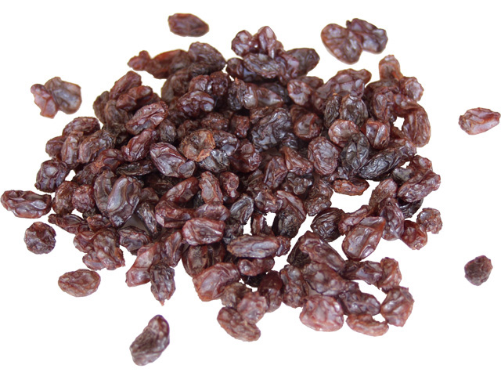
Raisins!
Dehydrated grapes
Notes:
Raisins! Raisins are dried up grapes and they are still poisonous to dogs

Slide 14
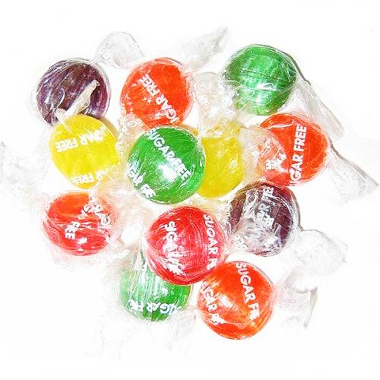
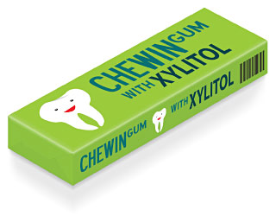
Sugar free candies
Notes:
Sugar free candies
Sugar free candy and gum contain a chemical called “Xylitol” which is a substitute for sugar because it tastes sweet
In dogs, it causes their blood sugar to drop very low making them very ill
It also causes damage to the liver
The dog may be puking or shaking if they become sick from this type of poisoning
It is always a good idea to keep candy and gum in a safe place where dogs cannot reach it

Slide 15
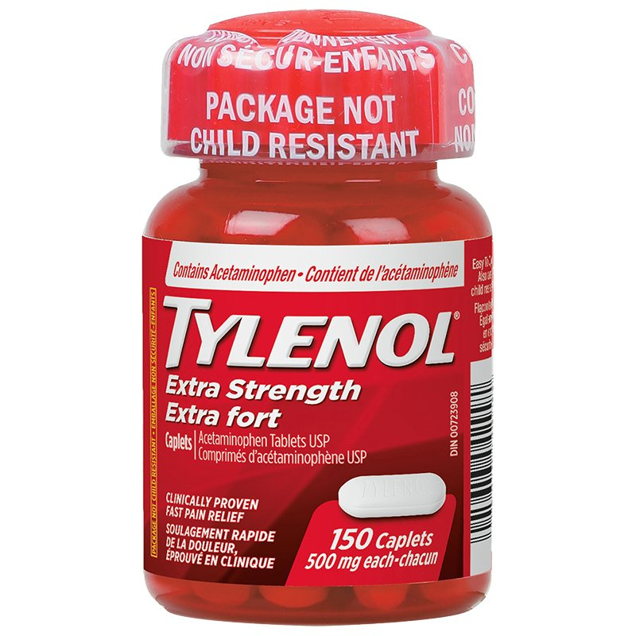
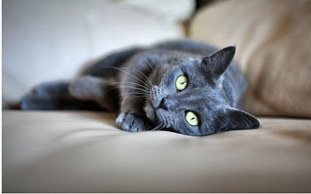
Tylenol
Poisonous to cats
Notes:
Tylenol
Human medicines, such as Tylenol, can be harmful to animals.
Tylenol is not processed in animal’s bodies the same way it is by human bodies

Slide 16
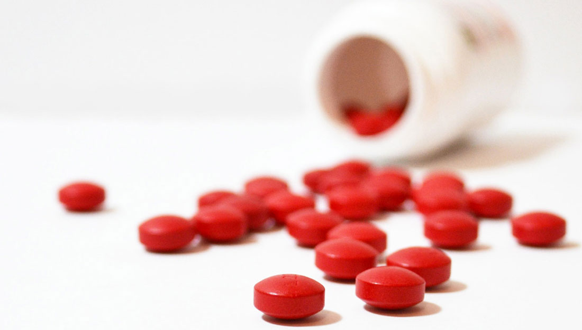
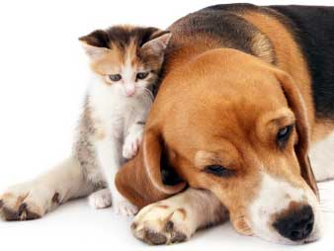
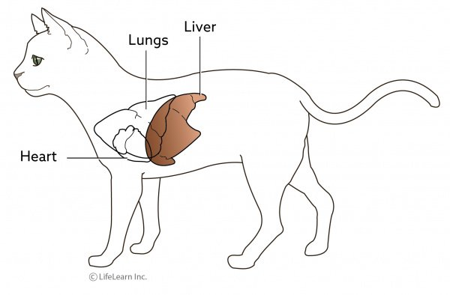
Tylenol
Damage to the liver
Notes:
Tylenol can cause liver damage in cats and sometimes dogs too
When a dog or cat is sick, it is important to give them medicine that is made for animals and not human medicine

Slide 17
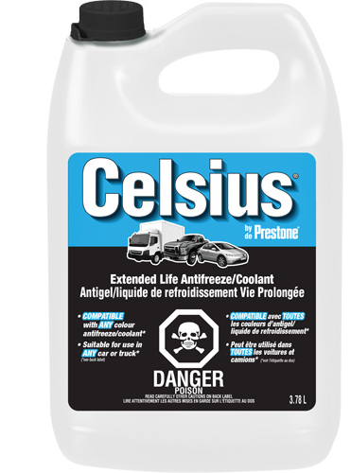
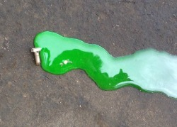
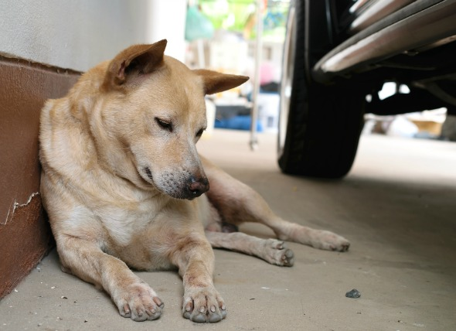
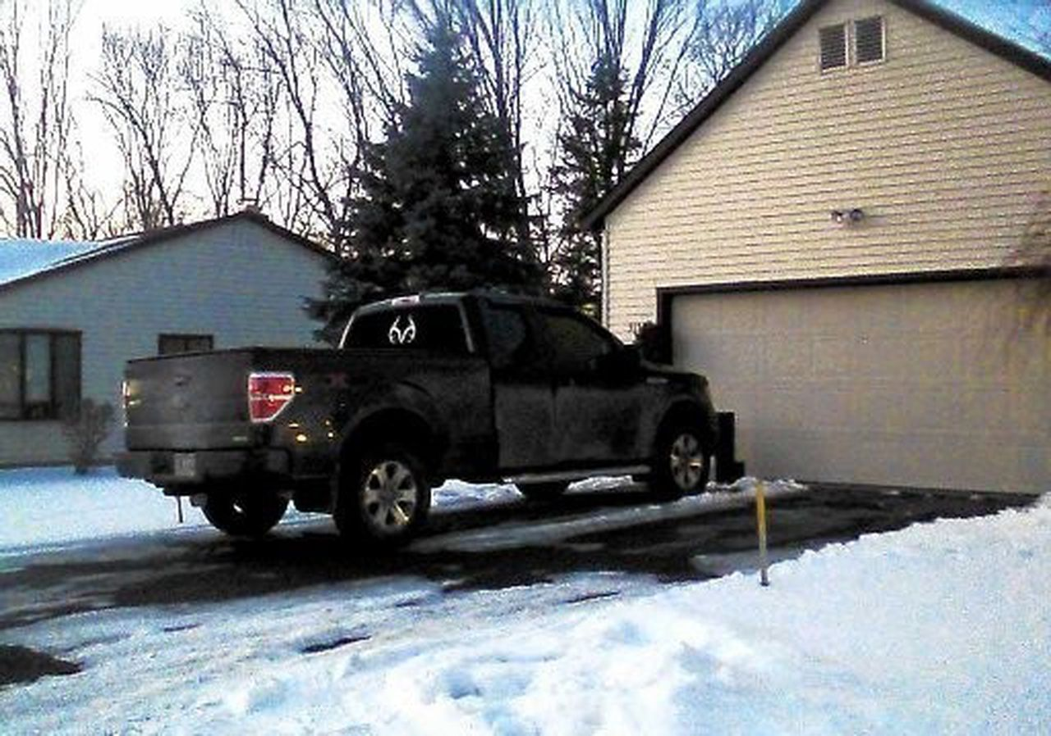
Antifreeze
Notes:
Antifreeze is a chemical used in cars and other machinery, especially during wintertime
Antifreeze can be found in garages, shops and even driveways underneath vehicles

Slide 18
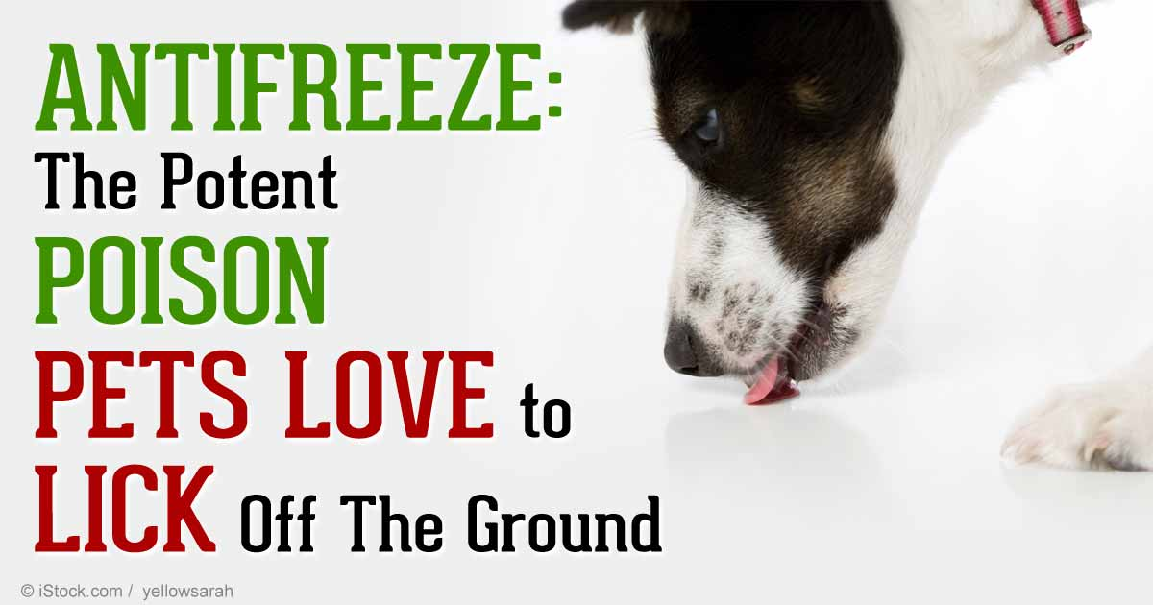
Notes:
Antifreeze tastes sweet to dogs and cats, which is why it is a common poison as they like the taste of it
The toxic chemical in antifreeze causes kidney failure
It is always a good idea to tell an adult if you see a chemical spill in a garage or under a vehicle

Slide 19
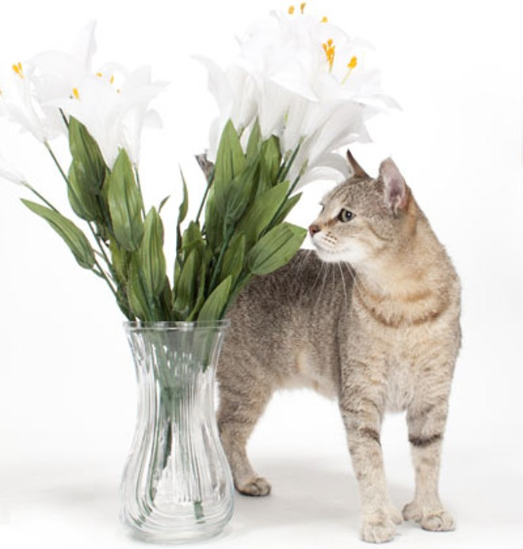

Some Plants
Lilies
Notes:
Toxic plants
Certain household plants can be toxic to cats and dogs if they eat them
Lilies are toxic to both dogs and cats. Lilies are commonly displayed in houses in the springtime. Lilies can cause damage to the kidneys if eaten by cats. It is best to avoid so buying these flowers if you own pets in your home.

Slide 20
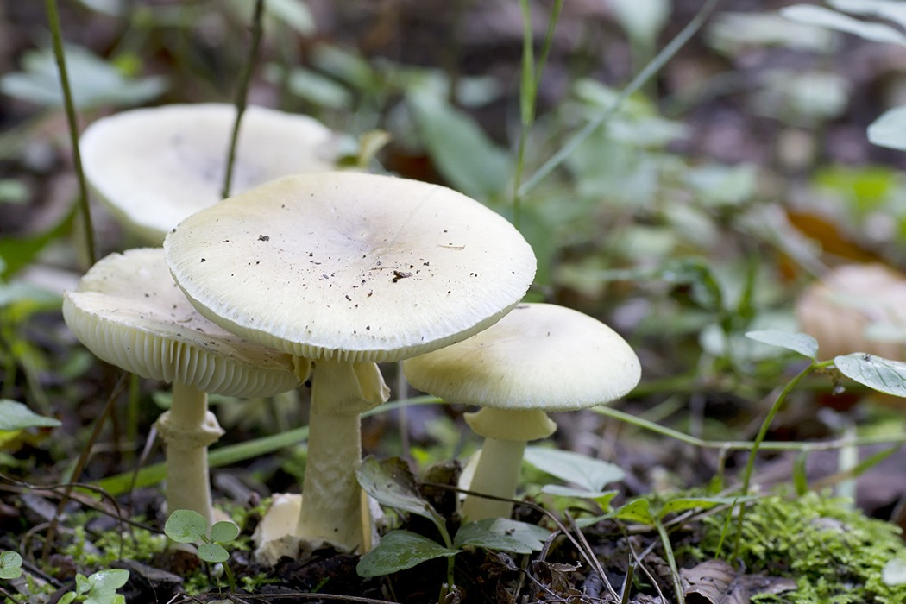
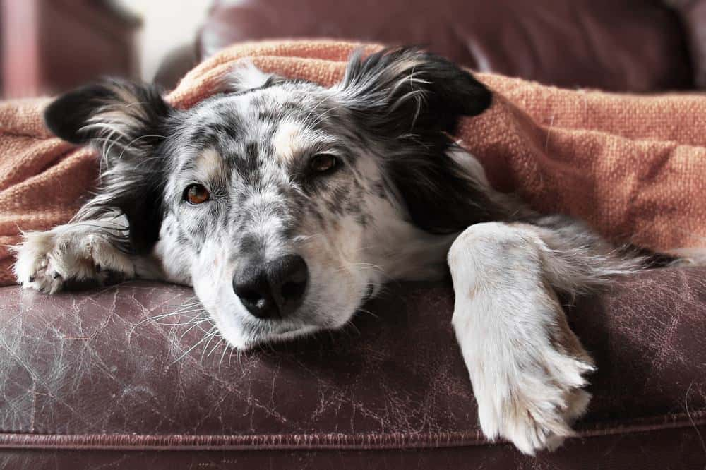
Mushrooms
Can be dangerous for animals and people
Notes:
Mushrooms
Mushrooms are common to see in the forests of Canada
Some mushrooms are safe to eat but others can be poisonous to dogs, cats and even humans
It is important to keep pets from eating mushrooms they find in the woods
Mushroom poisoning can cause different signs depending on the type of mushroom eaten. Some signs of mushroom poisoning can be an upset stomach and shaking

Slide 21
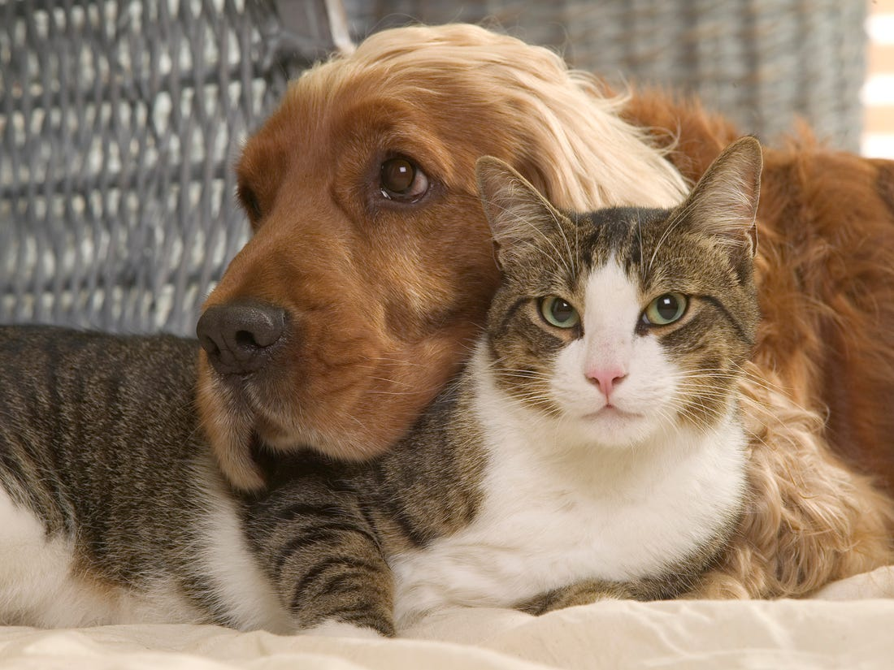
How to keep pets safe?
Keep toxins in a secure safe place that the pet cannot get into
Keep pet food and water available to the animal
Tell your friends and family about common poisons so they do not accidentally feed a pet these
Notes:
How to keep pets safe from common poisons?
Keep food and items that are toxic in a secure safe place that the pet cannot get into
Keep pet food and water available to the animal so that they don’t eat things that they shouldn’t
Tell your friends and family about common poisons so they do not accidentally feed a pet these

Slide 22
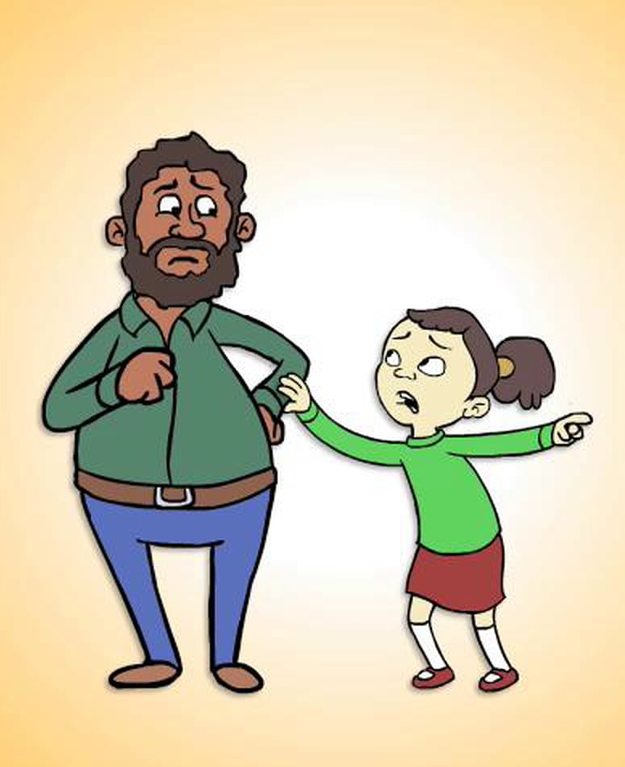
What to do if I think my pet has eaten something poisonous?
Tell an adult right away
With an adult, call a veterinary clinic or Pet Poison Helpline to learn how to help the animal if they are sick or could be sick
Notes:
What to do if I think my pet has eaten something poisonous?
Tell an adult right away
With an adult, call a veterinary clinic or Pet Poison Helpline to know how to help the animal if they are sick or could be sick

Slide 23
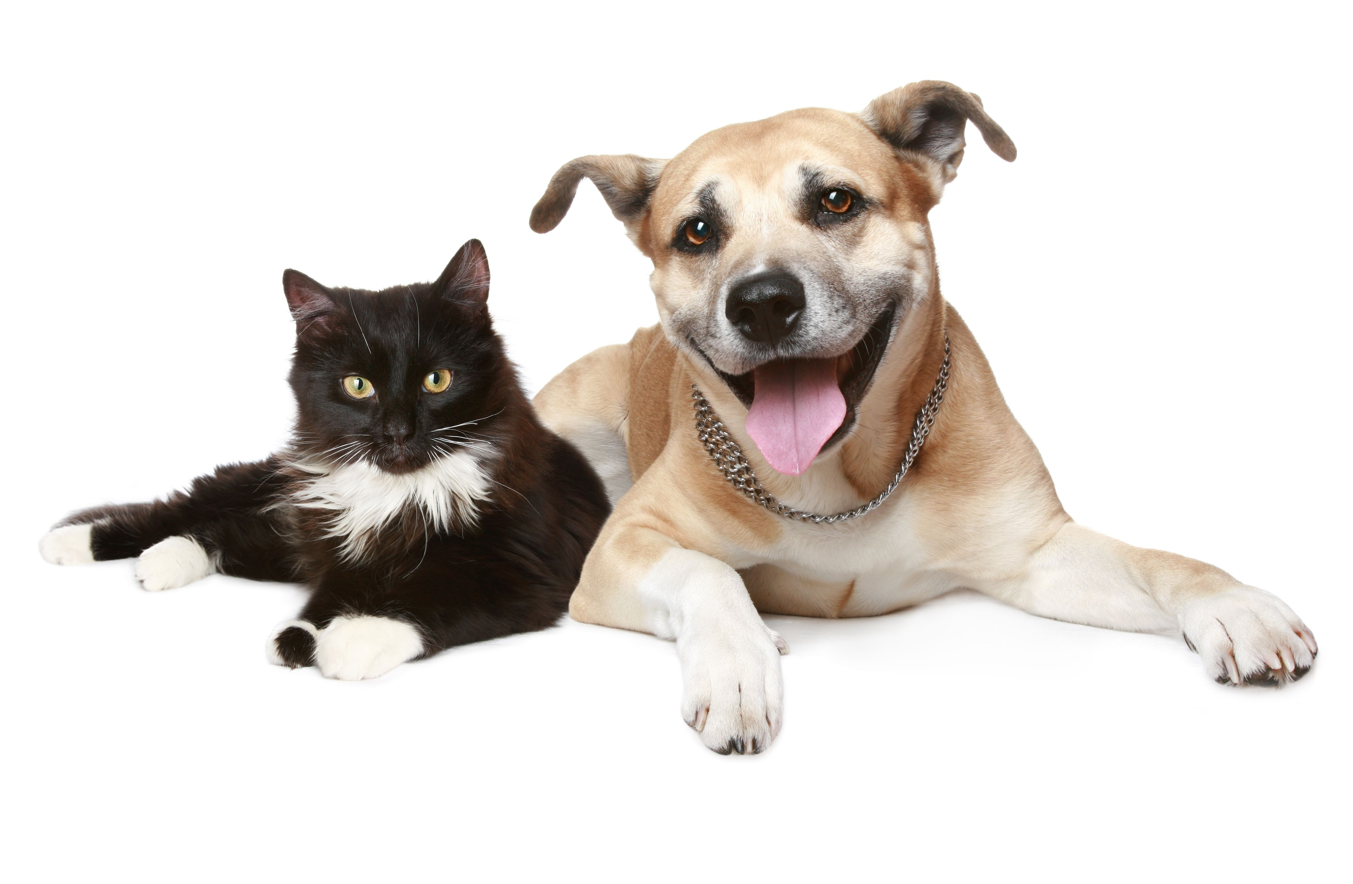
Thank you for listening

