Slide 1
Rabies: Explained
What it is, why it matters, and how to prevent it
Notes:
Created by Hannah Sorenson, WCVM 2023
[TEACHER-SPECIFIC COMMENTS IN PRESENTER NOTES]
This slide set and the accompanying take-home assignment is meant to supplement learning outcome USC6.3 in the Saskatchewan Curriculum for Grade 6 students. The PowerPoint is meant to be an interactive presentation delivered by the teacher in-class, and the take-home assignment is designed for students to review and solidify what was discussed in class, as well as provide the opportunity to discuss the idea with family members.
Questions to ask class are highlighted in purple. These are meant to try and engage the class and allow them to think critically about the disease and its potential effects on their lives.
USC6.3: Demonstrate an understanding of how non-curable infections, including HIV and Hepatitis C infection, are transmitted and how these infections influence the health (i.e., physical, mental, emotional,
spiritual) and the identities of self, family, and community.

Slide 2

Group Discussion:
What do you know about rabies?
Notes:
Take 2-3 minutes to establish a baseline of knowledge on what the students know about rabies. Have they heard any stories or cautionary tales from a friend or family member? Can they tell you what a rabid animal would look like, or what behaviors they would be showing? There are no wrong answers at this point in the lesson, students should be encouraged to share their ideas and ask questions.

Slide 3
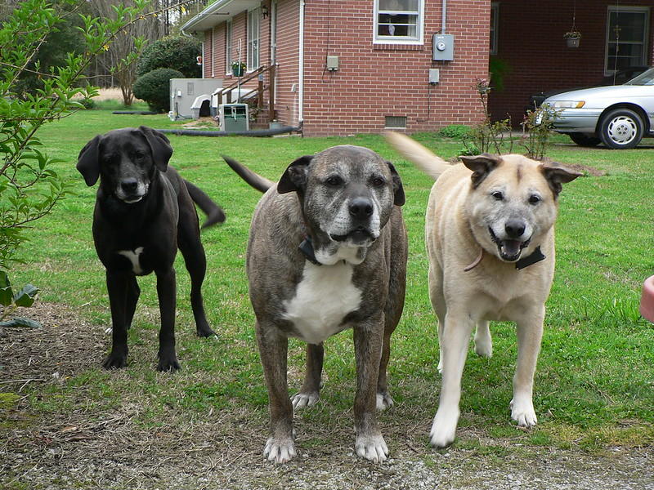
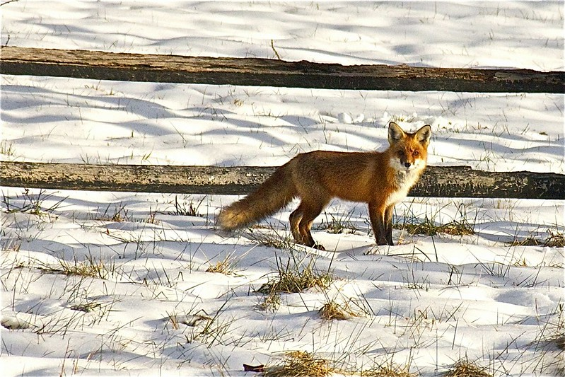
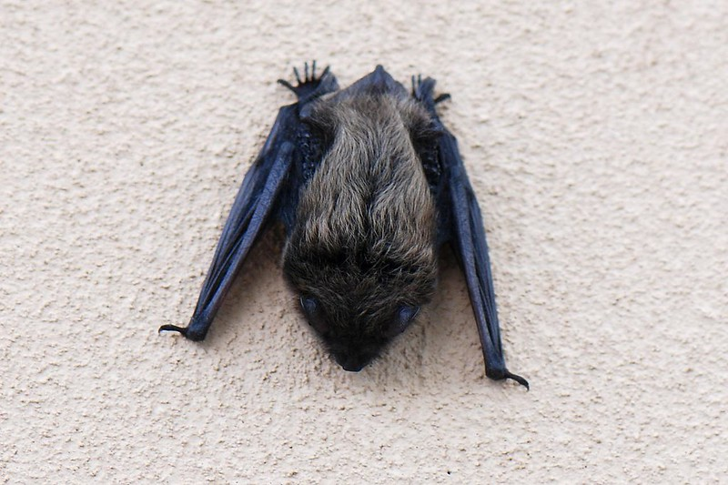
Who does it affect?
What is it?
Fatal disease caused by a virus.
HUMANS
Dogs
Cats
Other wild animals:
  foxes, skunks, bats
Notes:
Fatal = always causes death once infection sets in.
Highlight to students that many wild animals who could carry and transmit rabies to dogs or humans are found in local community. These animals could either bite you directly, or bite a stray dog (who could then go on to bite you), or even your pet dog.
Both humans and animals can die from a rabies infection.

Slide 4
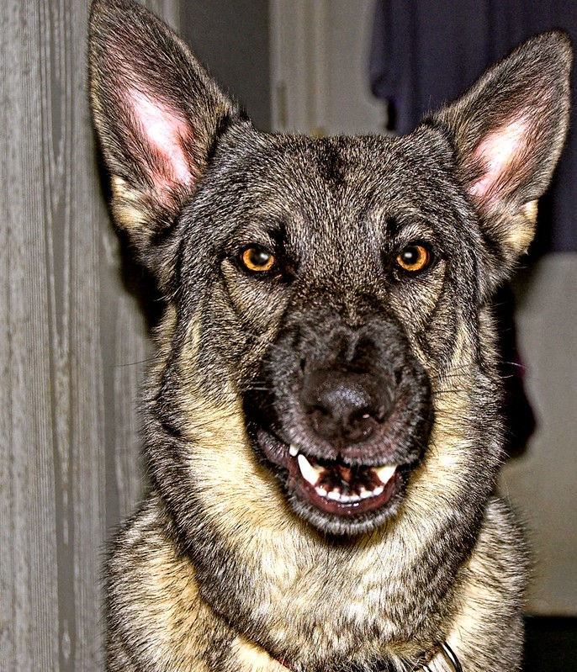
How is it transmitted?
Bites
  Virus lives inside saliva of infected animal
  Bite → saliva can penetrate through skin into tissue of bitten animal
Notes:
A rabid animal will carry the rabies virus itself within its saliva. That way, when the animal bites somebody else, the saliva carrying the virus can reach a new host (either an animal or a human). The saliva on the teeth that are biting enters through the skin and into the muscle of the newly infected animal. This virus then starts traveling through the body of the new host.
But, what tissues does it use to travel along? …

Slide 5

What does it do once it enters the body?
Travels along the peripheral nerves, to the spinal cord, to the brain
  Car on a highway
Takes time (days-weeks) to reach final destination in the brain.
  Lag period between infection and symptoms!!
  What is the significance of this?
Bite closer to brain = less time before fatal effects.
Notes:
Remember: peripheral nerves are the structures that allow us to feel sensations, such as tickling/sharp pokes/pets. They also help signal our muscles to move our bodies. They are found all over our bodies, since we have the ability to feel sensations and move all over, from feeling a hair being plucked from your head, to being able to wiggle your toes.
As such, no matter where a rabid animal bites you, chances are you will have a peripheral nerve nearby. The rabies virus uses these nerves like a “highway” to drive along, until these nerves reach your spinal cord in the centre of your back. Then, from your spinal cord, rabies moves all the way up into your brain, where it causes changes to the way your brain thinks, behaves, and reacts.
An important thing to note about rabies is, like a long road trip from Ile-A-La-Crosse to Saskatoon, it takes awhile to travel the highway and reach your destination. This is the same when the rabies virus is driving along your nerve “highways”. This means that after a bite from a rabid animal, it might take days or even weeks for the infection to reach the brain and make the infected animal start behaving like a typical rabid animal.
Answer: an animal that may not ”look”/appear to be infected with rabies could actually have the virus and transmit it. Cannot rely on an animal ”fitting the role” of rabid animal, need to be cautious if an animal bites you no matter what!
Lastly, a bite that is located closer to the spine or brain will have a shorter highway to travel, and so it will take less time to set up shop in the brain and cause symptoms, and eventually death. For example, an animal who is bitten on the neck will have a shorter time period until it becomes infected, compared to an animal who is bitten on its hip or paw.

Slide 6
Symptoms seen in a rabid animal or human
Behavioral changes
  More aggressive
  Wild animals/prey species may be less fearful of humans
Voice change
Frothing at the mouth
Eventually: seizures/paralysis
Always fatal if left untreated!!!
REMEMBER: you may not see these symptoms right away!

Slide 7
What to do if you get bitten by an animal you suspect has rabies?
GO TO HOSPITAL IMMEDIATELY, and inform healthcare workers you have been bitten
You will receive 4 rabies vaccines over a period of two weeks
Humans who work with animals for a living (veterinarians, zookeepers, laboratory researchers) are often required to get rabies vaccine even before they start working with animals
  Why do you think this is?
Notes:
Rabies vaccines are similar to the shots you all got in class last year. A small needle is placed into the arm and the vaccine is deposited.
Answer: humans in careers involving animals are at a greater risk of exposure to rabies, by nature of being exposed to more animals. If a vaccinated human gets bitten by a rabid animal, they will still need to get post-exposure care at the hospital, but are more likely to already be mounting an immune response, and less shots will be required for these workers.

Slide 8
What will happen to the animal that bites me?
GO TO VETERINARIAN and tell vet that the animal has bitten someone!
If animal has been vaccinated/appears healthy:
  Isolate from humans for 10 days → why?
If unvaccinated animal or showing symptoms of rabies:
  Euthanize – brain will be tested for presence of rabies.
Notes:
Answer: Just because the animal looks healthy, does not mean that it is healthy! Because of the disease’s long incubation period, an animal may have rabies and not be showing signs yet. The quarantine period is meant to monitor for the development of symptoms of rabies in the dog who has bitten someone.

Slide 9
Prevention for animals
Avoid bites from wild animals or other dogs
  Fencing to enclose animals
  Leash-led walks
VACCINATION
  1st vaccine at 12 weeks old, then at 1 year, then every 3 years
  If older than 12 weeks old: 1st vaccine ASAP, then 1 year after 1st vaccine, then every 3 years

Slide 10
Homework!
Notes:
Homework: complete the rabies review and reflection sheet attached to the slide set. Encourage students to have parents and/or other family members help them think about their personal risk of rabies contact, and come up with some steps to decrease that risk (if any is present).

