Slide 1
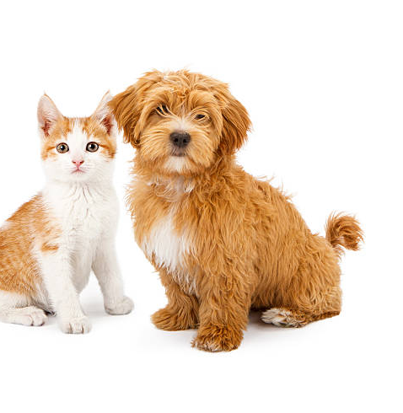
Identifying healthy habits in humans and animals
Health 1
Notes:
y

Slide 2
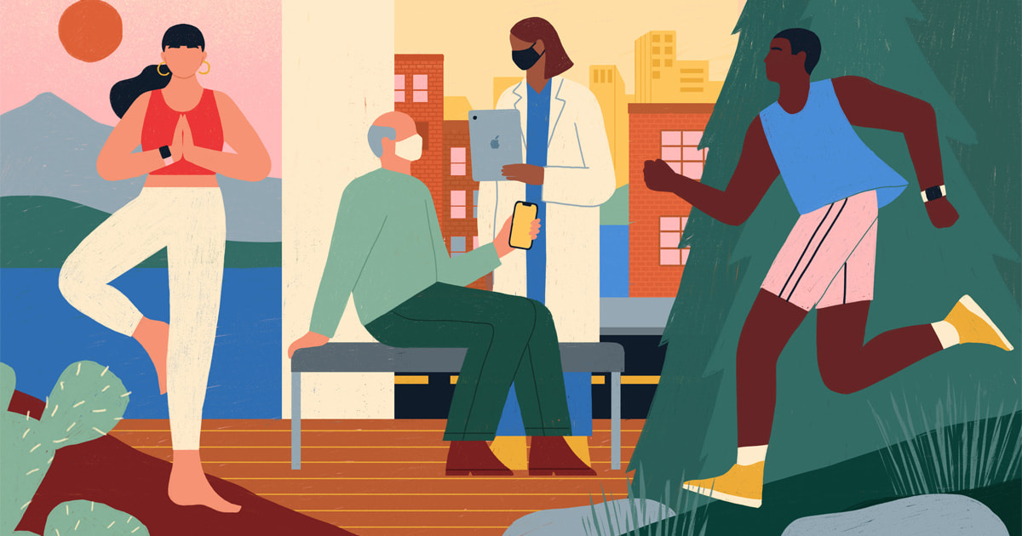
What does health mean to you?
How do you stay healthy?
Notes:
y

Slide 3
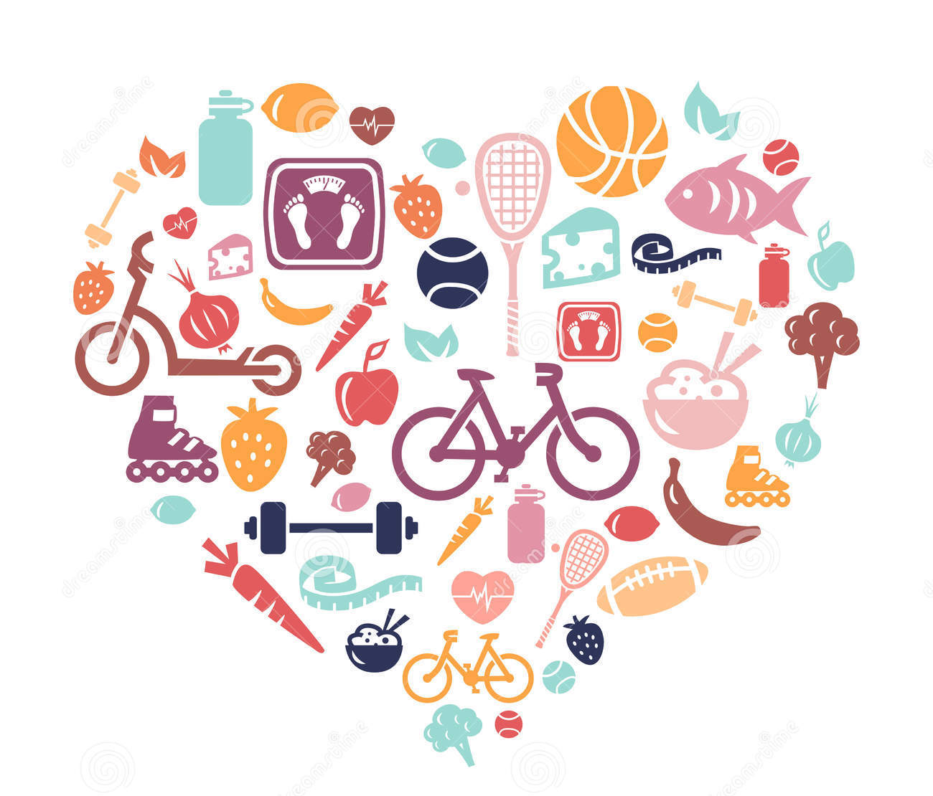
Health is more than not being sick, and there are many ways to live a healthy life!
“physical, mental, social well-being”
not only ‘not sick’
means different things to all of us
changes over time
Notes:
-defined differently by many organizations

Slide 4
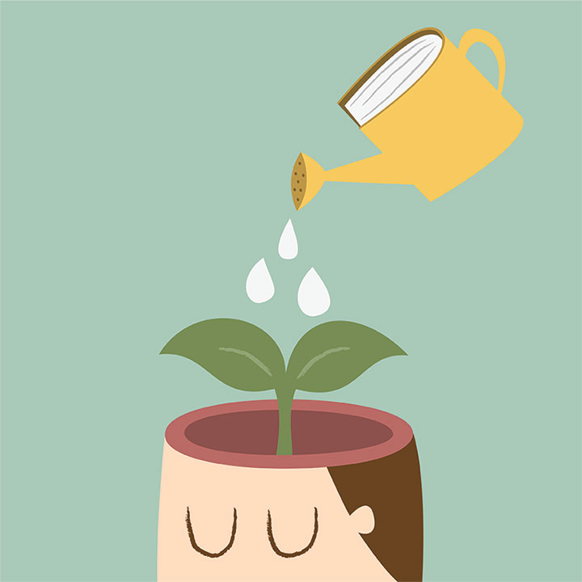
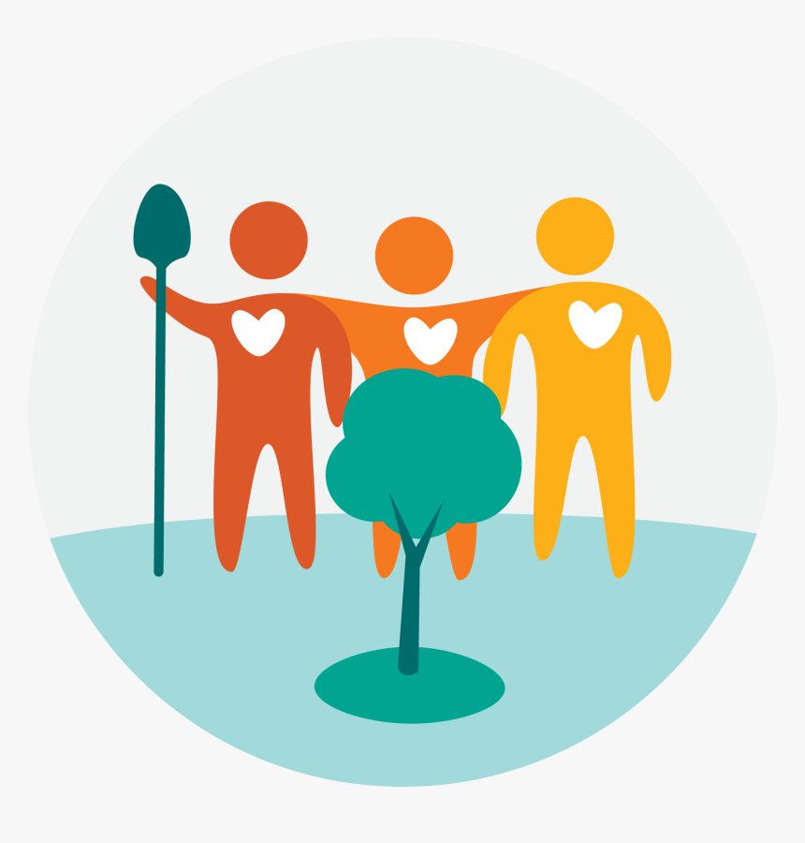
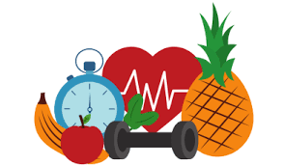
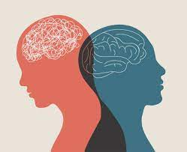
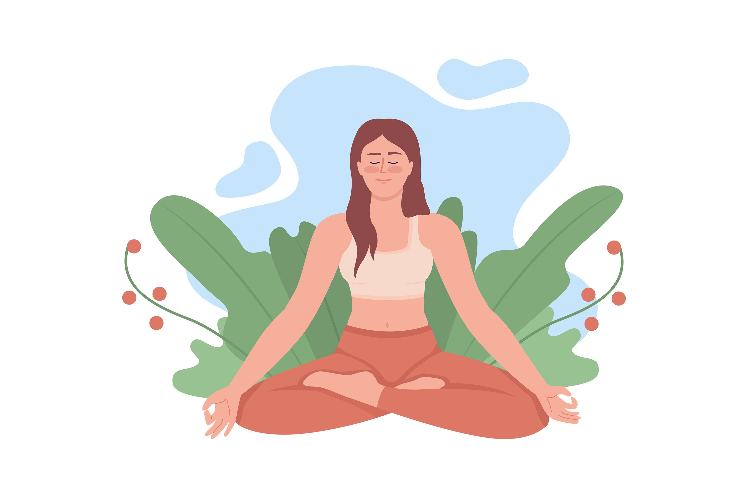

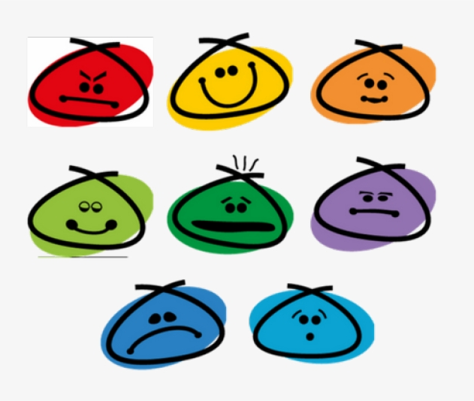
Health
Physical health
Intellectual health
Mental health
Community / Social health
Environmental health
Emotional health
Spiritual health

Slide 5

What does health look like?
Notes:
How can you tell if a person is healthy by looking at them?
Full range of emotional expression
Able to do physical activities consistent with their body’s unique abilities (some people can’t use their legs, but that doesn’t mean they aren’t healthy)
Enjoys positive relationships with multiple different people (friends, family, teachers, etc)
Can do all the things expected of a person their age and mental/physical ability; has enough energy to perform these tasks
Has access to food, water, shelter, love
Has respect for self, others, animals and the planet

Slide 6

What does health sound like?
Laughter
Talking about our feelings, constructive and respectful communication
Birds chirping / nature sounds
Music
Notes:
Other ideas from students

Slide 7

What does health feel like?
Happy and thankful
Strong and energetic
Loved and supported
Rested and calm

Slide 8
What are some behaviours that can help us stay happy and healthy?
Exercising and eating well
spending time outdoors / Fresh air
Playing with friends or pets
Talking to someone when you are sad or angry
Sharing with others
Getting enough sleep
Can you think of other examples??

Slide 9
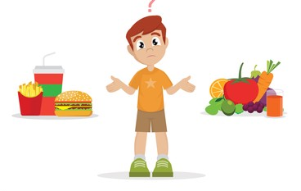
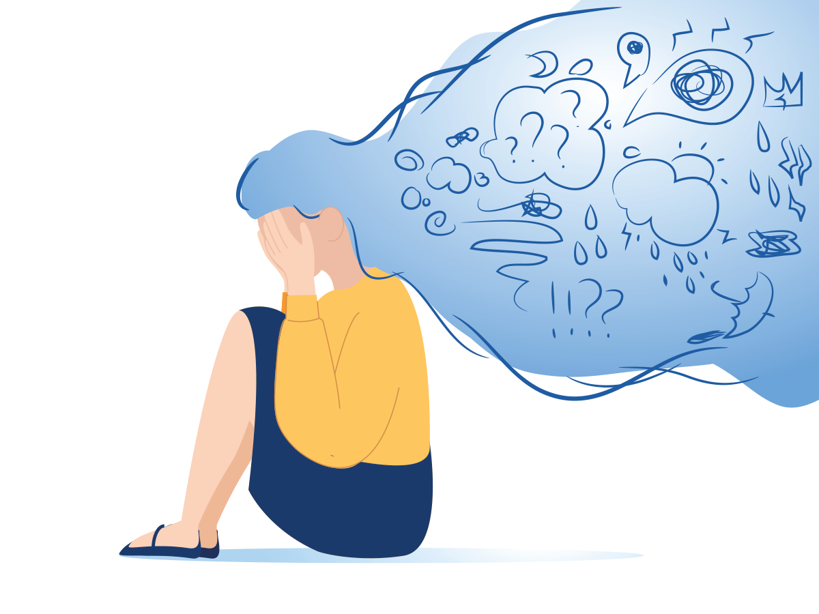
Can you think of examples of unhealthy choices?
Remember the different aspects of health:
Physical
Mental
Social
Environmental
Spiritual
Intellectual
Emotional
Notes:
y

Slide 10
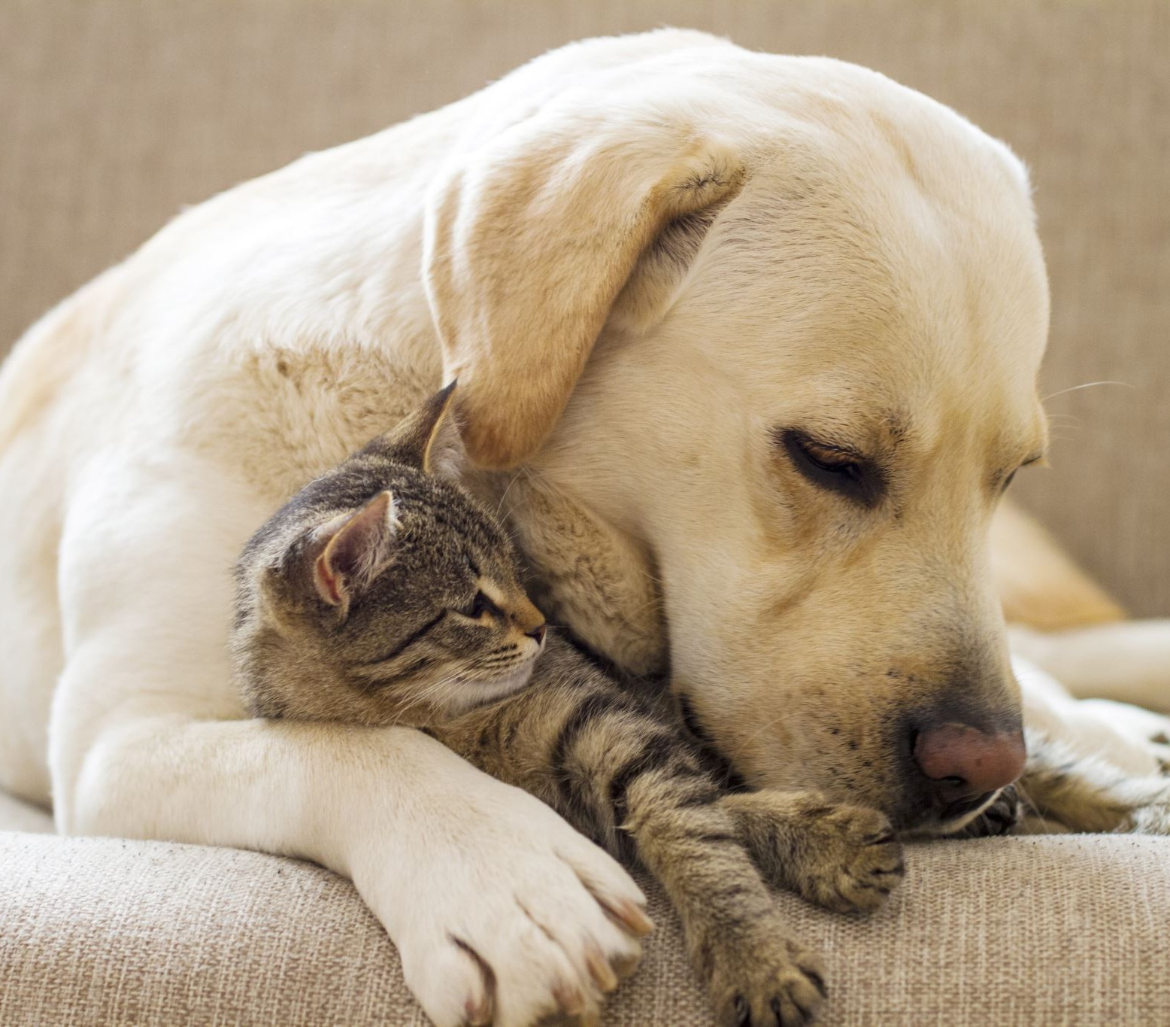
What do animals need to stay healthy?
FOOD
WATER
SHELTER
VETERINARY CARE
SOCIAL INTERACTION
Notes:
y

Slide 11
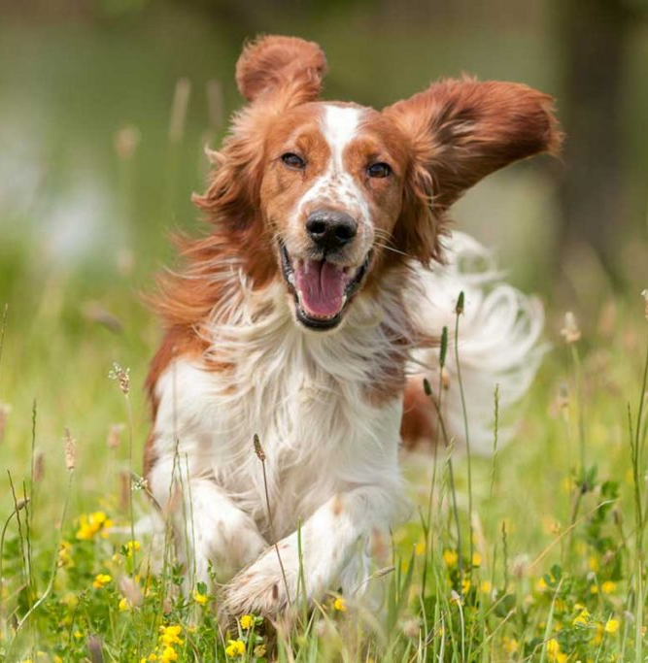
How can we tell if animals are healthy?
Shiny fur coat, white teeth
Clear eyes, nose, ears
Normal breathing, walking, running, sleeping
Energetic, tail wags (from excitement), happy
Good appetite, steady weight, normal bathroom habits
Notes:
y

Slide 12
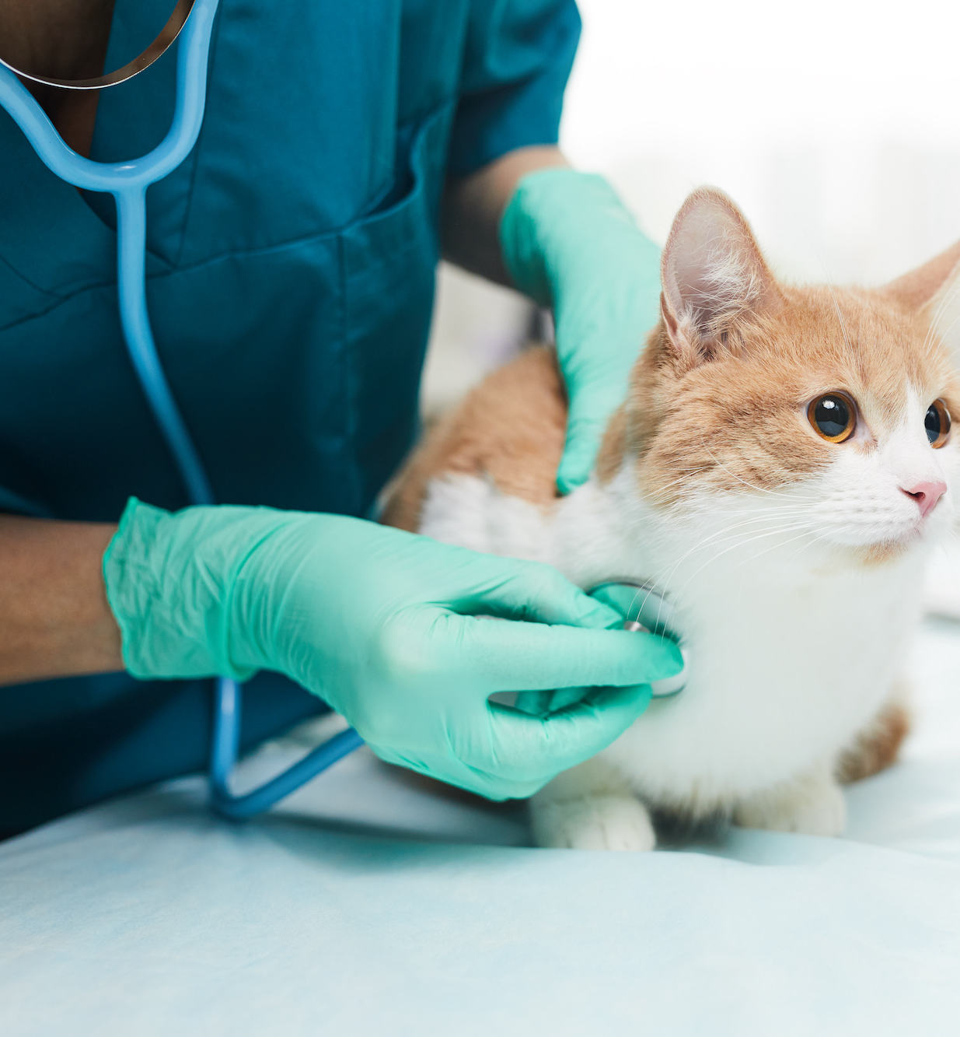
What do we hear in healthy animals?
Normal heartbeat and lung sounds with breathing
Normal vocalizations (woofs, howls)
No coughing, sneezing
Notes:
y

Slide 13
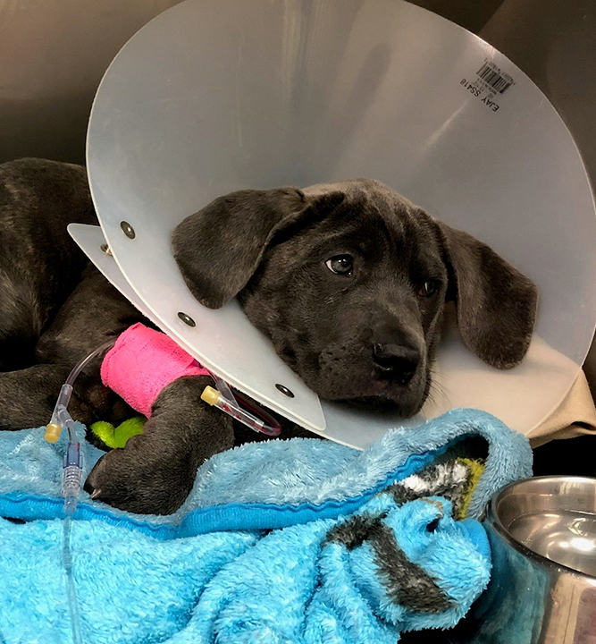
How can we tell when animals are not feeling well? Physical Signs
Dull looking or greasy fur
Breathing too fast or with too much effort
Coughing, sneezing, itching, scratching, vomiting, diarrhea
Crusting or goo around eyes, nose, ears
Notes:
y

Slide 14
How can we tell when animals are not feeling well? Behavioural Signs
Lethargy
Restless
Hunger change
Fawning
Hiding
Self-Harm
Notes:
Self-harm: they may bite, lick, or scratch at an area that is uncomfortable
Sleeping more than normal or less energetic- this is called “lethargy”
Sleeping less than usual or very restless / agitated
Lack of appetite, or eating too much
‘Fawning’: Constant purring / tail wagging may indicate nervousness instead of excitement / happiness
Hiding from people
This is a natural instinct since if they were sick or hurt in the wild, they would hide to avoid predators seeing them!

Slide 15
Other behaviours that may mean your dog is in pain:
Limping / protecting a body part
Lack of grooming
Facial expression (flat ears, wide eyes, etc.)
Aggression or personality change
Barking/whining more
Won’t move or play

Slide 16

Do animals feel pain like humans? Yes!
Some reasons they may feel pain include infections, dental problems, bone or joint disease, and cancer.
The good news is that we can help animals in pain by noticing the signs that they are not feeling well and talking to a veterinarian or other animal helper!

Slide 17
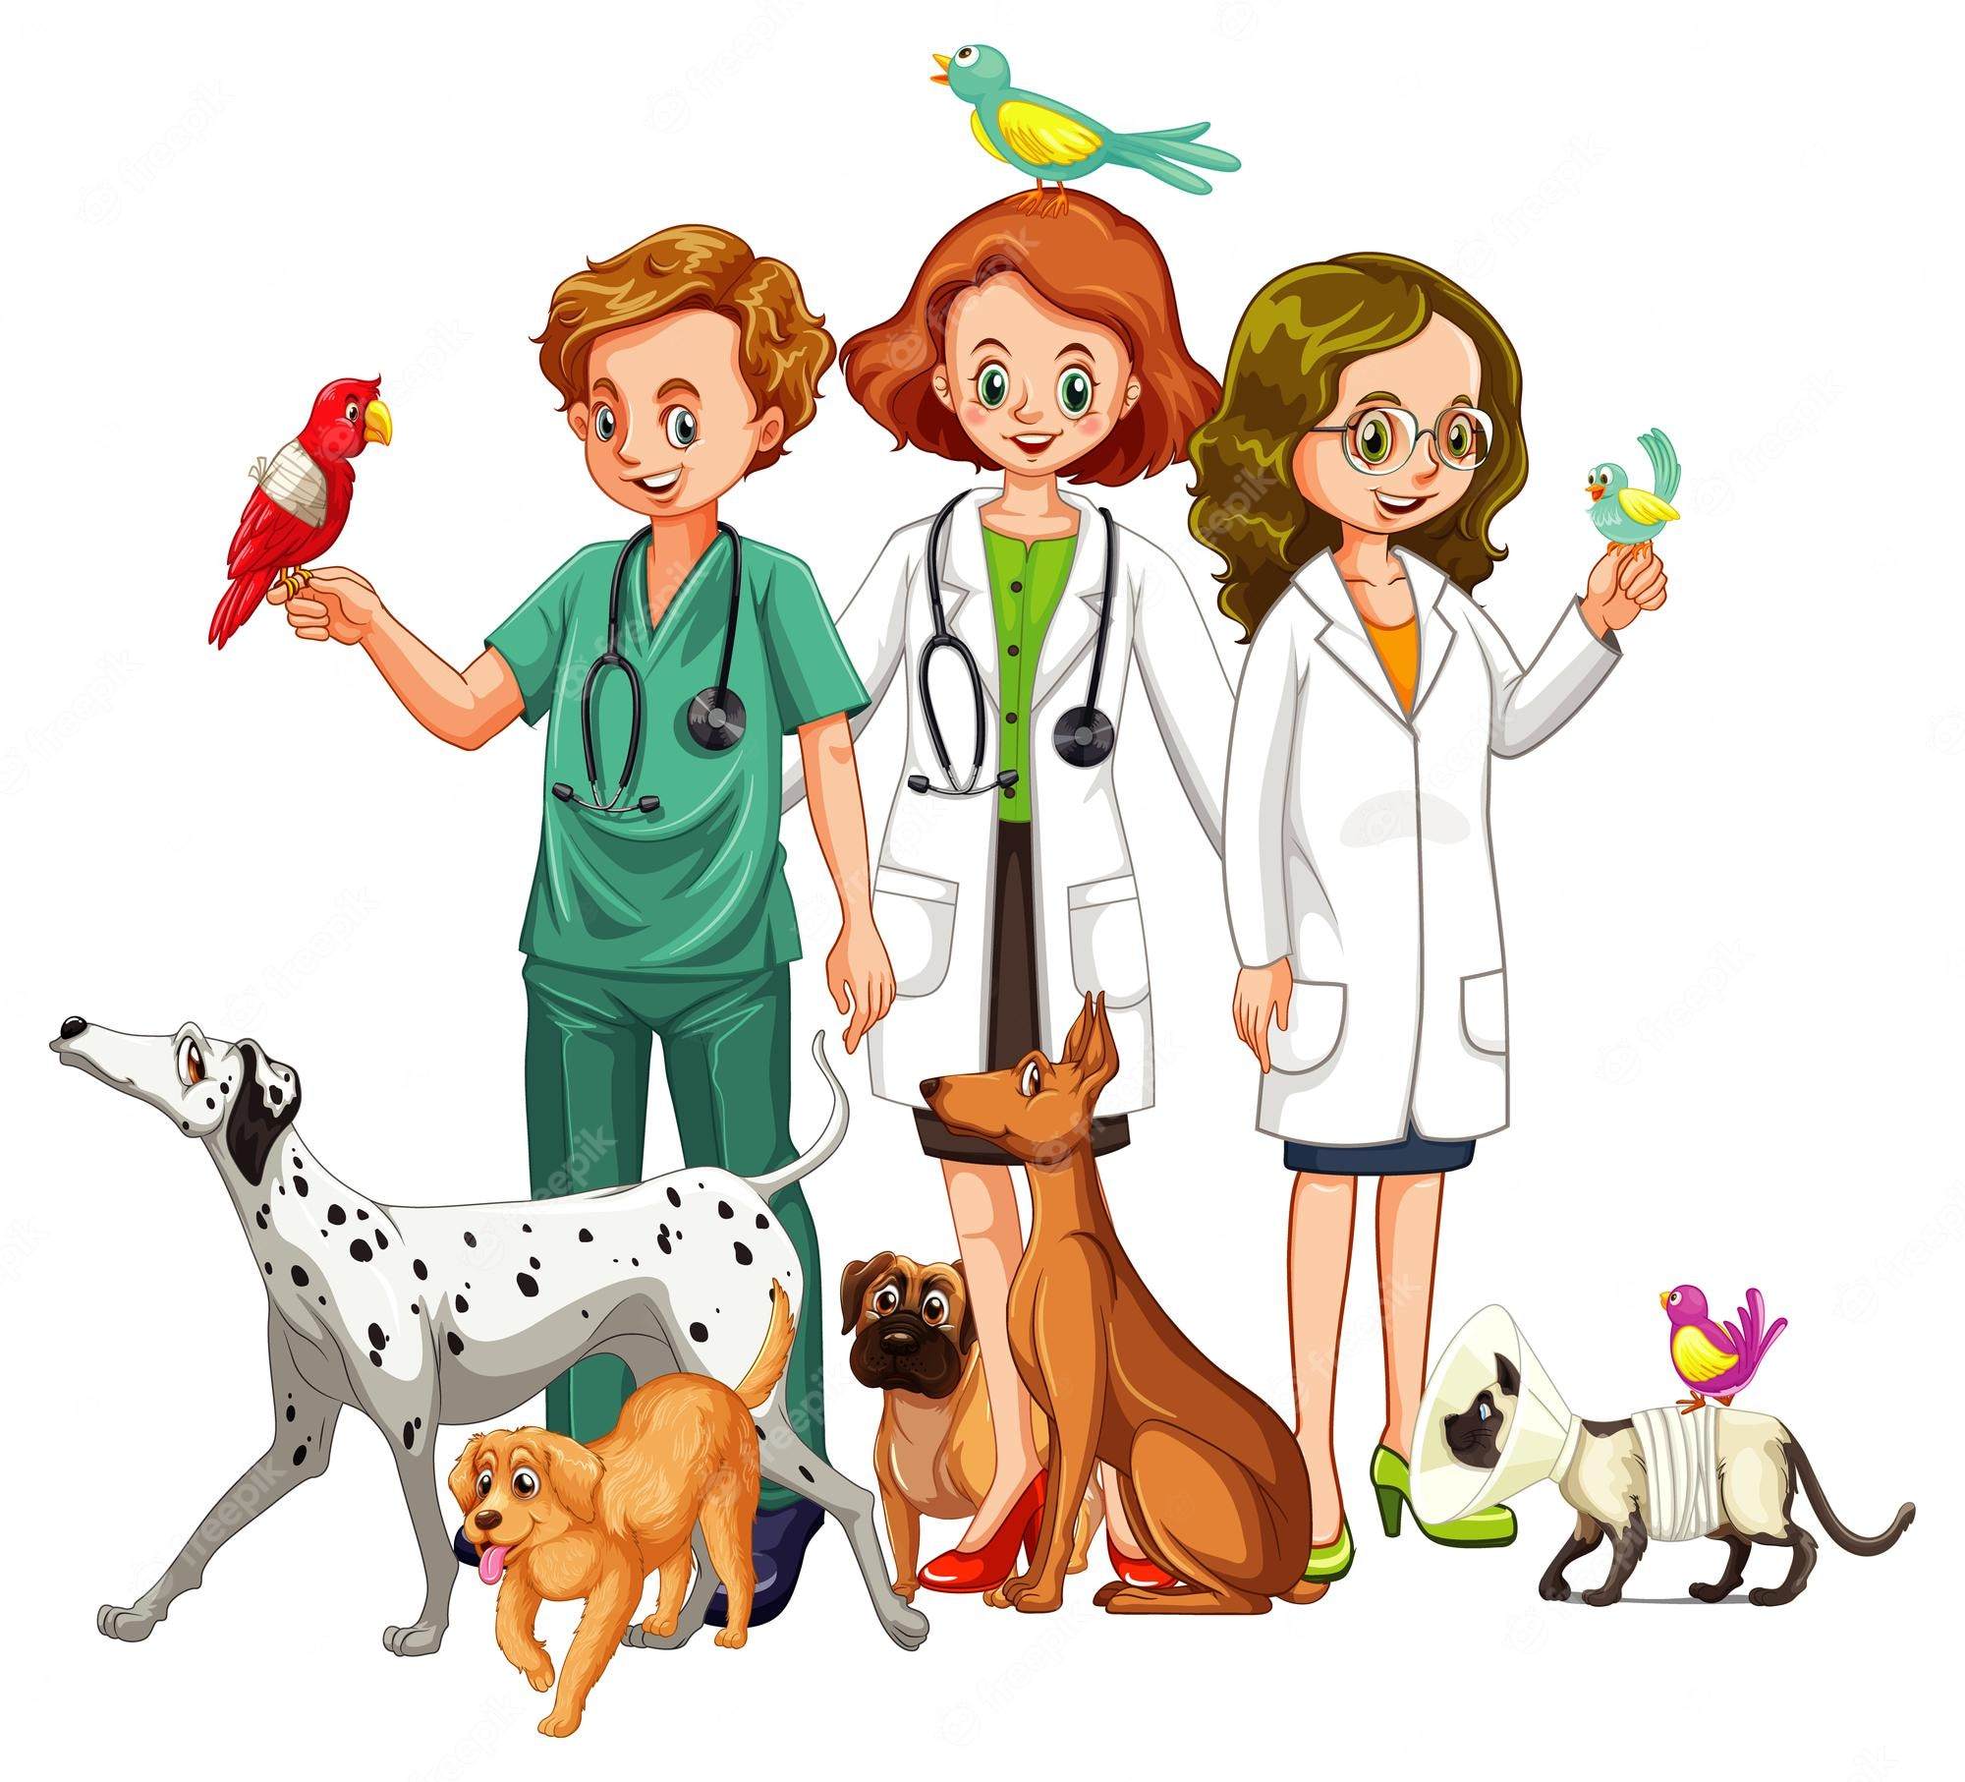
How can veterinarians help keep animals healthy? List some examples!
Notes:
y

Slide 18
Role of veterinarians in animal care:
FINDING PROBLEMS EARLY WITH CHECKUPS
FINDING AND TREATING DISEASE
DISCOVERING NEW THINGS (RESEARCH)
PUBLIC AND OWNER EDUCATION
Prescribe medications
Protect Animal Welfare

Slide 19
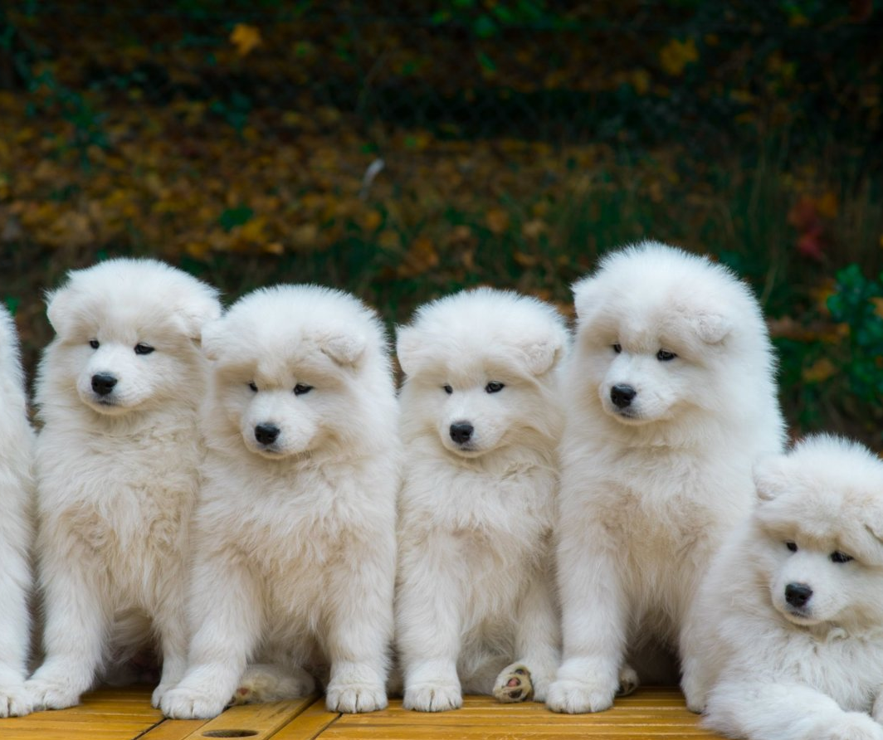
In summary… What are things we can do to keep our pets healthy?
Proper nutrition
Daily exercise
Provide shelter and water
Offer social stimulation and companionship
Regular check ups with a vet if possible

Slide 20
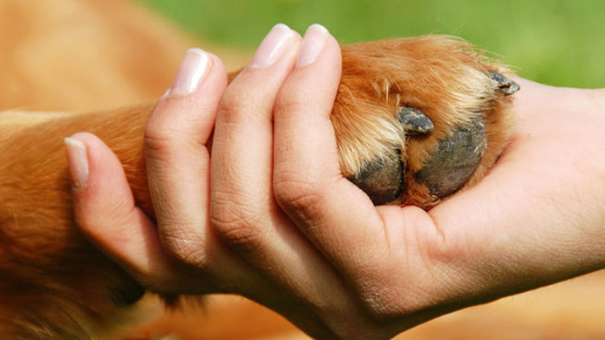
Resources to learn more about the human-animal bond and how it impacts our health:
https://habri.org/
https://everylivingthing.ca/information-for-teachers/human-animal-bond/
https://gamesforchange.org/studentchallenge/nyc/human-animal-bond/
Notes:
y

Slide 21
Presentation Resources
https://www.canada.ca/en/public-health/services/health-promotion/population-health/population-health-approach/what-is-health.html
https://www.who.int/about/governance/constitution
https://slideplayer.com/slide/13612243/83/images/3/Definitions+of+Health+Negative+definitions+of+health+take+the+approach+that+health+involves+the+absence+or+lack+of+disease..jpg
https://www.lindenwood.edu/science/lindenwell/the-six-dimensions-of-wellness/#:~:text=The%20National%20Wellness%20Institute%20promotes,sense%20of%20wellness%20and%20fulfillment.
https://journals.sagepub.com/doi/pdf/10.1177/000841749806500204?casa_token=1BfSnKdcFeAAAAAA:o0S2HyiwiSiH1JfSJ6alYnaHcStVTzTyEkjDK9qSXtD6r9vbDnbfTneJsQQYZMeHmOmBoP2mVgI
https://www.avma.org/resources/pet-owners/yourvet/veterinarians-protecting-health-animals-and-people#:~:text=Today's%20veterinarians%20are%20the%20only,food%20safety%2C%20and%20public%20health.
https://vetsource.com/blog/7-signs-healthy-pet/
https://willowbrookvetclinic.com/why-do-pets-hide-when-theyre-sick
https://www.aaha.org/globalassets/02-guidelines/pain-management/painmanagement_dogs_web.pdf

Slide 22
Image Resources
https://www.apple.com/ca/newsroom/2022/07/how-apple-is-empowering-people-with-their-health-information/
https://www.dreamstime.com/illustration/healthy-lifestyle.html
https://www.istockphoto.com/illustrations/mental-health
https://www.fiercehealthcare.com/digital-health/mental-health-provider-ieso-lands-53m-for-digital-therapeutics-backed-by-real-world
https://www.shutterstock.com/search/healthy-unhealthy-food
https://www.istockphoto.com/photo/orange-and-white-puppy-and-kitten-gm536722277-57645902
https://www.bentley.edu/library/in-the-know/display-health-and-wellness
https://www.pngitem.com/middle/hmiibih_success-clipart-emotional-health-community-service-clipart-hd/
https://www.drlenkaglassman.com/blog/2018/2/7/the-human-animal-bond-an-important-factor-in-healing-mental-illness
https://www.freepik.com/premium-vector/veterinarian-with-many-kind-animals_18233402.htm
https://www.istockphoto.com/photo/guy-and-his-dog-golden-retriever-nature-gm1204163981-346374184
https://nypost.com/2021/12/16/ny-pet-store-sold-sick-puppies-some-died-days-later-ag-suit/
https://sierraveterinary.com/2022/02/27/the-importance-of-an-annual-wellness-exam-for-your-pet/
https://www.homeopet.com/ca/?sorc=ca_ck
https://www.istockphoto.com/photo/yellow-labrador-with-a-tabby-cat-on-a-sofa-gm453143911-30858202
https://www.pinterest.ca/pin/185210603411845898/
https://designbundles.net/ntl/2074435-tranquil-woman-meditating-outdoor-2d-vector-illust
https://www.hiclipart.com/free-transparent-background-png-clipart-nktxp

