Slide 1
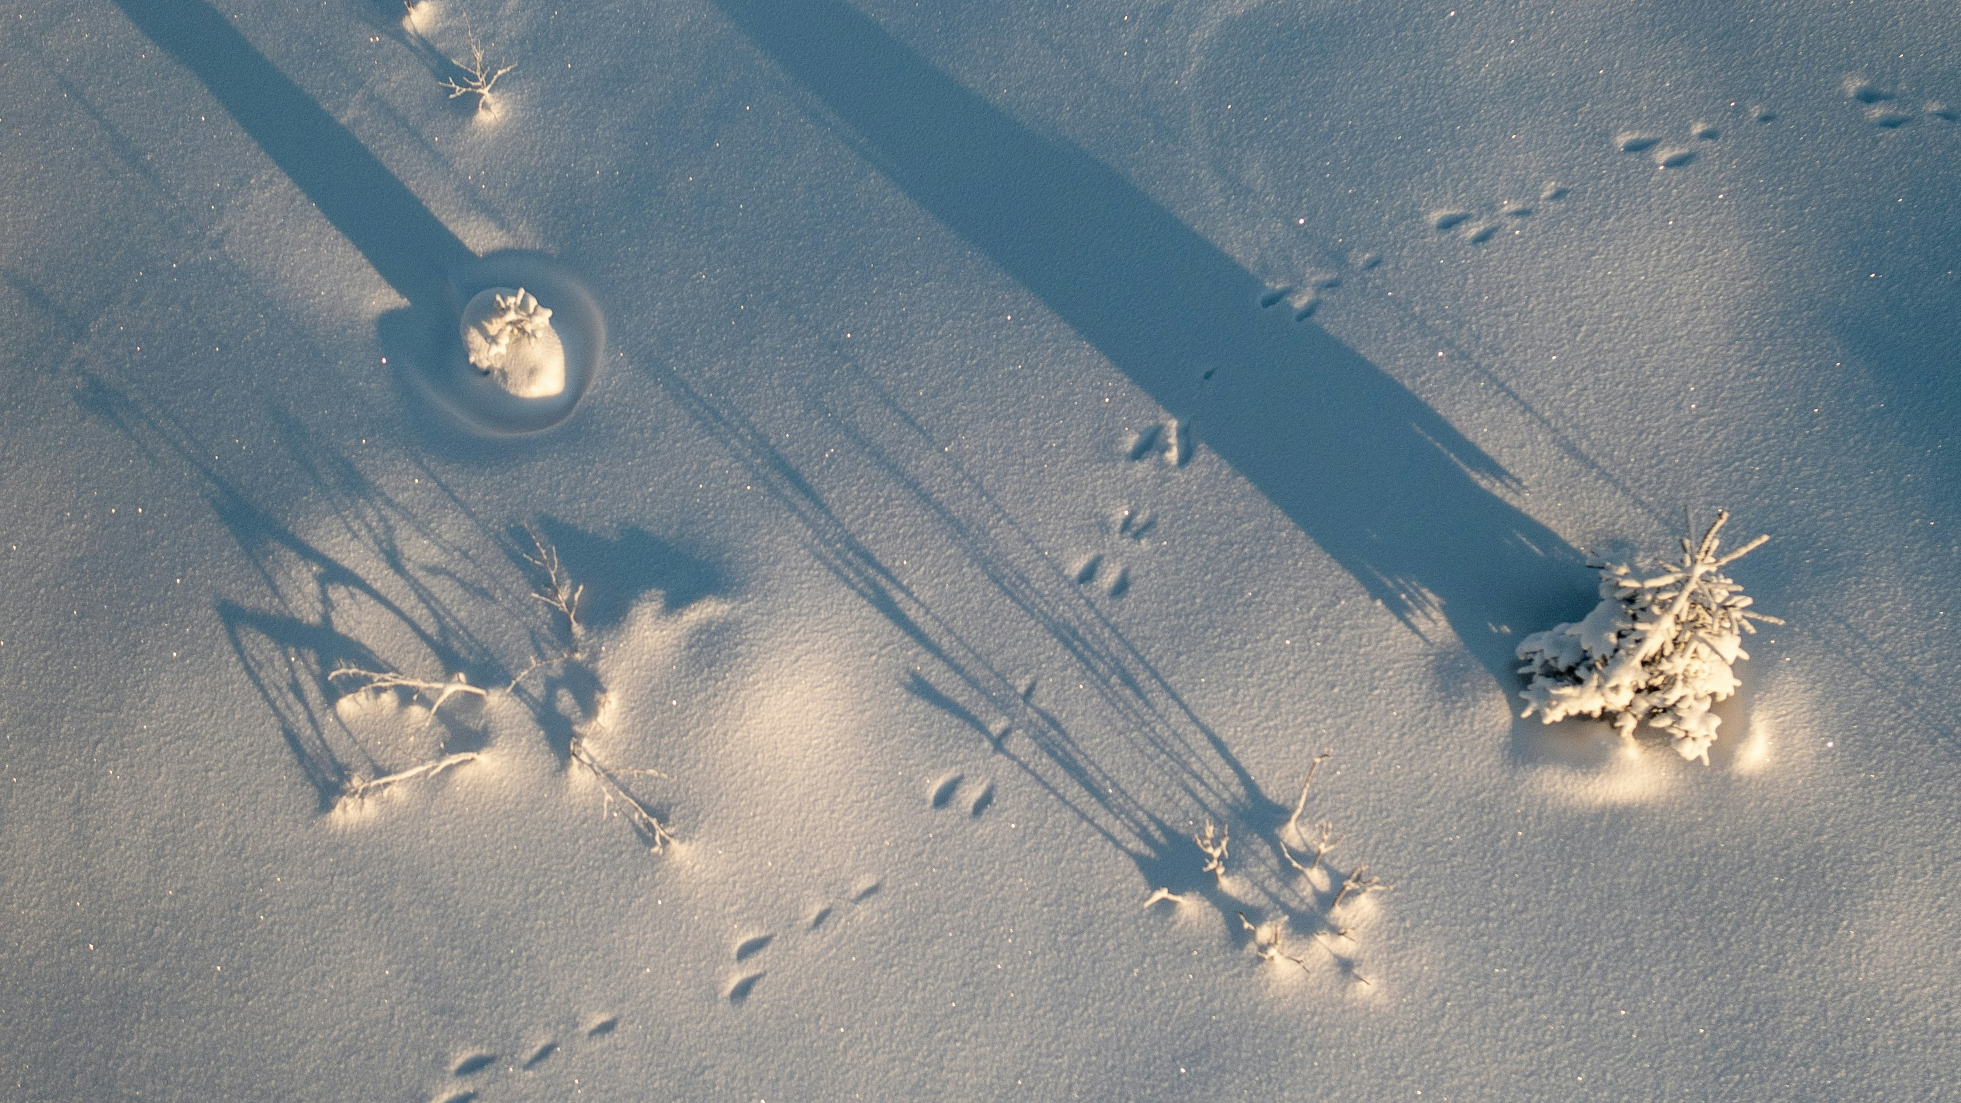
Whose tracks are these anyways? Learning about species at risk in Saskatchewan

Slide 2
What is a species at risk?
Any plant or animal that is decreasing in number or has a small population size is at risk.
Without change, then these species may continue to decrease and eventually no longer exist.
In Saskatchewan, there are over 100 species at risk.

Slide 3
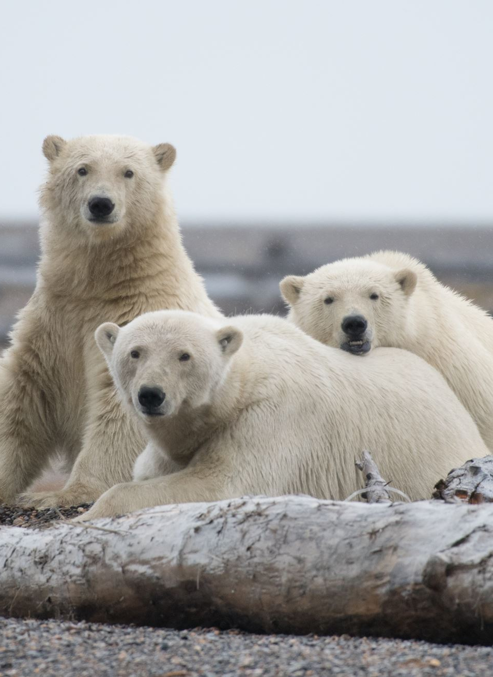
Risk categories
Some species are of “special concern” which means they are not endangered yet, but they may be in the future due to threats such as pollution.
A threatened species numbers are getting smaller in the wild. They may become endangered if their numbers keep decreasing.
An endangered species is an animal or plant that is at risk of disappearing forever because there are not many left in the wild. If we do not protect them, they may go extinct, which means they will exist anymore.
Extirpated species: no longer exist in the wild in one area they used to but exist elsewhere.
Notes:
Ask students: What is an endangered species? Ask them to list a few they may know of.
Species at risk can be put into categories based on how big the risk to their survival is.

Slide 4

Why do species become endangered?
Brainstorm: What are some reasons why an animal or plant may become endangered?
Habitat loss
Hunting and poaching
Climate change
Pollution
Invasive species
Human Disturbances
Diseases
Unknown
Notes:
Ask students to brainstorm some reasons why a species of plant or animal may be decreasing in the wild. These are some main reasons to consider. Some species are more susceptible to one cause than others. Often many factors are at play not just one cause.

Slide 5
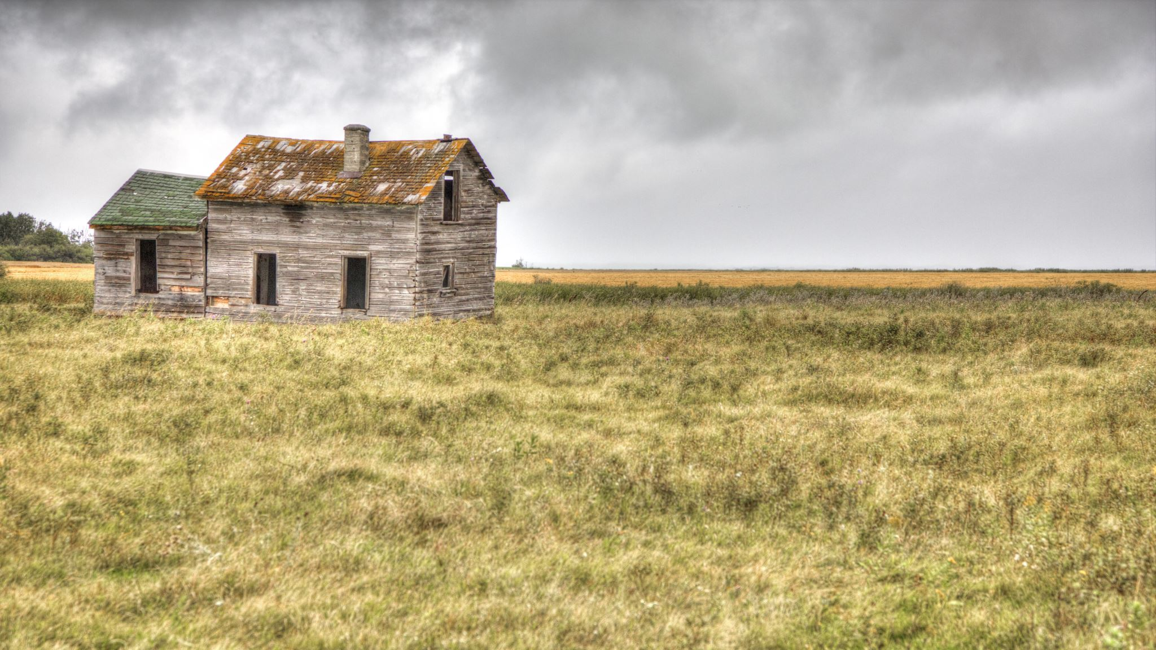
Species at risk in Saskatchewan

Slide 6
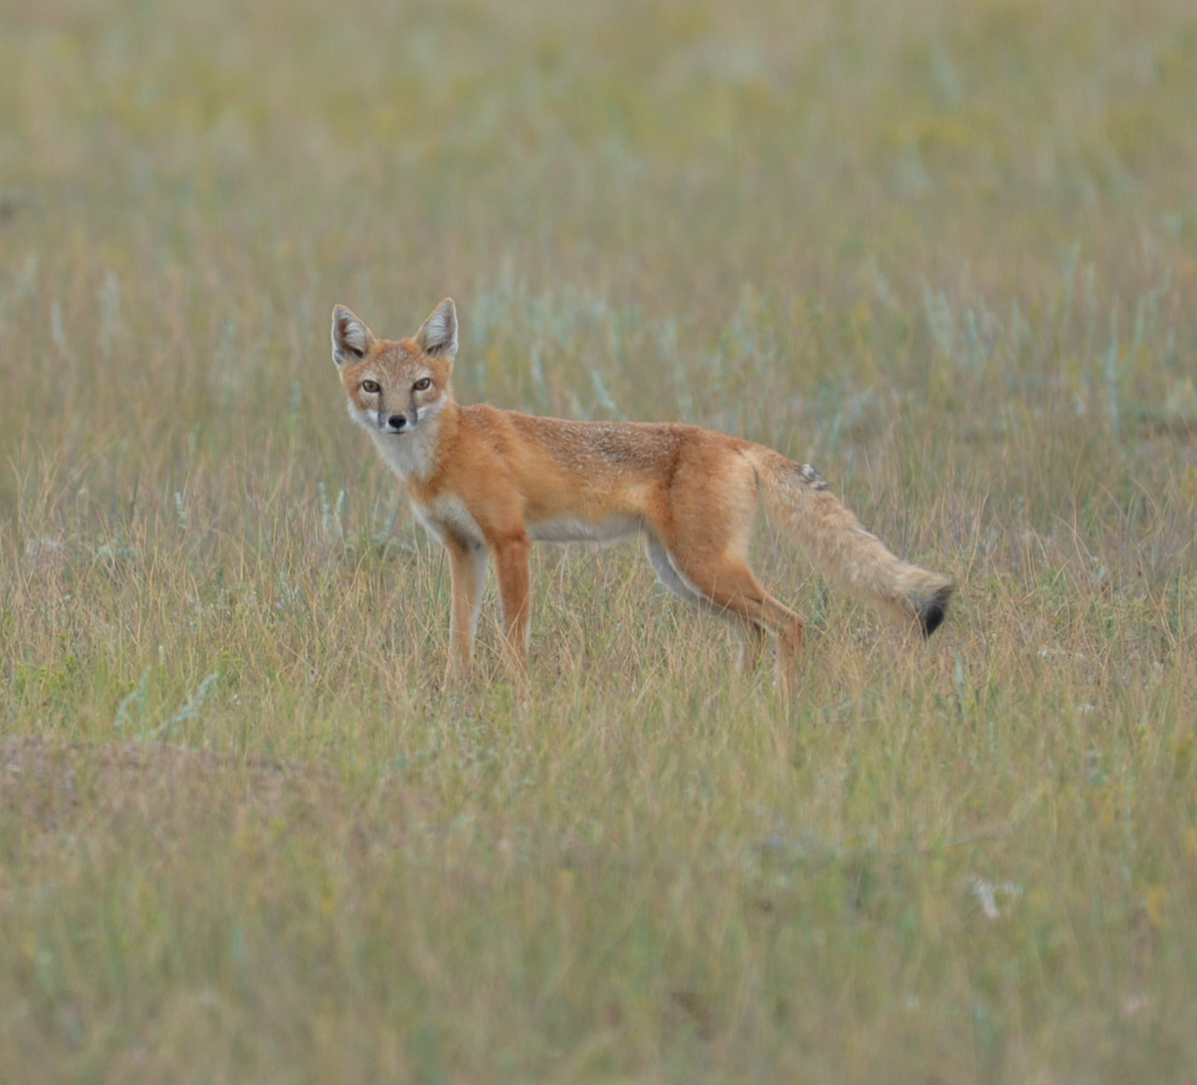
Species at risk in Saskatchewan
Swift fox (Vuples velox)
Don’t be fooled by their small size – they may be one of the smallest members of the canid family, but they are also one of the fastest mammals in North America.
They can run up to 60 km/hr!
Notes:
Threatened status (downlisted due to recovery efforts – used to be endangered/extirpated in SK)

Slide 7
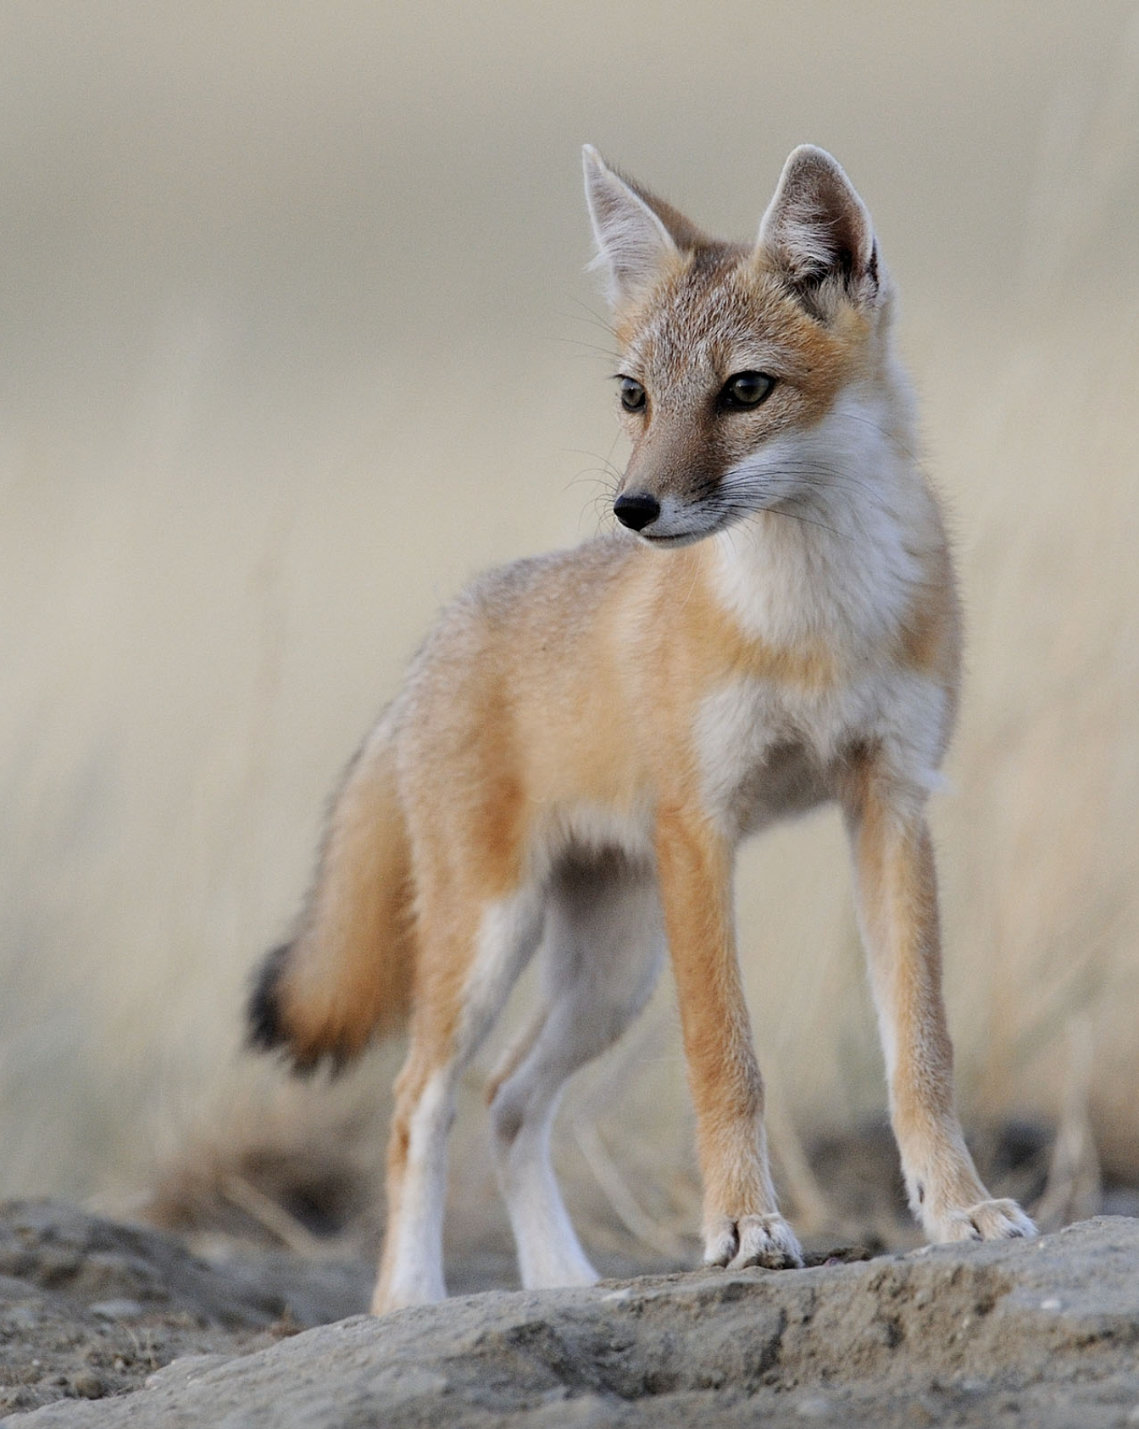
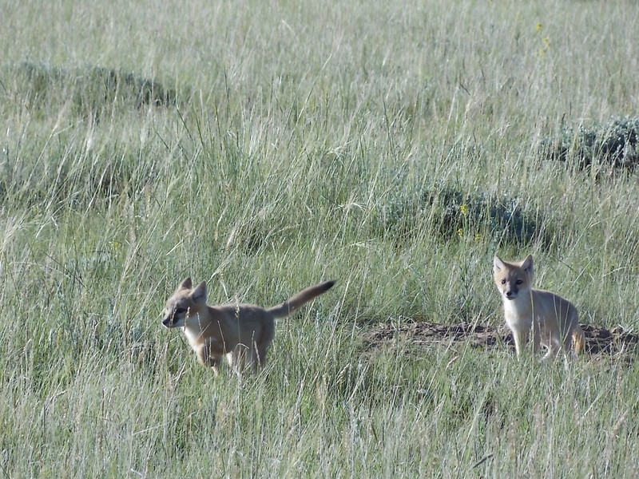
Swift Fox
Range: AB, SK (Grasslands National Park)
Habitat: Native to grasslands and prairies.
The health of this species can be used as an indicator for the health of the grasslands as a whole!

Slide 8
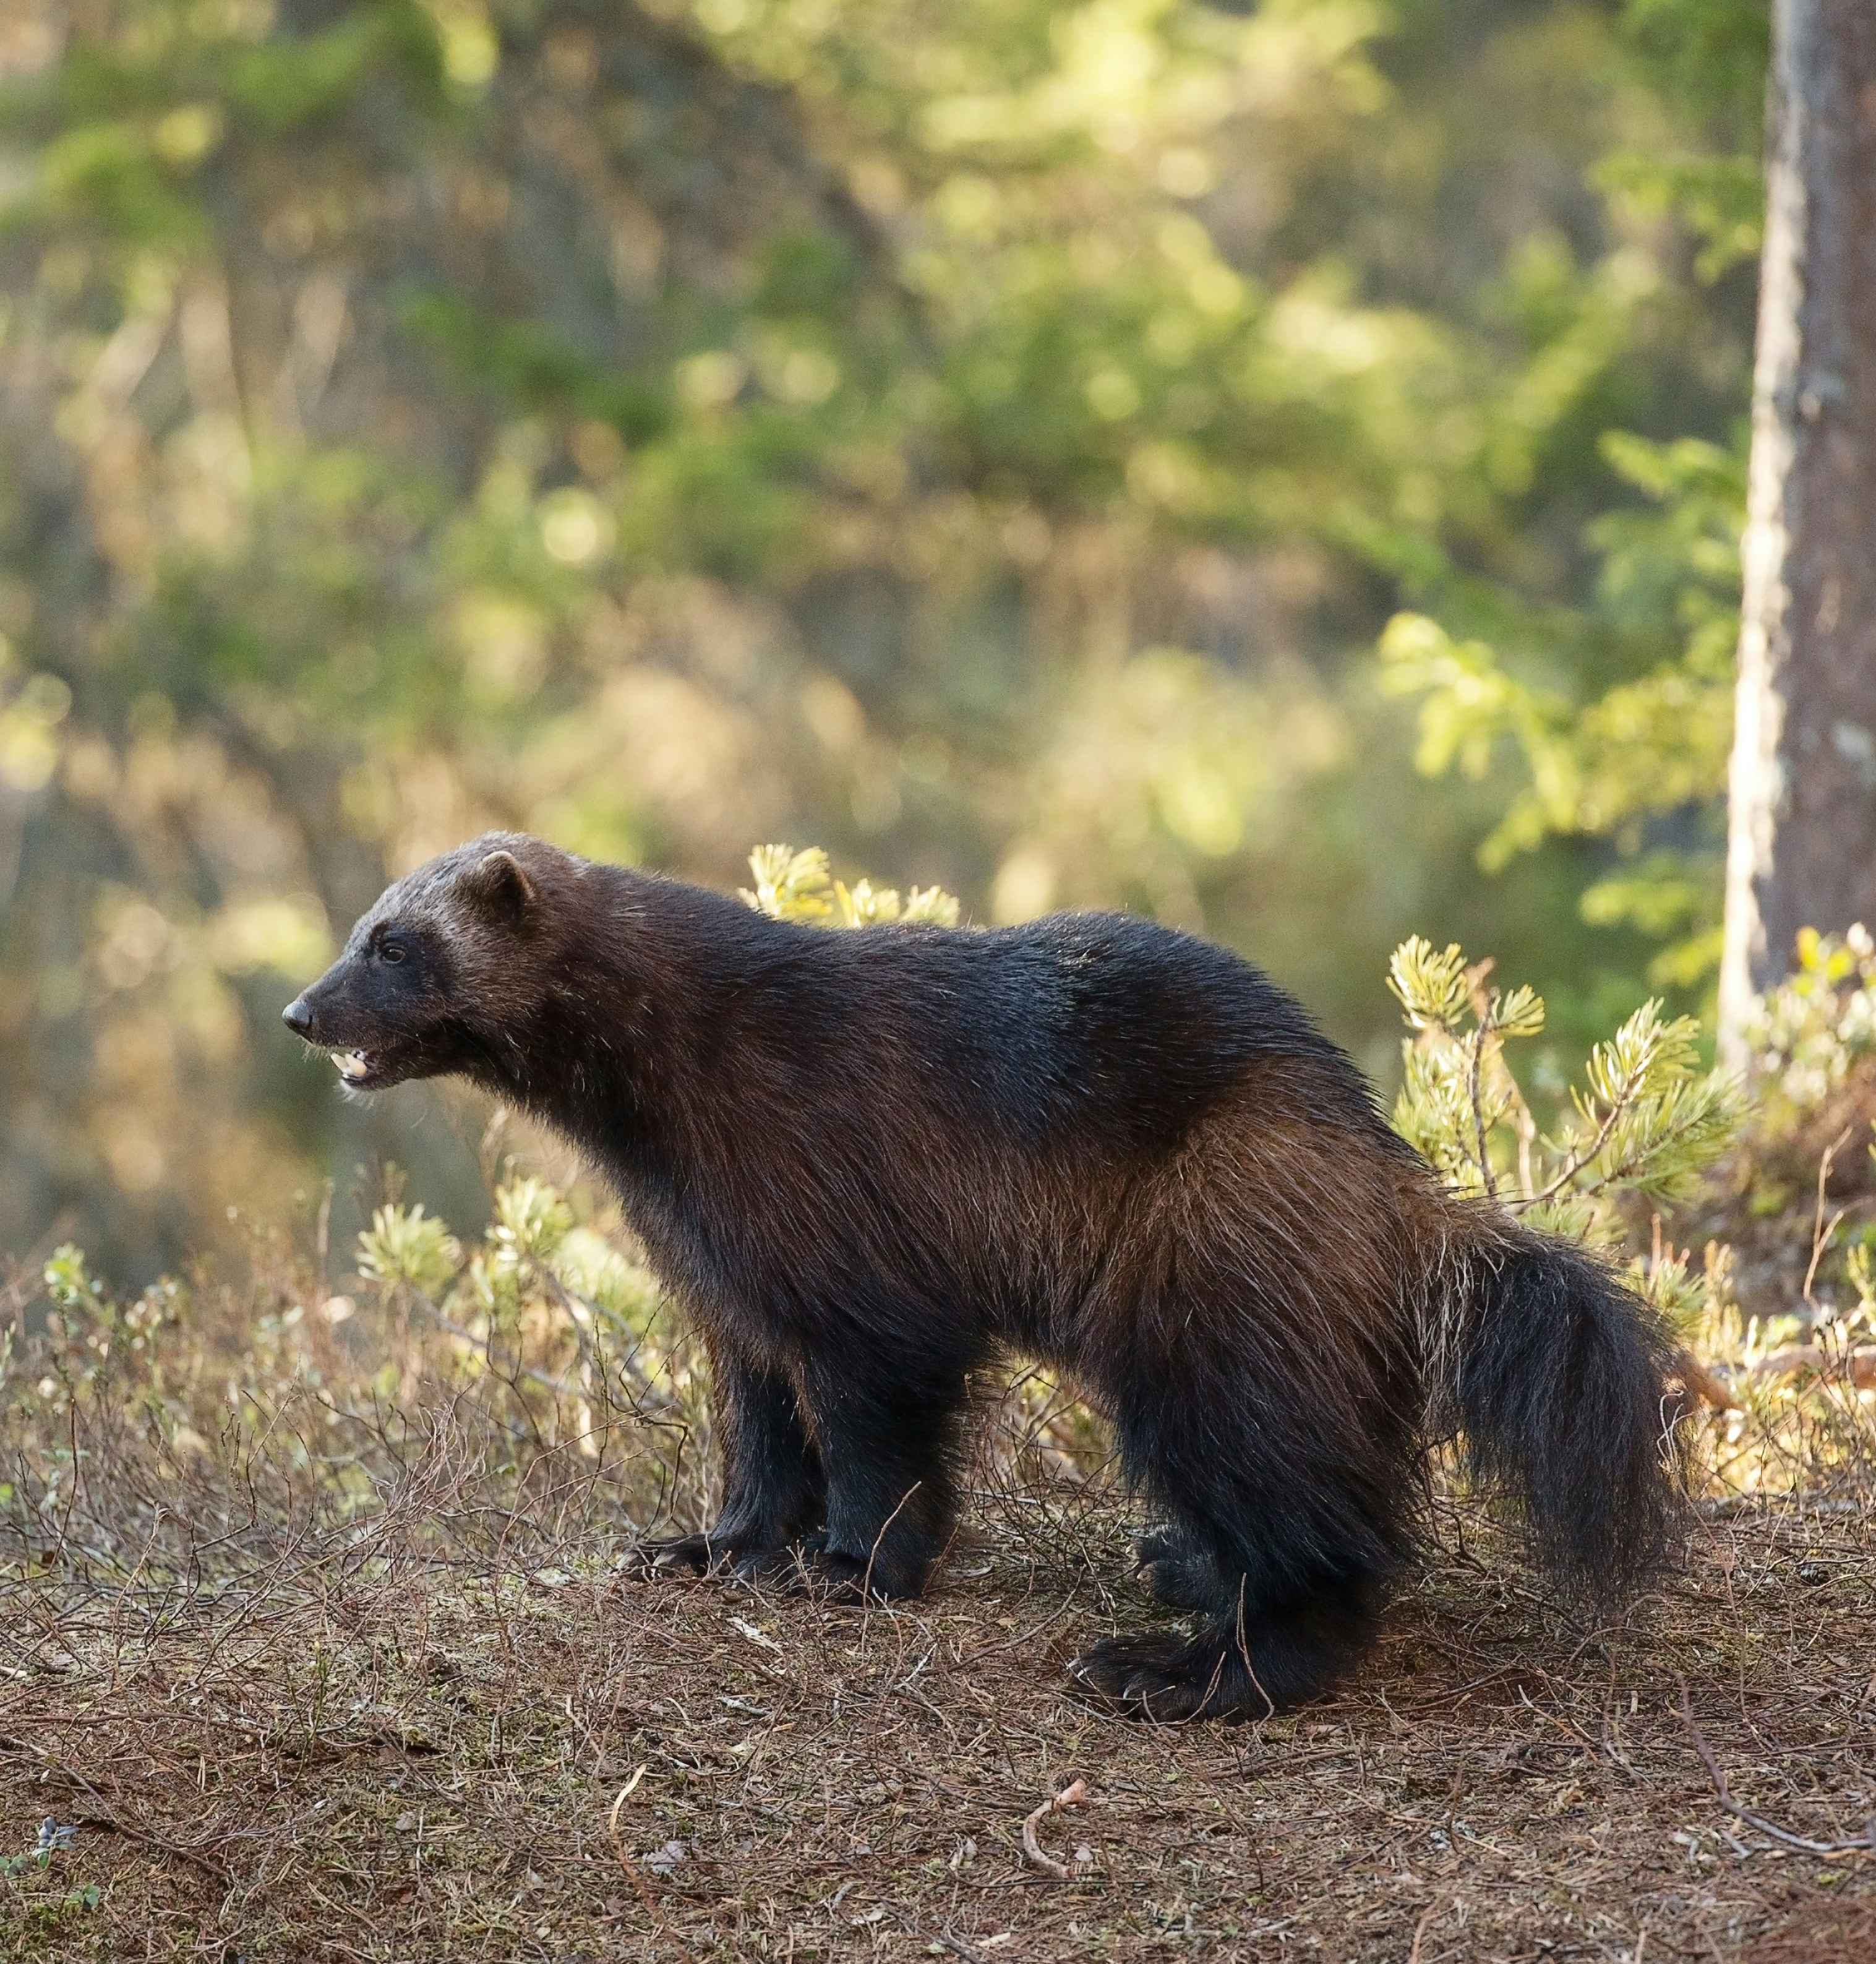
Species at risk in Saskatchewan
Wolverine (Gulo gulo)
Largest land-dweller of the weasel family!
Valuable fur coat in fur trade for their silky, frost-resistant fur.
Their scientific name “gulo” means glutton – because they’ll eat anything they come across! They prey on rodents and hares but will also scavenge on larger carcasses left by predators including Moose, Caribou and Muskox.
Notes:
Species of Special Concern

Slide 9
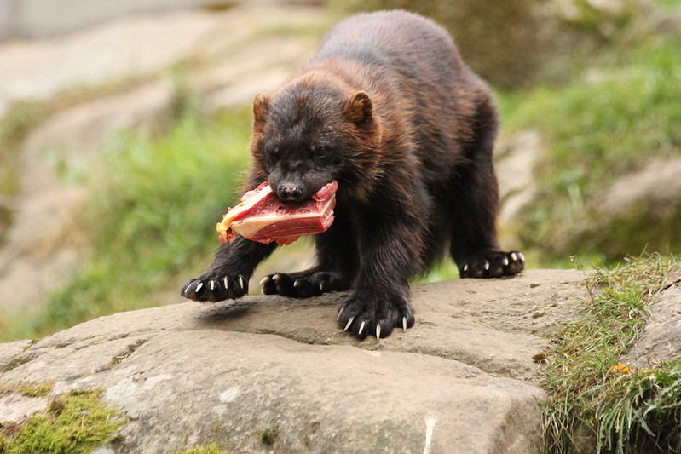
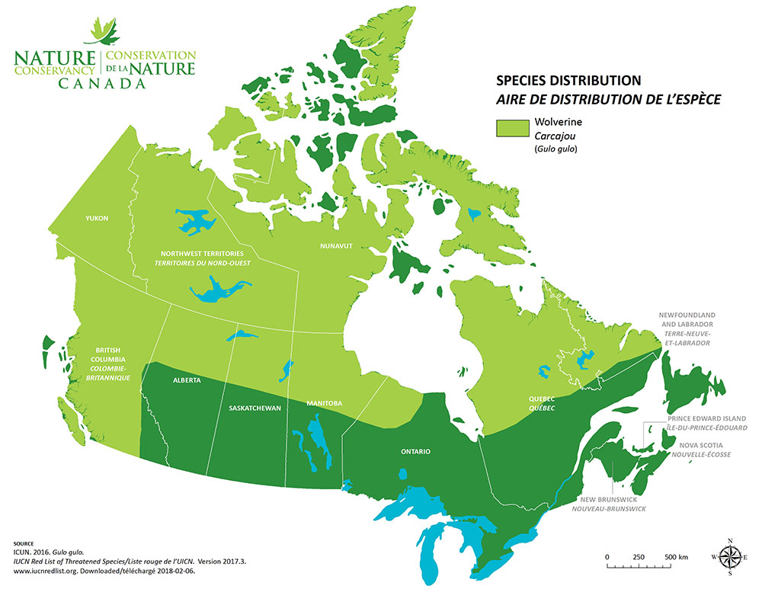
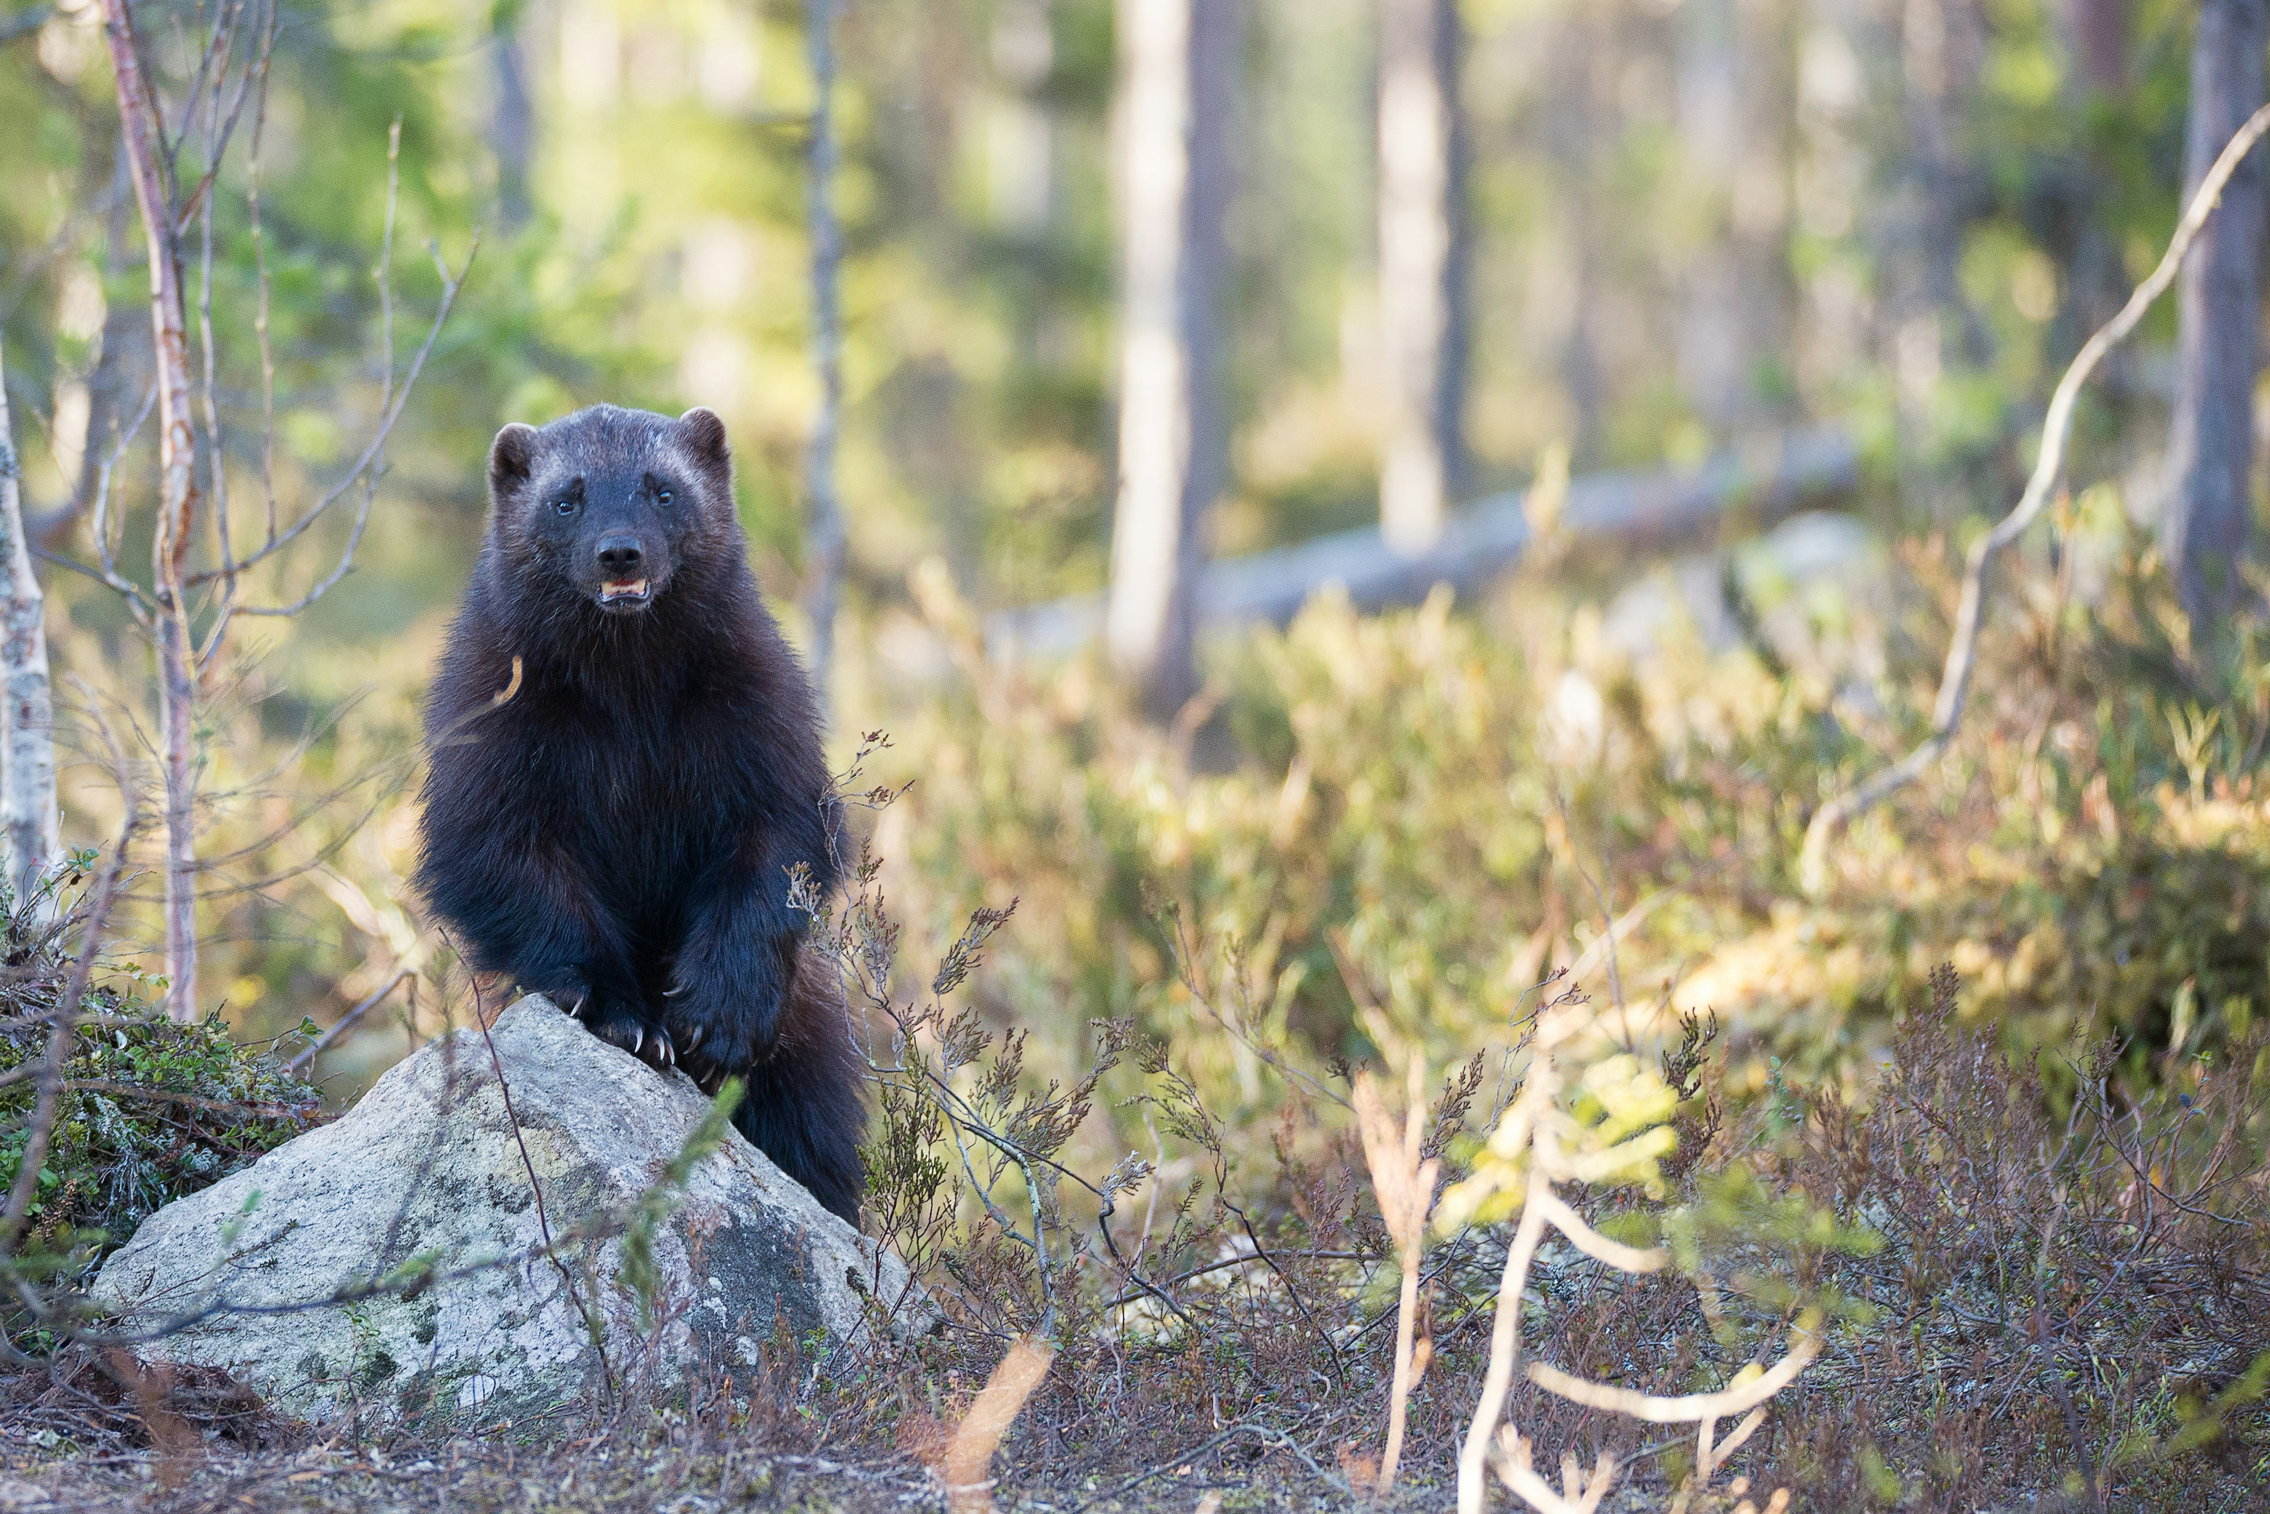
Wolverine
Kitsusi/Flickr
Range: Alpine and boreal forests, grasslands, alpine and arctic tundras of Canada
Photo by Vincent van Zalinge on Unsplash

Slide 10
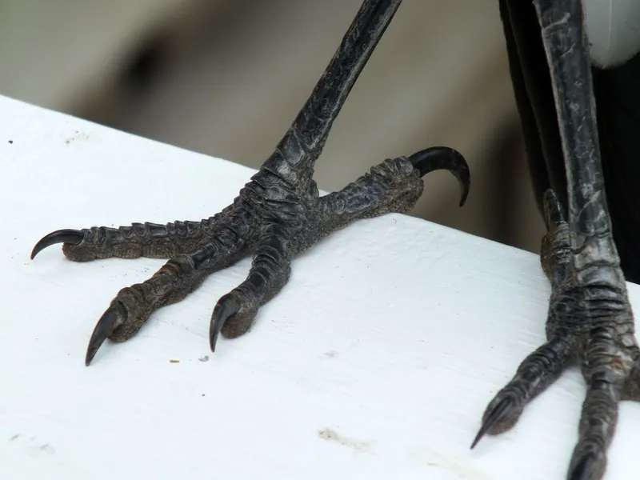
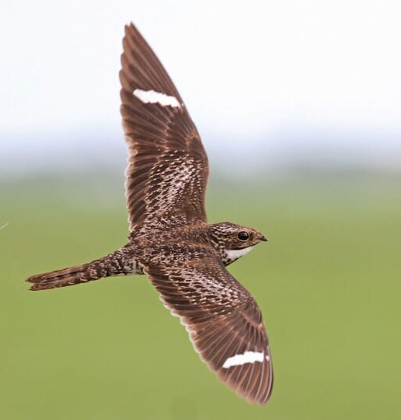
Species at risk in Saskatchewan
Common Nighthawk (Chordeiles minor)
Call
This bird feeds on insects and is most active at dawn and dusk (crepuscular).
They have specialized structures in their eyes to allow them to see well even in dim light. The nighthawk uses their vision to detect their prey.
© Alex Lamoreaux / Macaulay Library
Notes:
Downlisted from threatened to special concern in 2023

Slide 11
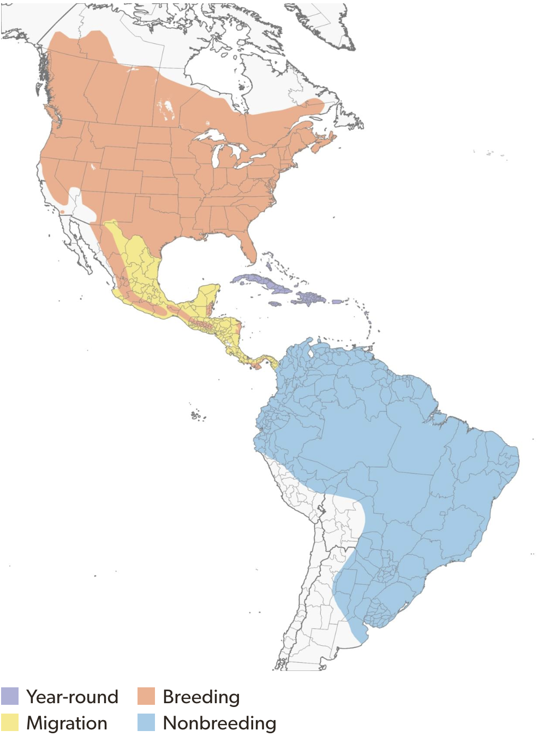
Common Nighthawk
Range: Found across southern and Boreal Canada.
Breeds as far north as central Yukon and SW Northwest Territories, United States, and south as Central America.
Overwinters in South America.
Map credit: allabout birds.org

Slide 12
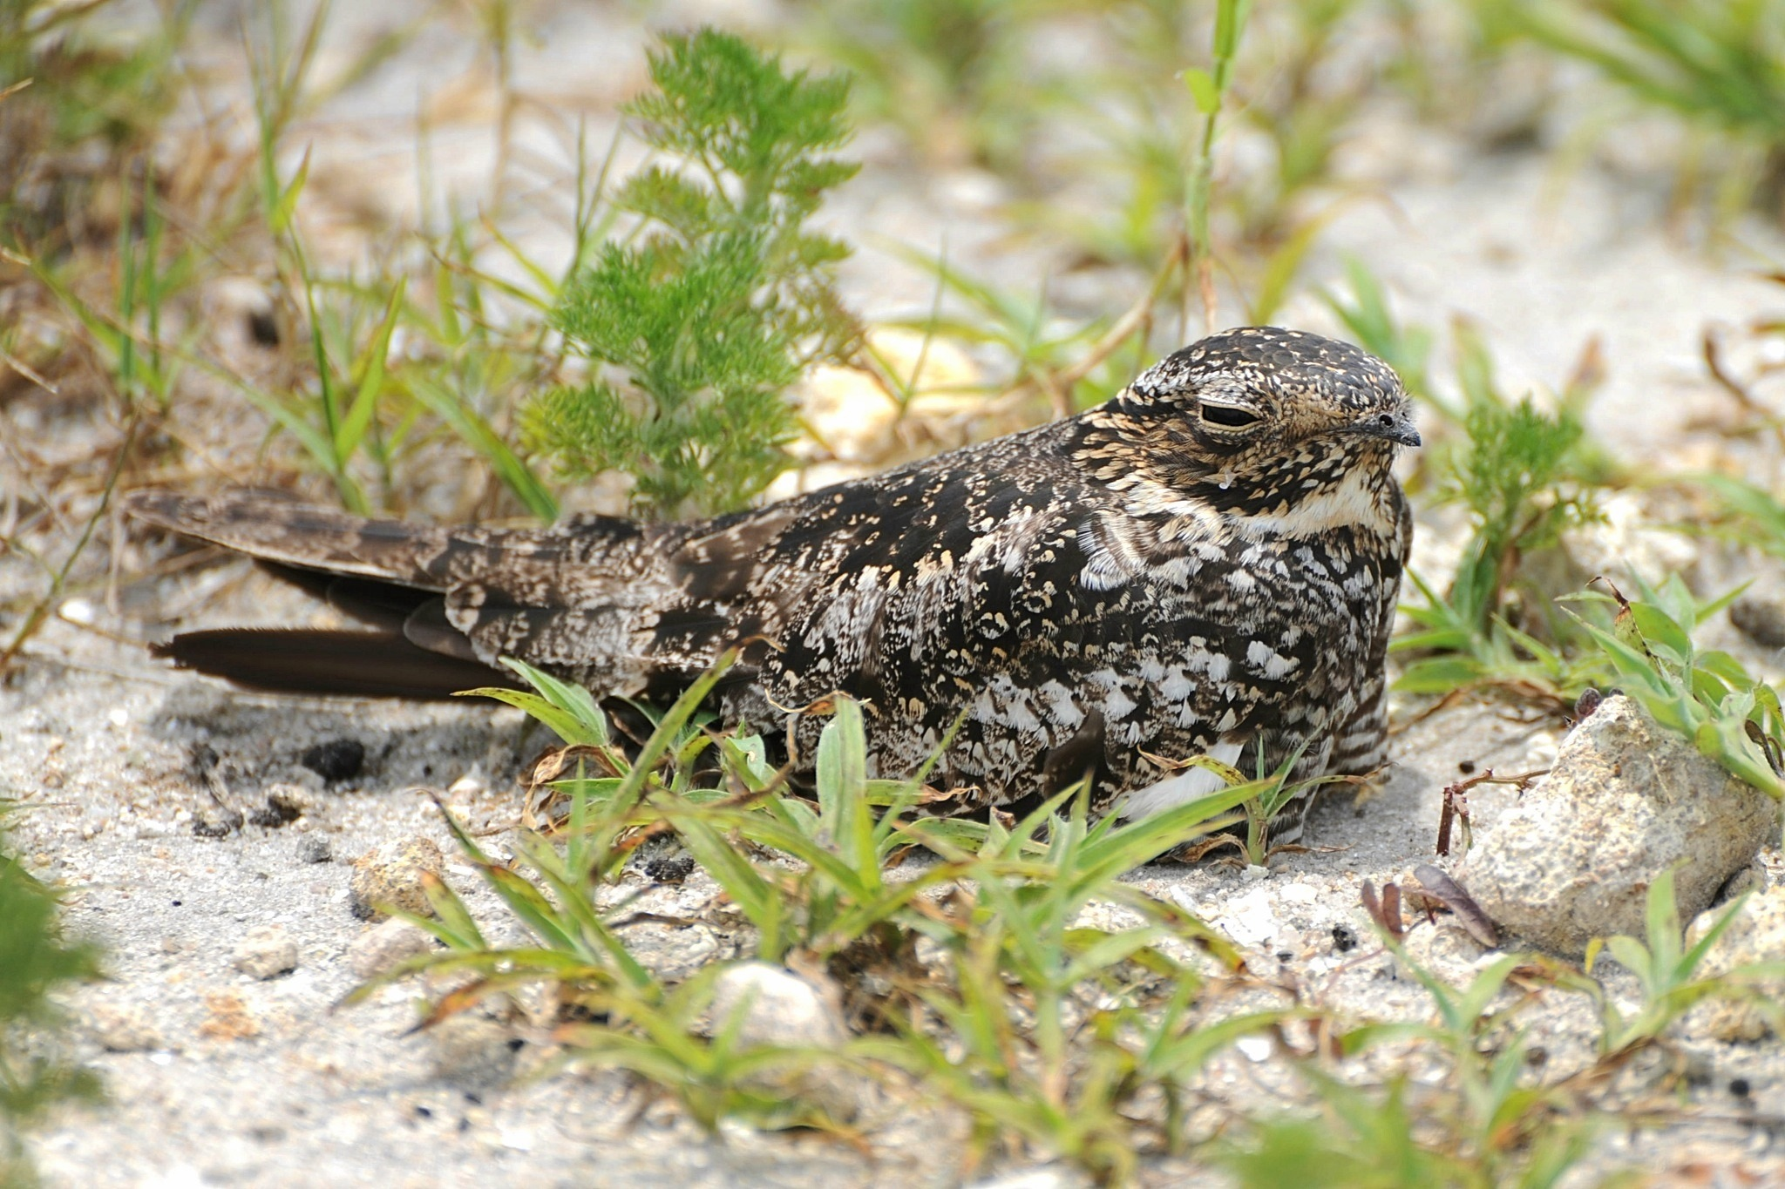
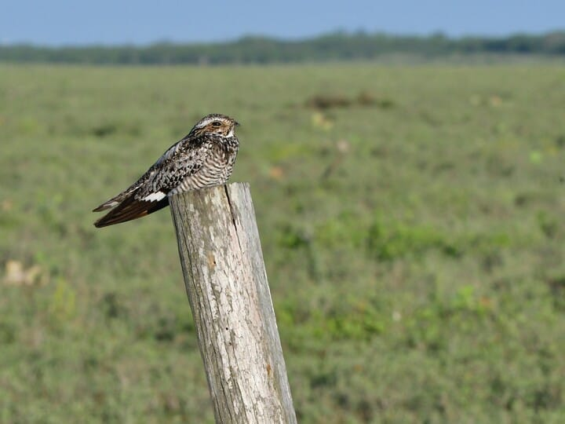
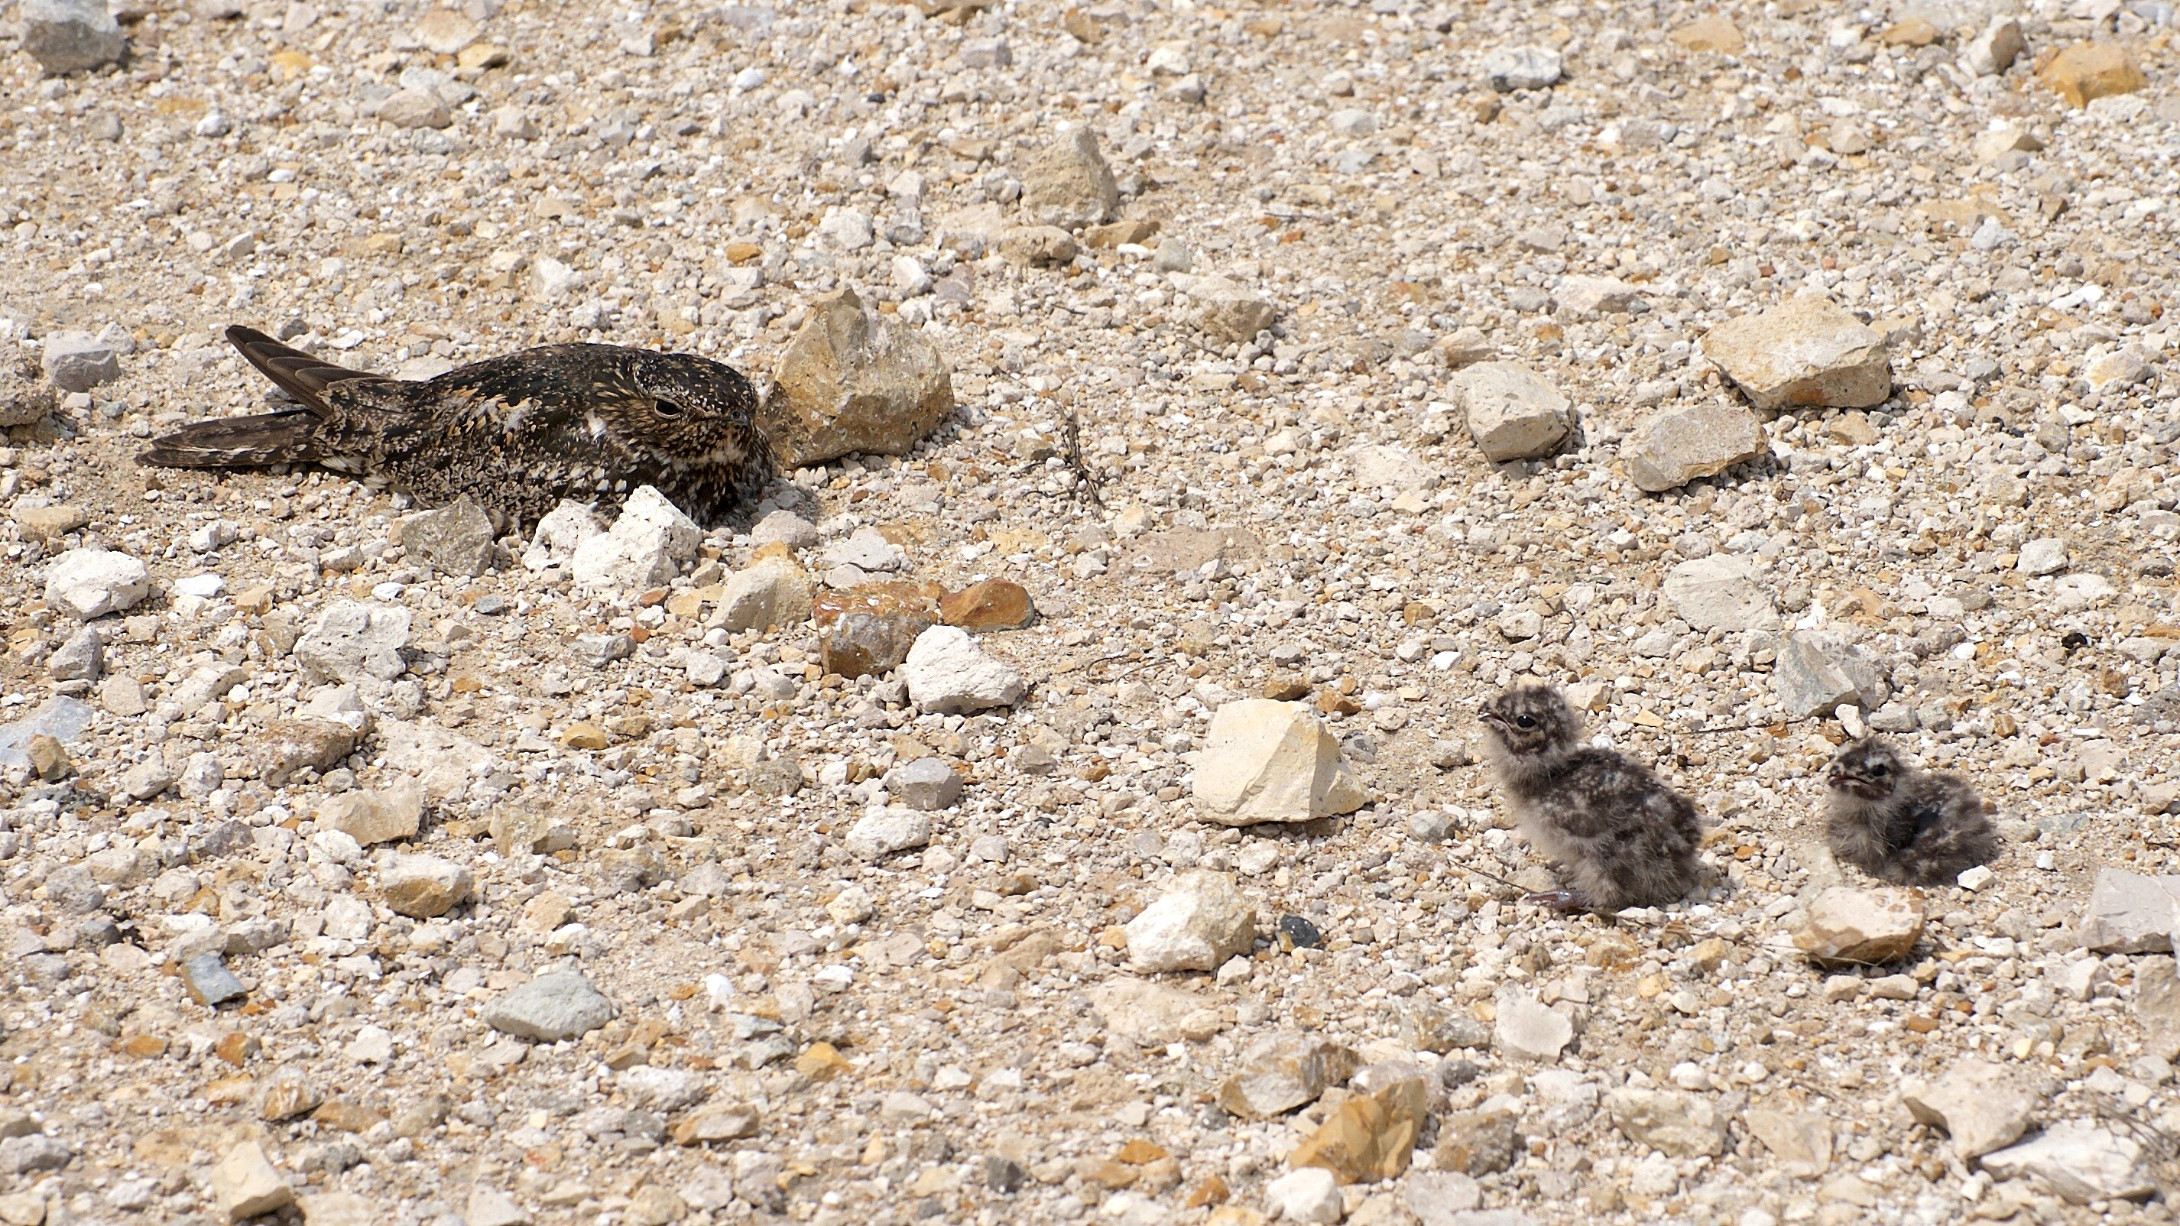
Common Nighthawk
Habitat: Open areas like prairies, bogs, rocky natural habitats, forest openings.
Source: Vladeb/Flickr
© Bryan Calk/Macaulay Library
Source: Vladeb/Flickr

Slide 13
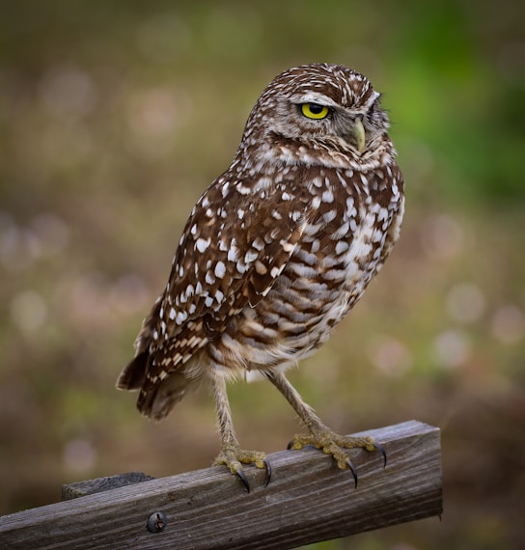
Species at risk in Saskatchewan
Burrowing Owl (Athene cunicularia)
Call
Small owls that are active during the day. They stay close to the ground, and hunt insects and small mammals like rats.
Nests in burrows already made by animals like prairie dogs, gophers and badgers.
Notes:
Endangered status

Slide 14
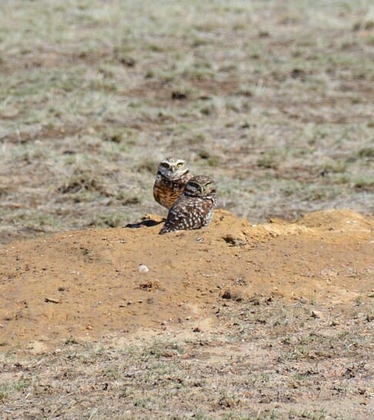
Burrowing Owl
Range: Widely found in North and South America. Within Canada, this includes BC, AB, SK, MB.
Habitat: Open areas such as prairies and deserts. They closely associate with animals like the prairie dog, as they use their burrows for nests.
© Nancy Westfall / Macaulay Library

Slide 15
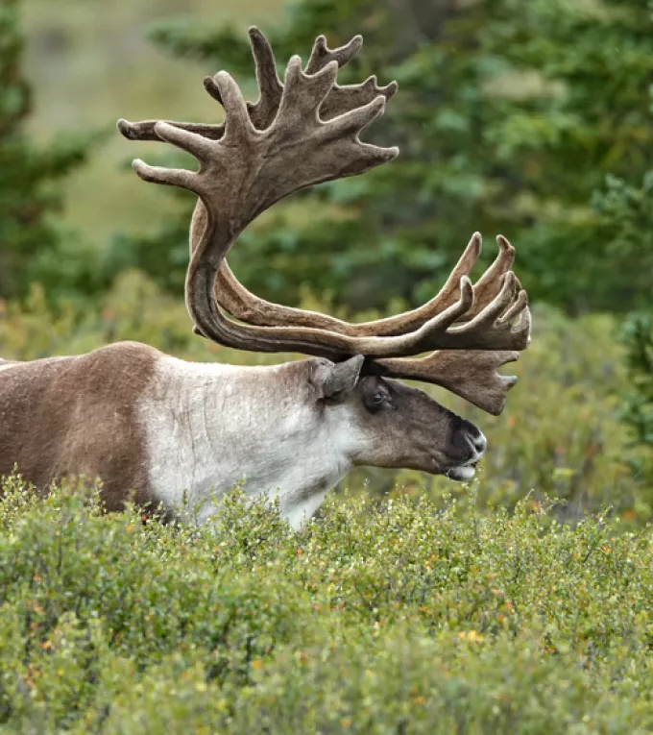
Species at risk in Saskatchewan
Boreal Woodland Caribou (Rangifer tarandus)
Unlike other members of the deer family, both male and female Caribou have antlers!
Despite their large stature, they are vegetarians! They have a specialized digestive system that allows them to turn lichens and plants into fuel.
Menno Schaefer/Shutterstock
Notes:
Threatened status

Slide 16
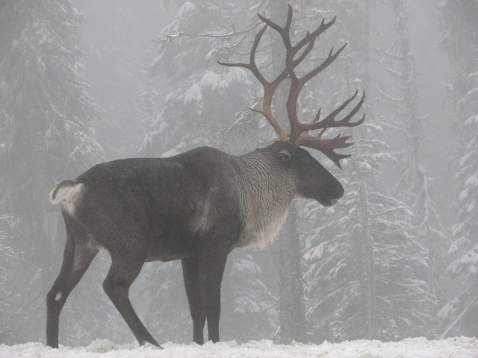
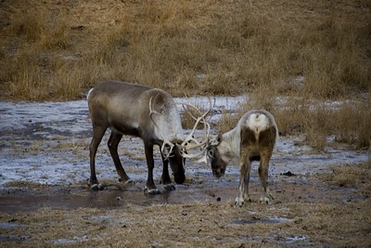
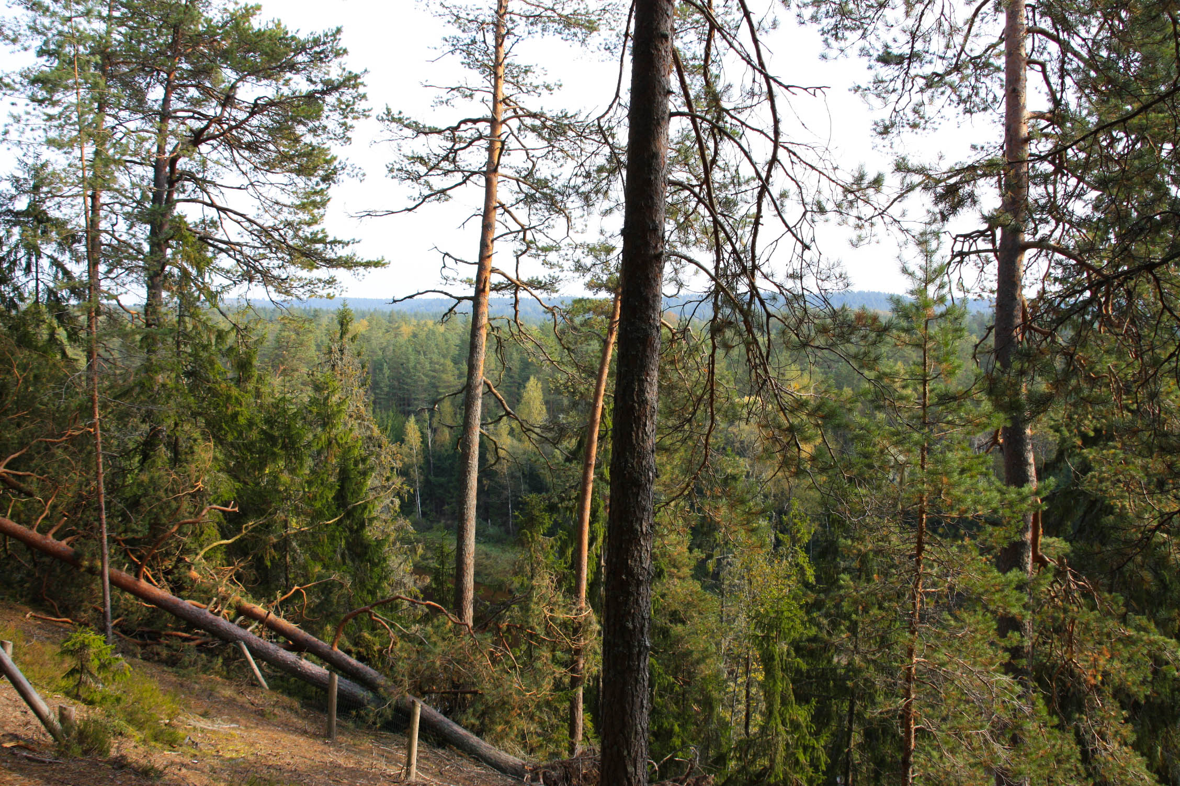
Boreal Woodland Caribou
Range: Found in the boreal forests of the NWT, BC, AB, SK, MB, ON, QC, NL
Habitat: Mature coniferous forests in the winter. In the summer, they may be found feeding on vegetation of young forests after fires/logging, or in peatlands.
USFWS – Pacific Region/Flickr
Troy B. Thompson/Flickr
Liga Eglite/Flickr

Slide 17
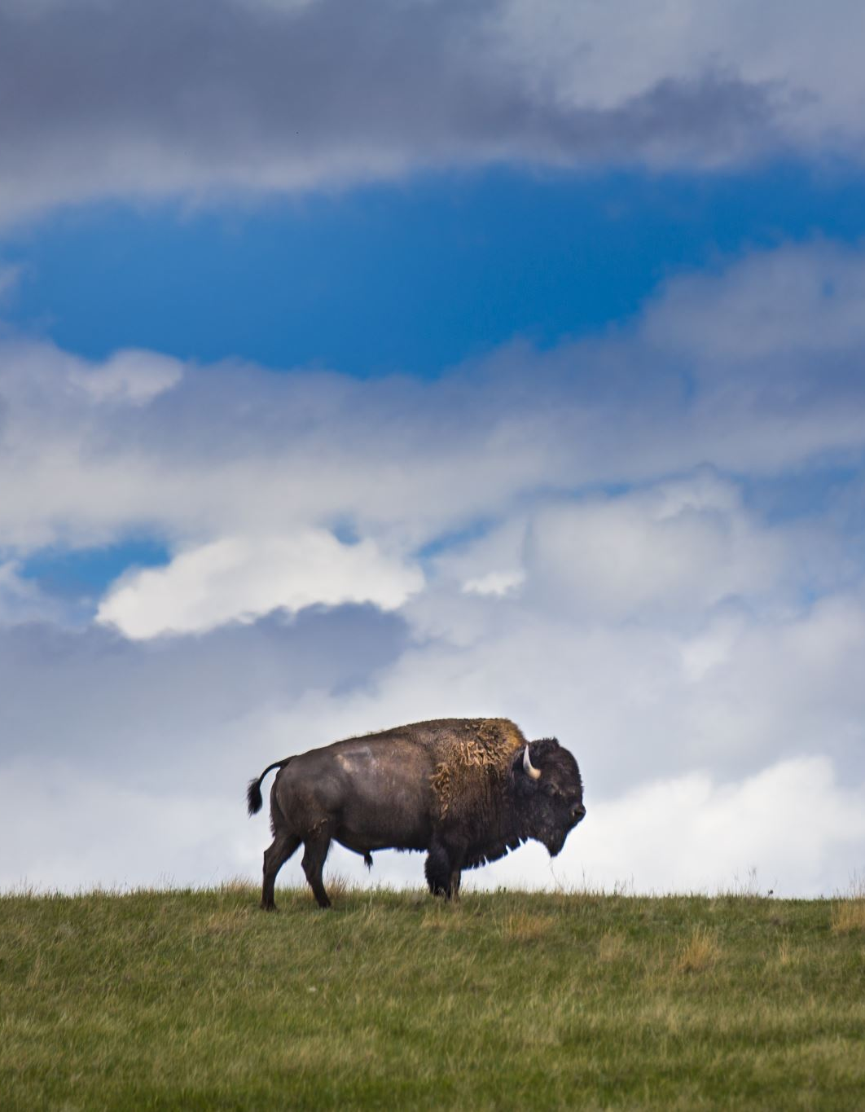
Species at risk in Saskatchewan
Plains Bison (Bison bison bison)
The largest land mammal in North America.
Bison are very important to the Indigenous peoples of the prairies. The Indigenous people used bison for meat, and nothing was wasted – their parts were used for clothing, shelter, and tools.
Bison represent strength, resilience, and a connection to the earth. They are also important for the health of the ecosystem.
Notes:
Threatened status

Slide 18
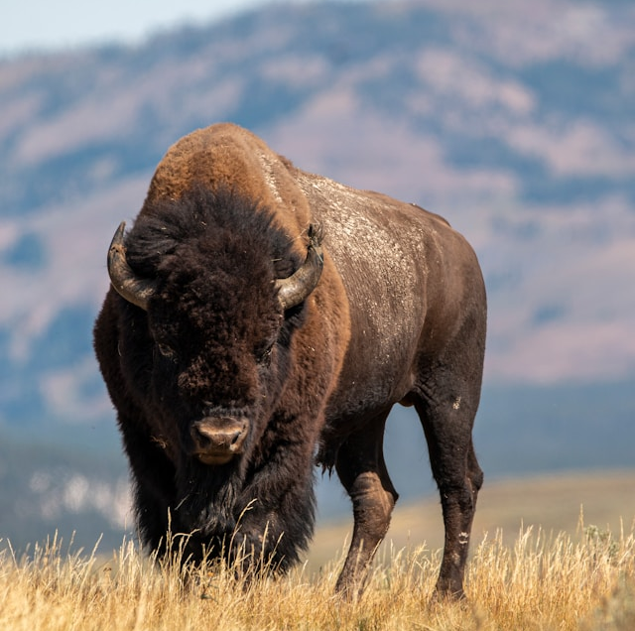
Plains Bison
Range: Millions of bison once roamed the grasslands of Canada, the US, and Mexico. Due to overhunting by European colonizers, their numbers are much smaller today. Wild populations exist in BC and SK.
Habitat: Open prairies with meadows and grasslands for grazing.

Slide 19
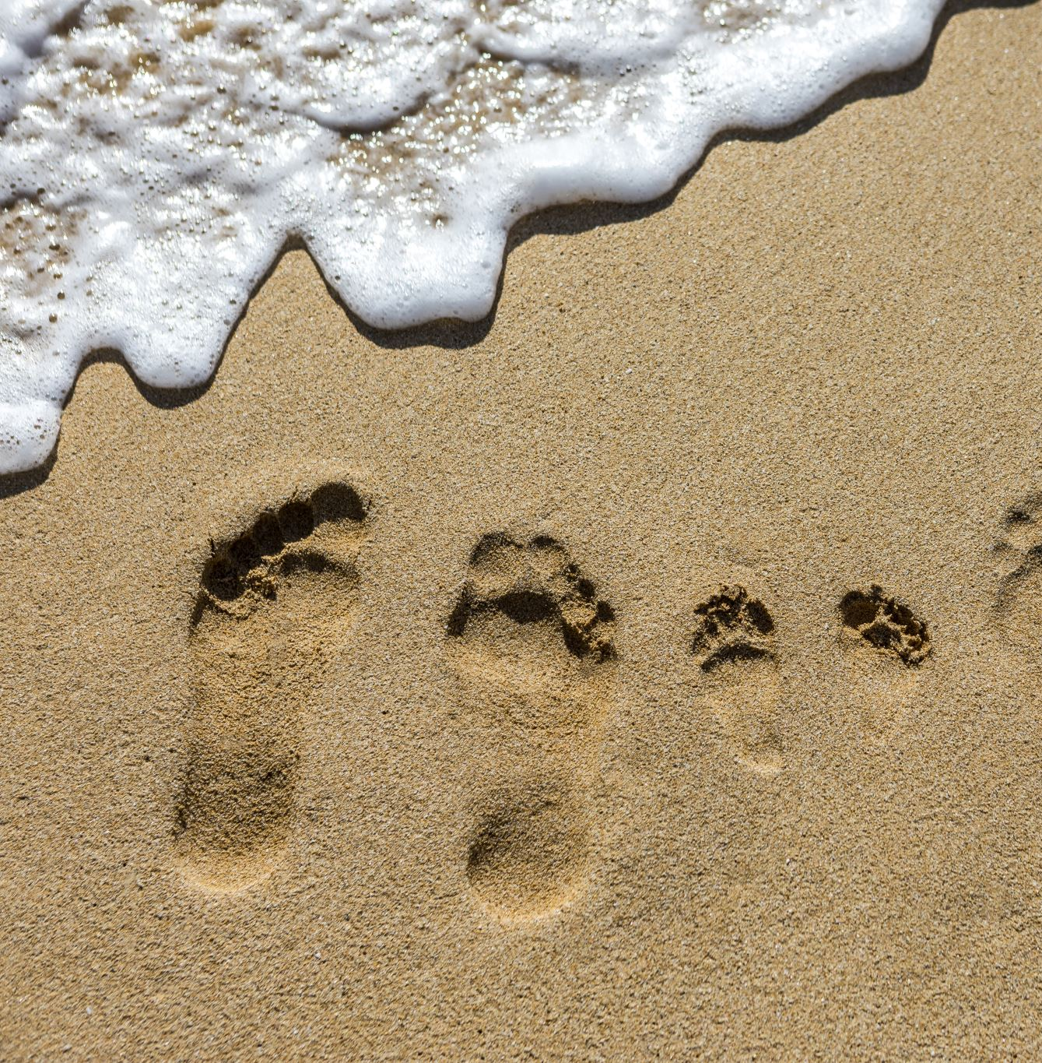
Activity: Who left these tracks behind?
Wild animals often hide when humans are around and can be hard to see. Sometimes they leave evidence, like tracks in the ground, that tell us where they were.
Based on your knowledge of these 6 species at risk in Saskatchewan, identify which animal left these mystery tracks!
Notes:
Option to split into groups or do activity together

Slide 20
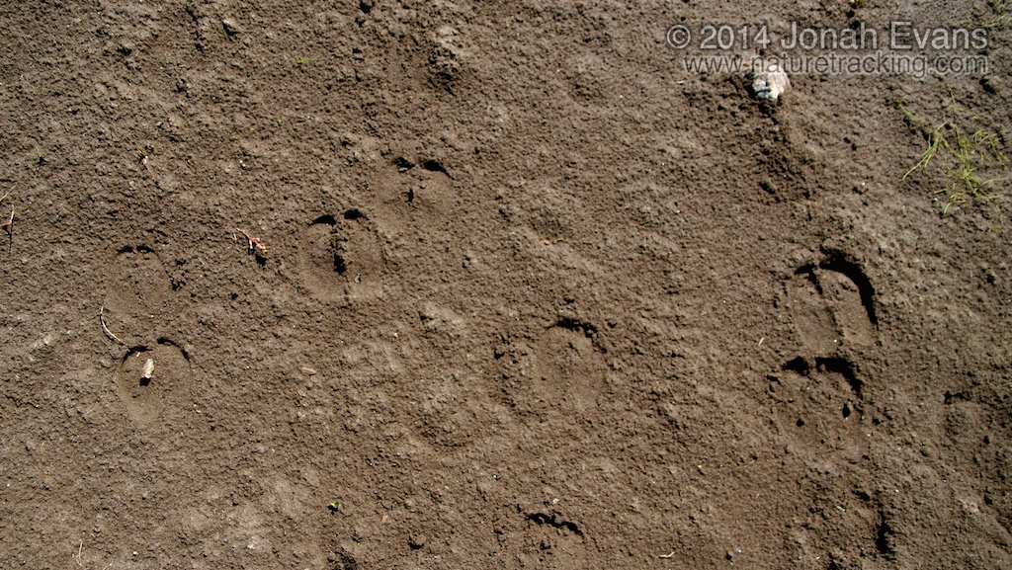
Mystery tracks #1
Hint: this animal has hooves and two toes, like a domestic animal that produces milk that we drink…
Notes:
https://naturetracking.com/mammal-tracks/#images-1/19/Bison-Tracks-2.jpg

Slide 21
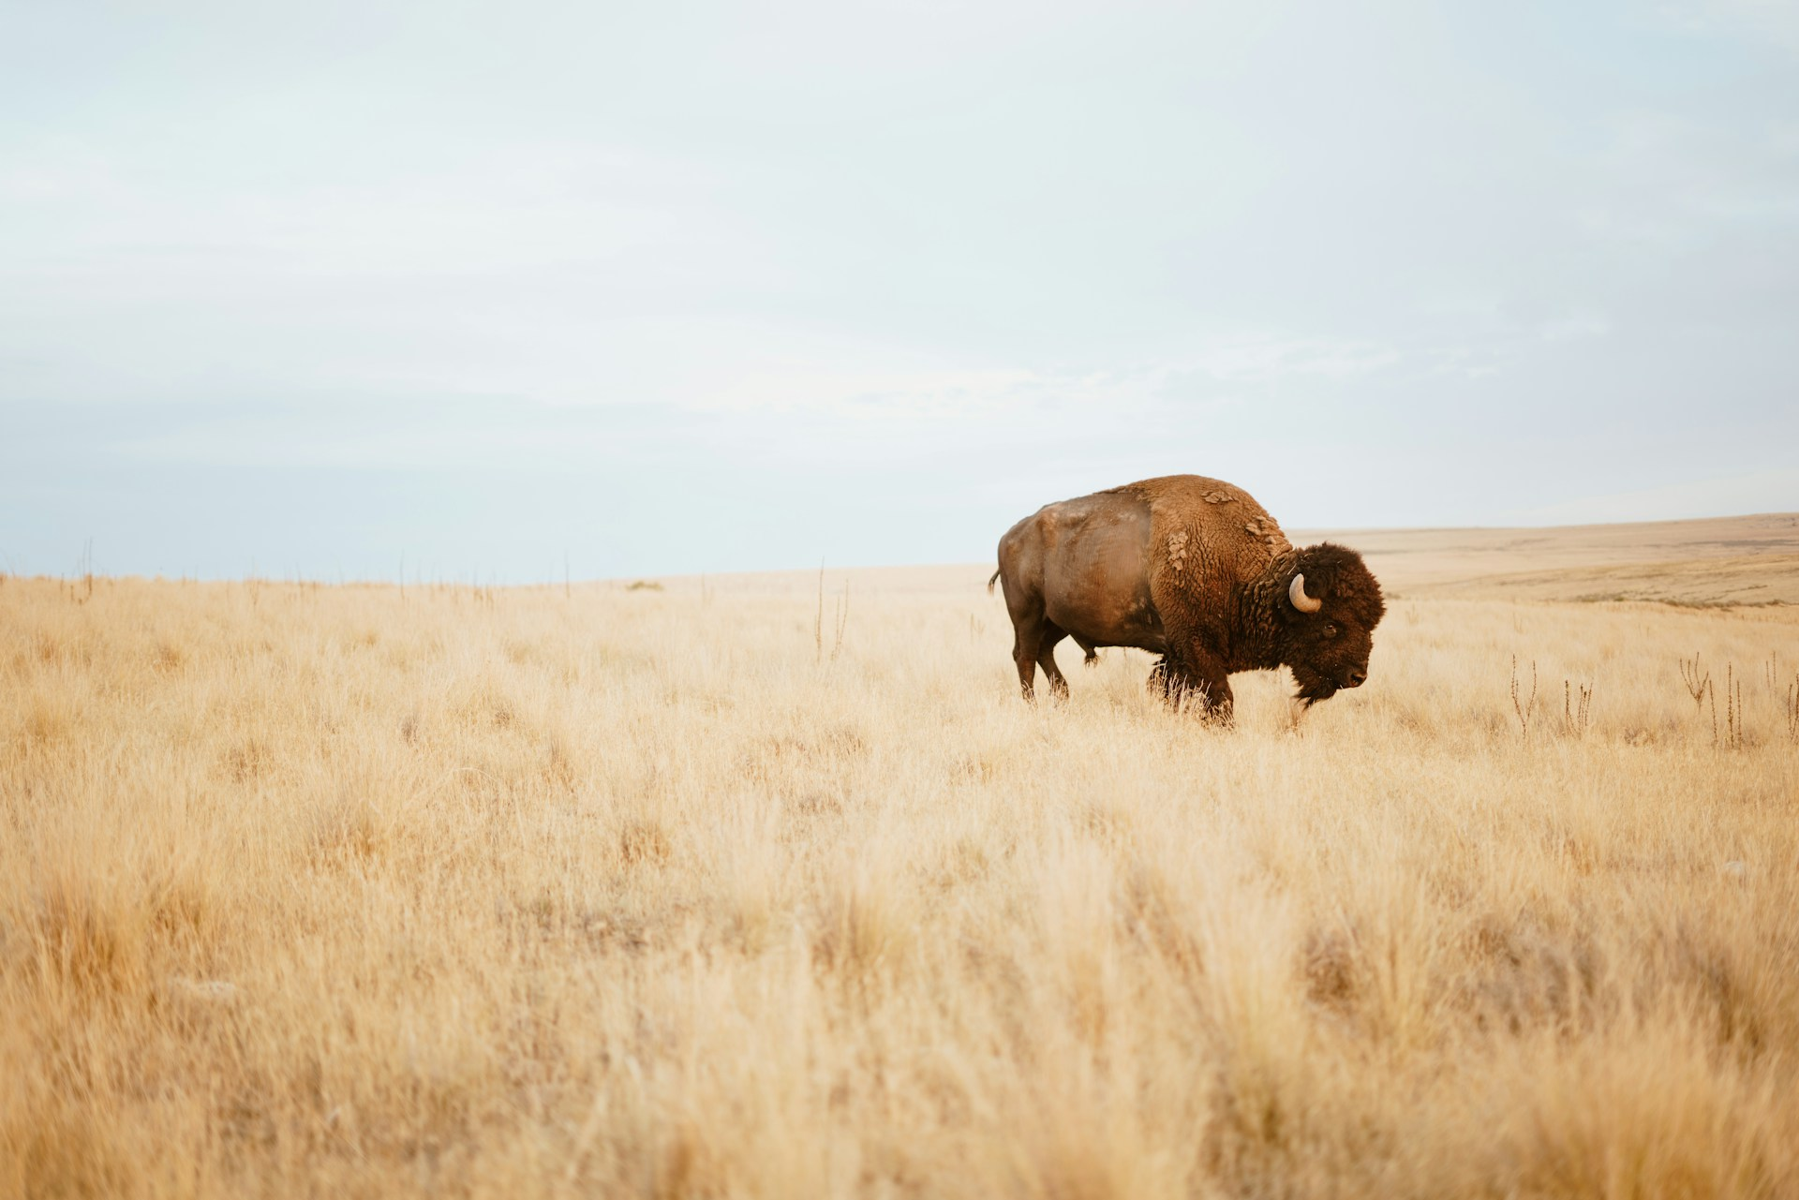
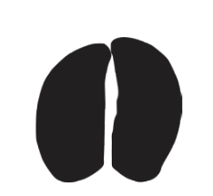
Answer: Plains Bison
These tracks were left by the bison!
They have 2 toes, and their tracks look like a cow’s (a very big cow!).

Slide 22
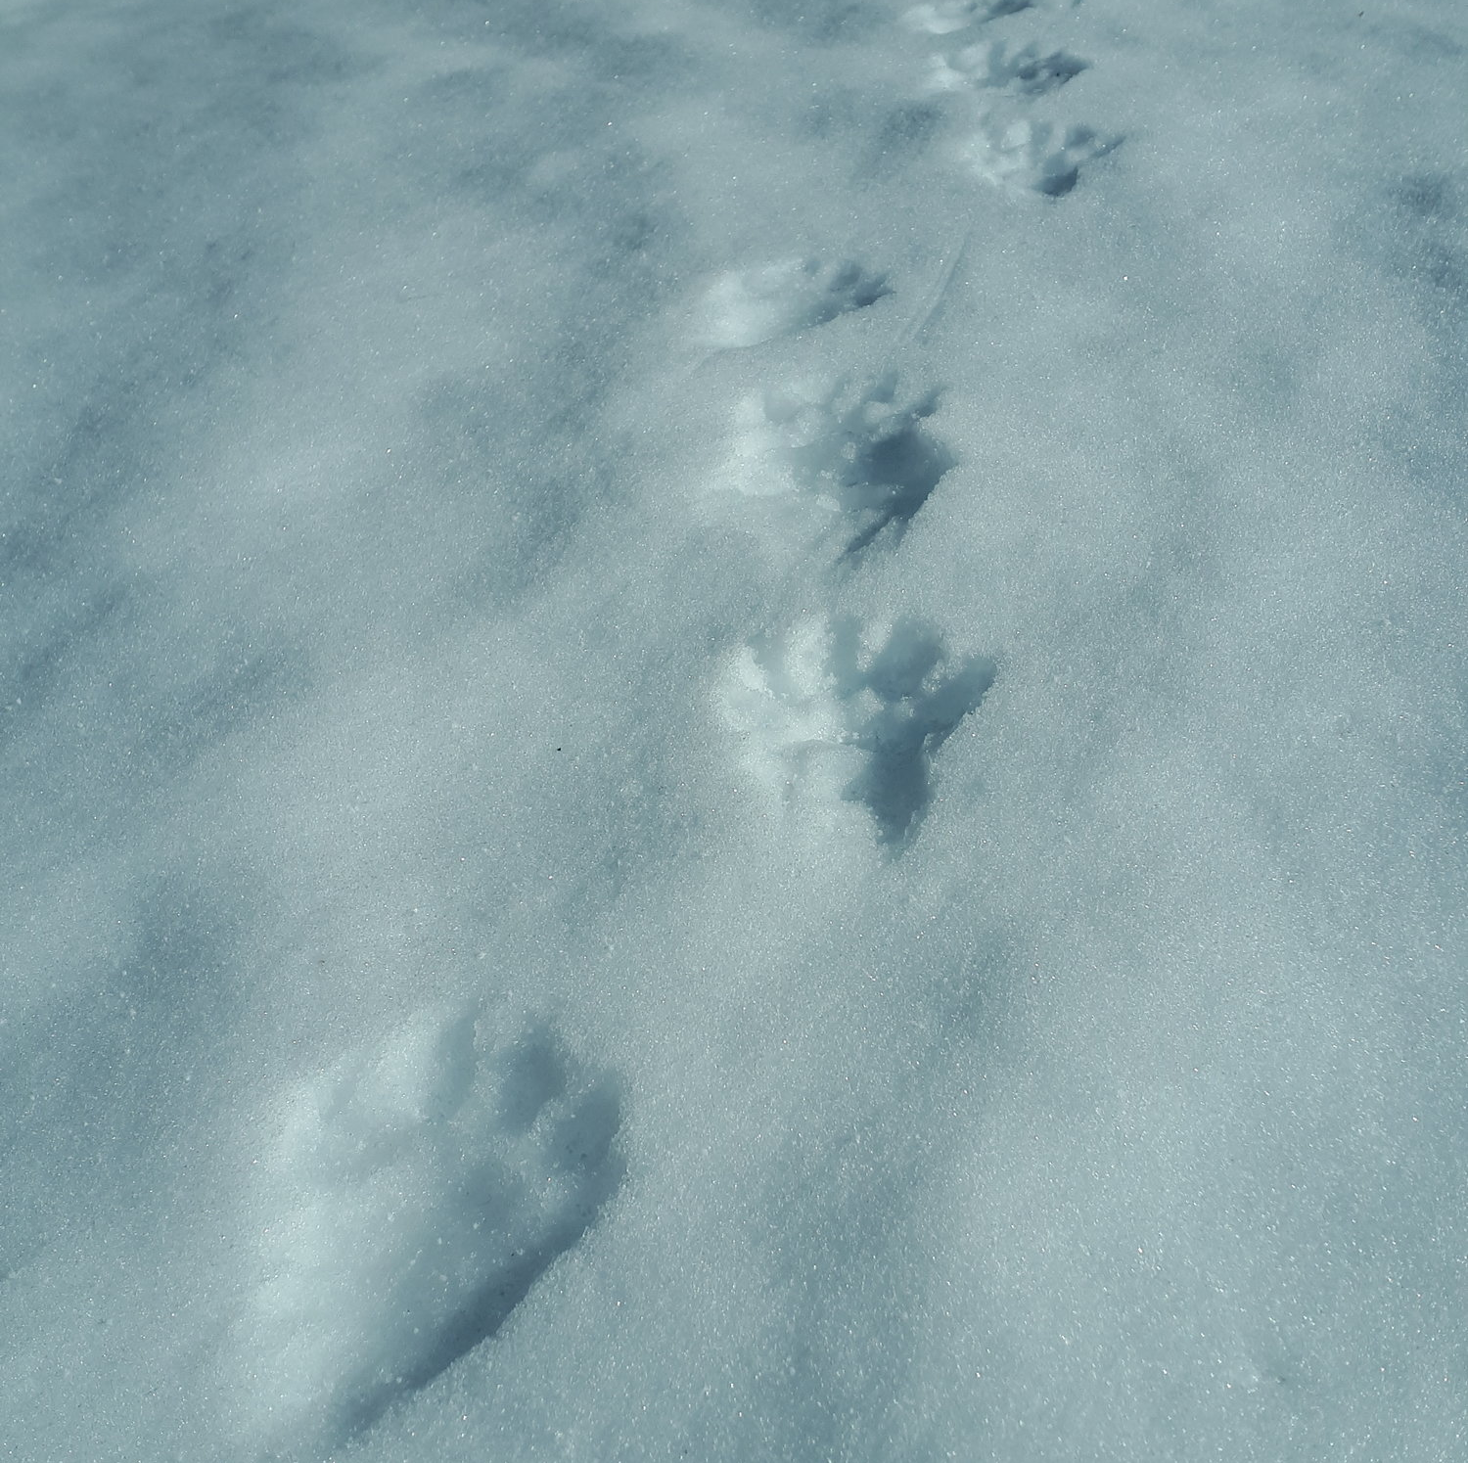
Mystery tracks #2
Hint: This animal’s paws are large and padded, which act like snowshoes in the winter. They have large claws and are not afraid to use them!

Slide 23
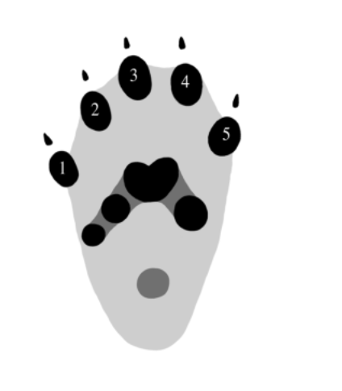
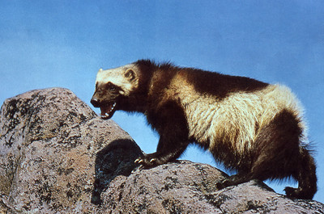
Answer: Wolverine
These tracks were left by the wolverine.
Their paws are large and have five toes that are about 9 cm across and 11 cm long (about the size of an adult hand!).
Notes:
https://www.wolverinewatch.org/wolverine-tracks

Slide 24
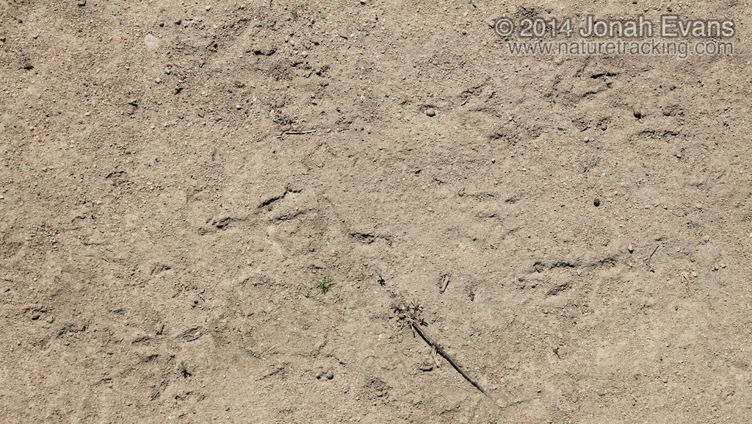
Mystery tracks #3
Hint: This animal is somewhat incorrectly named, because they are not only active at night. And they’re not closely related to a hawk…
Notes:
https://naturetracking.com/bird-tracks/

Slide 25
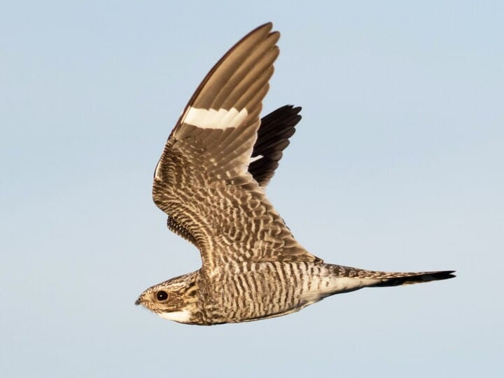
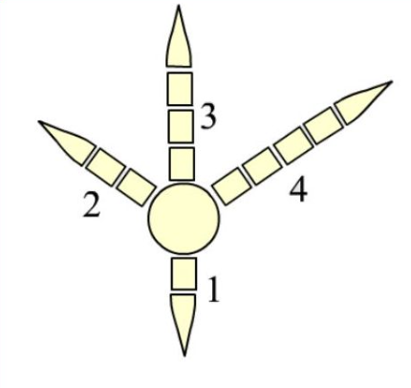
Answer: Common Nighthawk
These tracks were left by a hawk, like the common nighthawk!
They have 3 toes pointing forward, and 1 long toe pointing backwards. Many perching birds, doves, hawks, ravens, herons and more have feet like this.

Slide 26
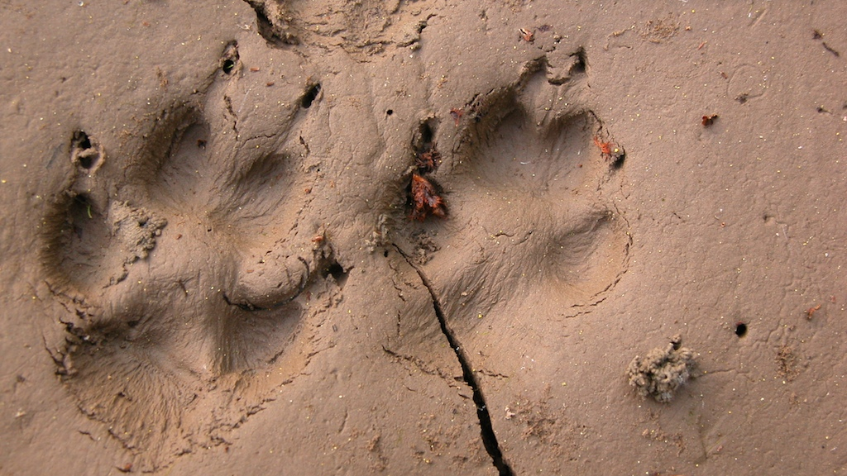
Mystery tracks #4
Hint: This animal is a member of the canid family, but about the size of a housecat!

Slide 27
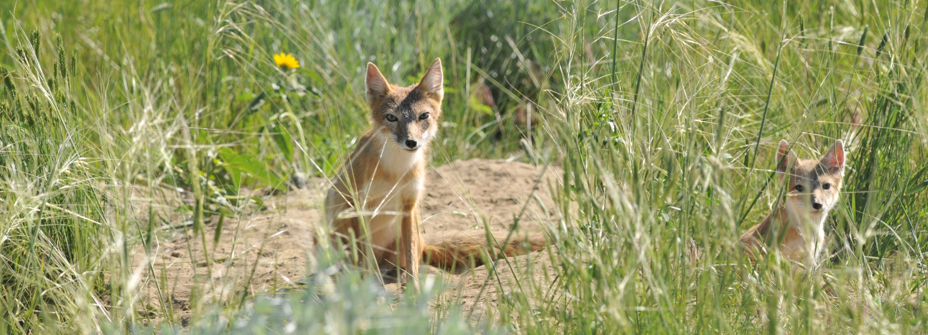

Answer: Swift Fox
These tracks were left by the Swift Fox!
The Swift Fox is a member of the canid family, which includes dogs, wolves, and coyotes. They leave four toe prints with the front and hind feet.

Slide 28
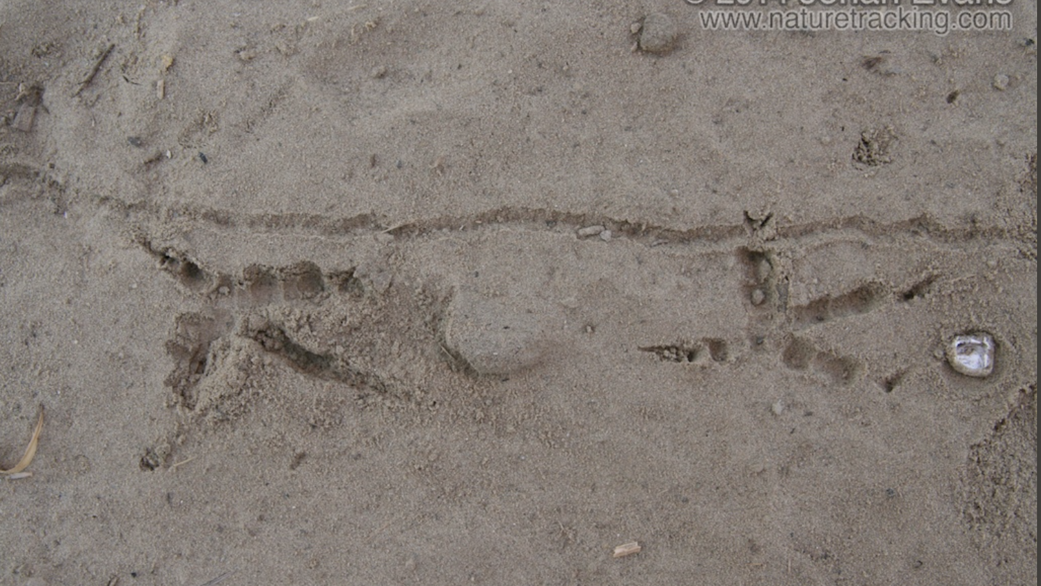
Mystery tracks #5
Hint: This animal is named after something it steals (or borrows)…
Notes:
https://naturetracking.com/bird-tracks/

Slide 29
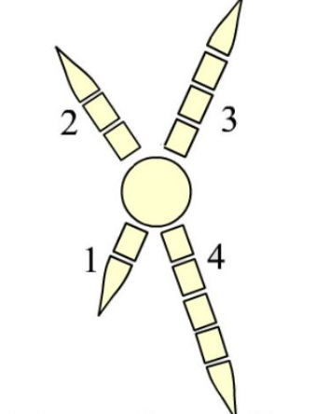
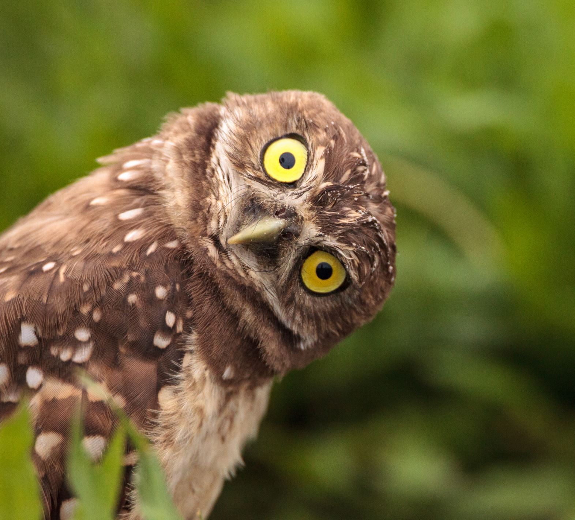
Answer: Burrowing Owl
These tracks were left by the burrowing owl!
They have 2 toes pointed forward, and 2 pointing backwards. Others that have feet like this include woodpeckers, cuckoos, and roadrunners.

Slide 30
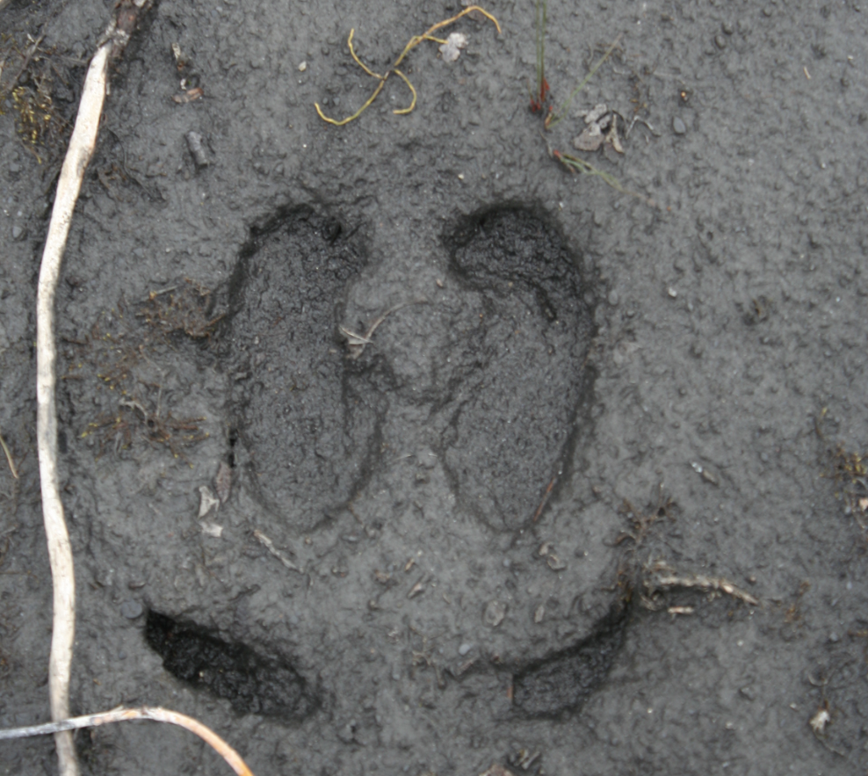
Mystery tracks #6
Hint: The Mi'kmaq people called this animal xalibu or qalipu, meaning "the one who paws."
Notes:
https://www.mynatureapps.com/caribou-tracks/

Slide 31
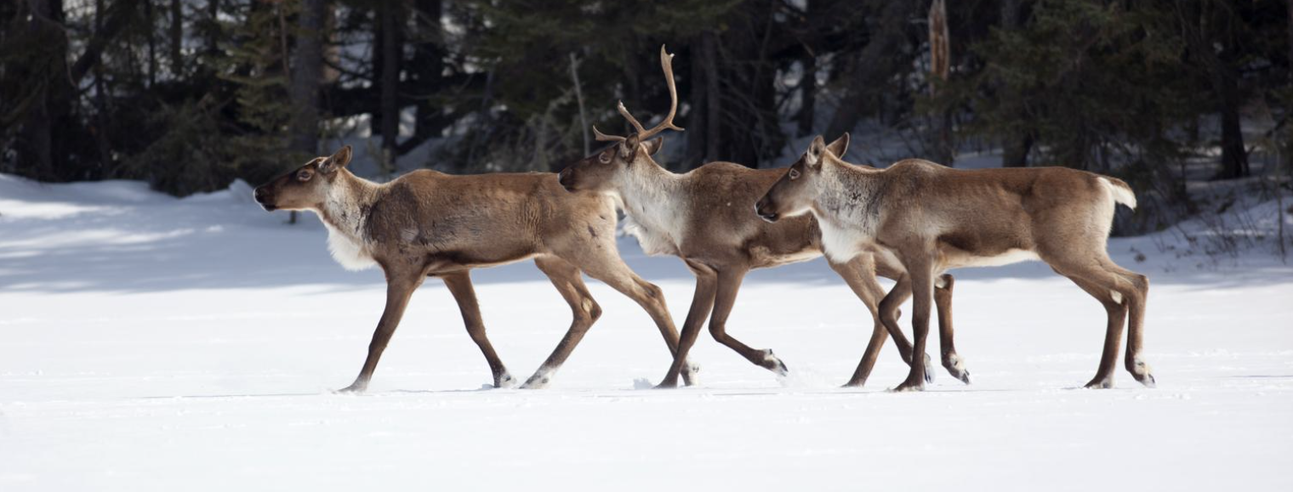

Answer: Boreal Woodland Caribou
Source
These tracks were left by the Woodland Caribou! Their toes are rounder than other animals with hooves.
Their hoof shape helps them stay on top of the snow. It also helps them to dig in the snow to reach their food below, such as lichens and other plants.

Slide 32
Discussion questions
What questions do you have about endangered animals?
01
How do you feel about what we learned today?
02
What are some ways that we can help animals that aren’t doing well?
Why is this important?
03

Slide 33
How can we help endangered species?
Protect their habitat
Laws and regulations
Rescue and conservation programs
Reduce pollution
Notes:
Reduce, reuse, and recycle. Consider donating gently used items, limiting buying new items, etc.
Don’t use pesticides in the home.
Learn about the species at risk, and existing groups that are trying to help! Volunteer for Canadian Parks and Wilderness Society (CPAWS) in SK and get involved in their events.
When possible, walk or bike to school, take public transport, or carpool.
Get involved in the community – question development plans that could destroy habitats of species at risk.
Respect laws created to protect species at risk.
Listen to the Traditional Knowledge shared by Elders and Knowledge Keepers of Canada. Indigenous peoples of Canada have protected and maintained the lands for generations before European colonization.

